Slide 1
Head Injury
Dr Zaid Saad Al-Nasrawi
Trauma and Orthopaedics surgery
Al Mustaqbal university

Slide 2
Traumatic Brain Injury
Traumatic Brain Injury (TBI): is a disruption in the normal function of the brain.
caused by : a blow to the head, the head suddenly and violently hitting an object or when an object pierces the skull and enters brain tissue.

Slide 3
Clinical signs
Symptoms of a TBI can be mild, moderate, or severe, depending on the extent of damage to the brain.
Loss of or decreased consciousness.
Loss of memory for events before or after the event (amnesia)
Focal neurological deficits such as muscle weakness, loss of vision, change in speech.
Alteration in mental state such as disorientation, slow thinking or difficulty concentrating

Slide 4
Symptoms of Head Injury
Symptoms vary greatly depending on the severity of the head injury. They may include any of the following:
Vomiting
Lethargy
Headache
Confusion
Paralysis
Coma
Loss of consciousness
• Dilated pupils
• Vision changes (blurred vision or seeing double, unable to tolerate bright light, loss of eye movement, blindness)
• Cerebrospinal fluid (CSF) (clear or blood-tinged) appear from the ears or nose
• Dizziness and balance concerns
• Breathing problems
• Slow pulse
• Cognitive difficulties
• Speech difficulties (slurred speech, inability to understand and/or articulate words)
• Difficulty swallowing
• Body numbness or tingling
• Droopy eyelid or facial weakness
• Loss of bowel control or bladder control

Slide 5
Types of Injuries
Hematoma: A hematoma is a blood clot within the brain or on its surface. Hematomas may occur anywhere within the brain.
An Epidural hematoma is a collection of blood between the dura mater (the protective covering of the brain) and the inside of the skull.
A Subdural Hematoma is a collection of blood between the dura mater and the arachnoid layer, which sits directly on the surface of the brain.

Slide 6
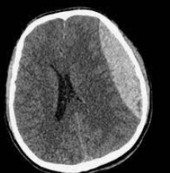
Epidural VS Subdural

Slide 7
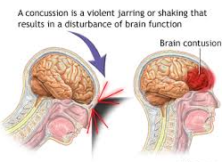
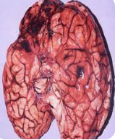
Cerebral Contusion
A cerebral contusion is bruising of brain tissue.

Slide 8
Cerebral contusion

Slide 9
Intracerebral Hemorrhage
Intracerebral Hemorrhage: An intracerebral hemorrhage (ICH) describes bleeding within the brain tissue.

Slide 10
Subarachnoid Hemorrhage
Subarachnoid hemorrhage (SAH) is caused by bleeding into the subarachnoid space.
It appears as diffuse blood spread thinly over the surface of the brain and commonly after TBI.
Most cases of SAH associated with head trauma are mild.
Hydrocephalus may result from severe traumatic SAH.

Slide 11
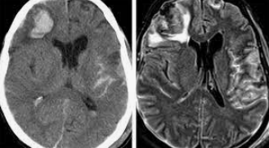
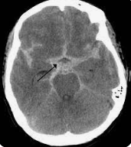
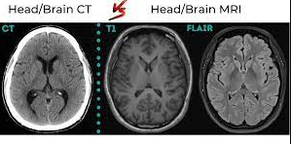

Slide 12
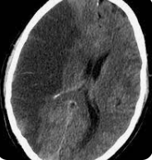
Ischemia
Ischemia: Another type of diffuse injury is ischemia or insufficient blood supply to certain parts of the brain.

Slide 13
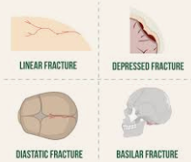
Skull Fractures
Linear skull fractures or simple breaks or “cracks” in the skull may accompany TBIs.
Fractures at the base of the skull are problematic since they can cause injury to nerves, arteries, or other structures. If the fracture extends into the sinuses, a leakage of cerebrospinal fluid (CSF) from the nose or ears may occur.
Depressed skull fractures, in which part of the bone presses on or into the brain.

Slide 14
Radiological Tests
A computed tomography scan (CT or CAT scan) is the gold standard for the radiological assessment of a TBI patient. A CT scan is easy to perform and an excellent test for detecting the presence of blood and fractures, the most crucial lesions to identify in medical trauma cases..
Magnetic resonance imaging (MRI) is not commonly used for acute head injury since it takes longer to perform a MRI than a CT. Because it is difficult to transport an acutely-injured patient from the emergency room to a MRI scanner, the use of MRI is impractical.
However, once a patient is stabilized, MRI may demonstrate the existence of lesions that were not detected on the CT scan..

Slide 15
Treatment
surgery is performed to remove a large hematoma or contusion that is compressing the brain or raising the pressure within the skull. After surgery, these patients are under observation in the intensive care unit (ICU).

