Slide 1
Ministry of Higher Education and Scientific Research Al-Mustaqbal University College Radiology Techniques Department
Chest X-Ray
By
Karar Haider
.

Slide 24
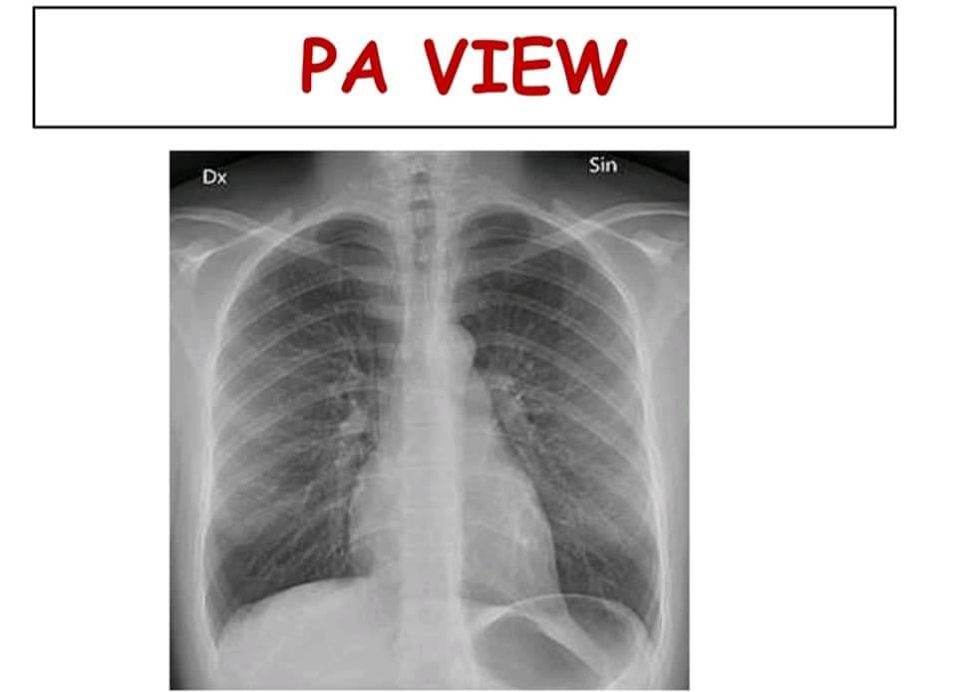

Slide 25
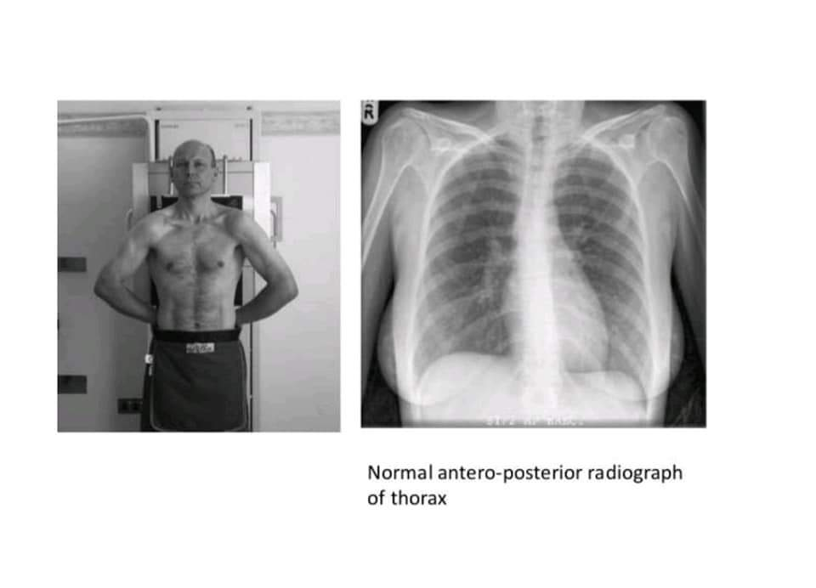

Slide 27
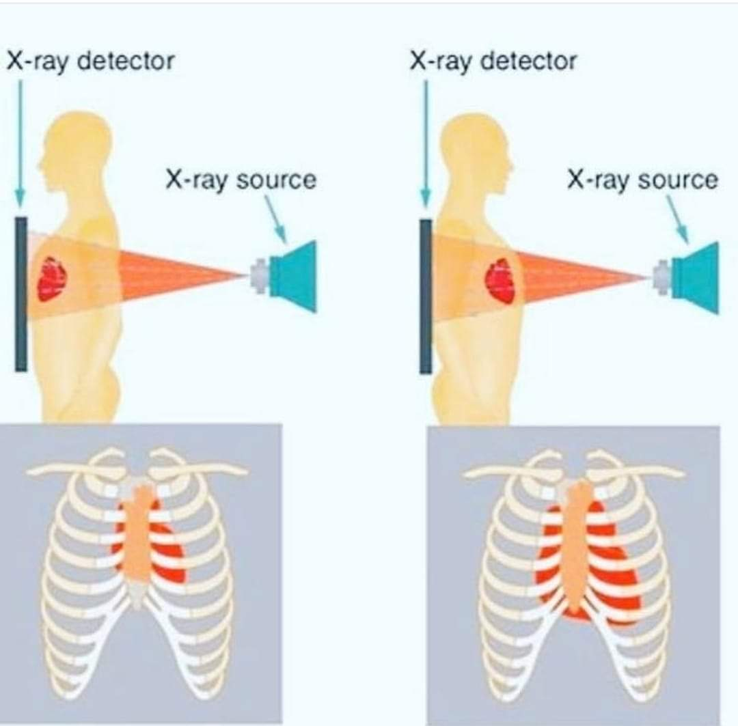

Slide 28
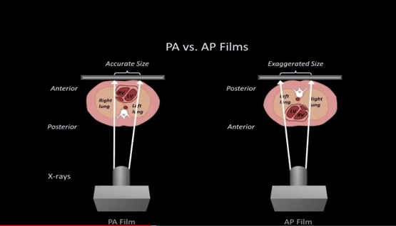

Slide 32
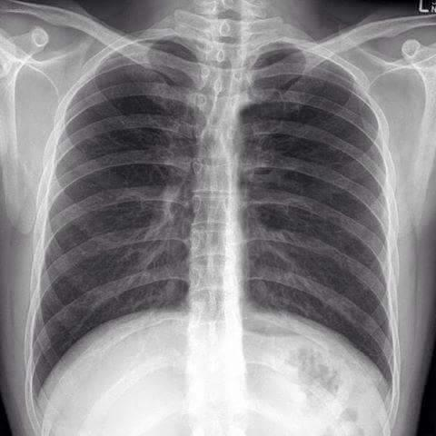

Slide 33
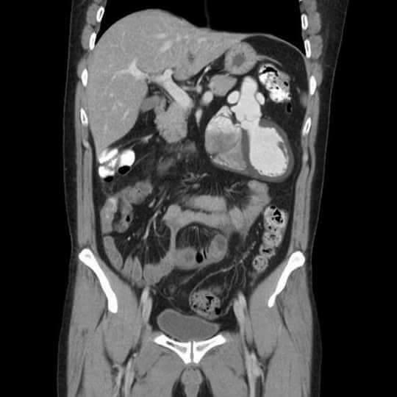

Slide 34
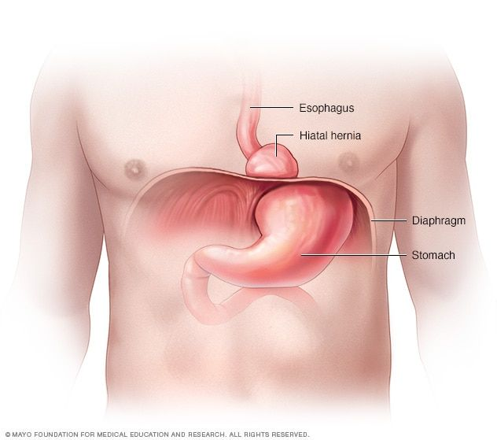

Slide 36
