Slide 1
Ministry of Higher Education and Scientific Research Al-Mustaqbal University College Radiology Techniques Department
Radiography of the bony thorax
مختبر تقنيات التصوير الشعاعي
المرحلة الثانية
By
Karar Haider

Slide 2
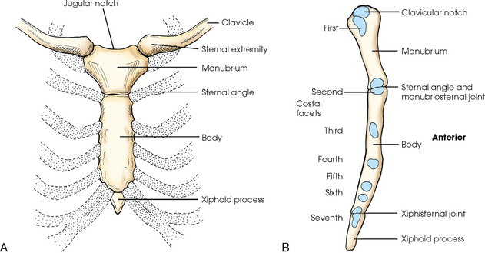

Slide 3
Sternum _ PA oblique view
1- Film size : 10 * 12 lengthwise
2- Prone patient with right PA oblique projection
( slight elevation of left shoulder & hip )
3- Take slow shallow breath
4- CR to midpoint of film

Slide 6
Sternum _ Lateral Erect projection
1- Film size : 10 * 12
2- Place patient in lateral projection
3-Upper border of Im is 1.5 inch above manubrial notch
4- Rotate shoulders posteriorly with hands behind body
5- Suspend respiration in inhalation
6- CR passes horizontally to middle of film

