Slide 1
Female Reproductive System

Slide 2
The female reproductive system consist of:
A- Two ovaries
B- Two oviducts (Uterine tubules)
C- Uterus
D- Vagina

Slide 4
Functions:
1- Produce female gametes (Oocytes)
2- Provide the environment for fertilization
3- To hold the embryo during its complete development
4- Produces steroidal hormones that control organs of the reproductive system

Slide 5
Ovaries
Ovaries are almond-shaped bodies approximately 3-cm long, 1.5-cm wide, and 1-cm thick.
Each ovary is covered by a simple cuboidal epithelium, the surface (or germinal) epithelium, continuous with the mesothelium and overlying a layer of dense connective tissue capsule, the tunica albuginea, responsible for the white color of ovary.

Slide 6
Ovaries have a cortex mostly connective tissue, and medulla (internal part) consist of loose connective tissue and blood vessels entering the organs
There is no distinct border between the ovarian cortex and the medulla.

Slide 7
Uterine tubule (Oviducts)
The paired uterine tubes, or oviducts, muscular tubes each measure about 10-12 cm in length. Each opens into the peritoneal cavity near the ovary, with regions in the following sequence:
The infundibulum, a funnel-shaped opening next to the ovary
The ampulla, the longest and expanded region where fertilization normally occurs

Slide 8
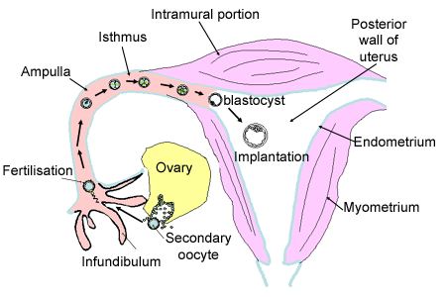
The isthmus, a more narrow portion nearer the uterus
The uterine or intramural part, which passes through the wall of the uterus and opens into the interior of this organ.

Slide 9
The wall of the oviduct consists of
A- a folded mucosa, composed of simple columnar epithelium and lamina properia of loose connective tissue.
B- a thick, well-defined muscularis with interwoven circular (or spiral) and longitudinal layers of smooth muscle
C- a thin serosa covered by visceral peritoneum with mesothelium.

Slide 10
Uterus
the uterus is a pear-shaped organ with thick, muscular walls supported by a set of ligaments
Its wall has three layers
A- An outer connective tissue the perimetrium
B- A thick tunic of highly vascular smooth muscles called myoterium
C- A mucosa (endometrium) lined by simple columnar epithelium

Slide 11
Parts of uterus
the body: Its largest part, is entered by the left and right uterine tubes
the fundus: curved, superior area between the tubes.
the cervix: is the lower cylindrical structure of the uterus that narrows in the isthmus

Slide 13
Vagina
The wall of the vagina consists of a mucosa, a muscular layer, and an adventitia.
Mucosa is stratified squamous epithelium
The muscular layer of the vagina is composed mainly of two indistinct layers of smooth muscle, disposed as circular bundles and as thicker longitudinal bundles
Adventitia The dense connective tissue is rich in elastic fibers, making the vaginal wall strong and elastic while binding it to the surrounding tissues.

Slide 15
Thank you

