Slide 1
Ministry of Higher Education and Scientific Research Al-Mustaqbal University College Radiology Techniques Department
Radiographs of Upper limbs
مختبر تقنيات التصوير الشعاعي
المرحلة الثانية
Karar Haider

Slide 2
Elbow AP view
1- Film size : 8 * 10 , no Bucky
2- Seat the patient so that the elbow & shoulder are in the same plane
3- Extend the elbow , supinate the hand
4- CR is perpendicular to the elbow (2.5 cm distal to a line joining the humeral epicondyles)

Slide 3
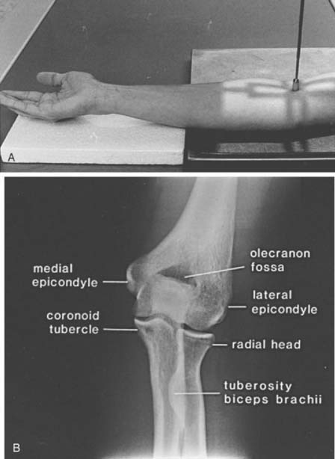

Slide 4
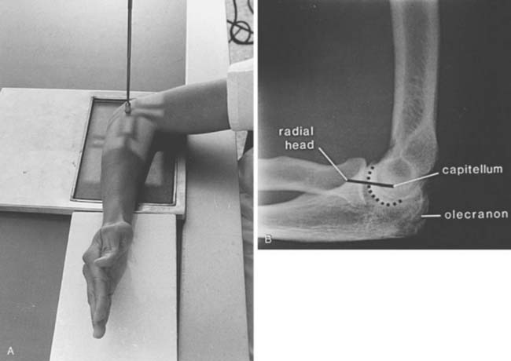

Slide 5
Humerus AP & Lateral views (erect)
1- Film size 11*14 or 14*17 with Bucky
2- The coronal plan passing the epicondyles will be parallel with plane of film in AP view & perpendicular to film in lateral view
3- CR midway between the elbow & shoulder

Slide 6
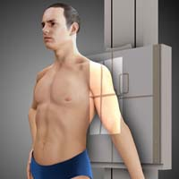

Slide 7
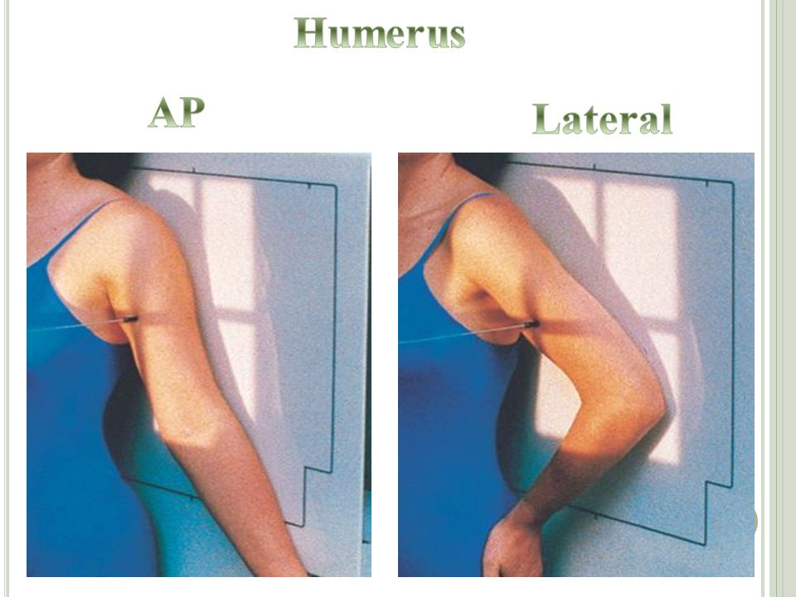

Slide 8
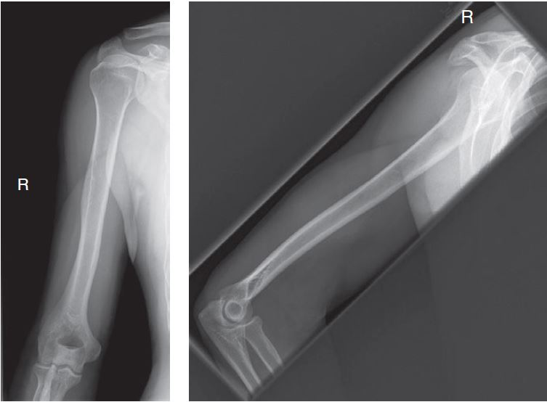

Slide 9
Shoulder AP view
1- Film size 10 * 12 with Bucky
2- Erect or supine , put the cassette center under the coracoid , rotate the patient to place the scapula parallel to film
3- Take a view external rotation , with a neutral position & with internal rotation
4- CR is directed to a point 1 inch inferior to the coracoid process

Slide 10
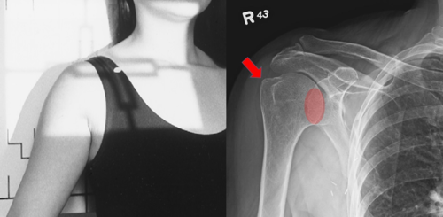

Slide 11
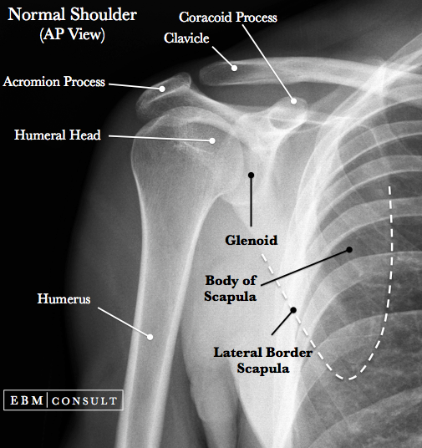

Slide 12
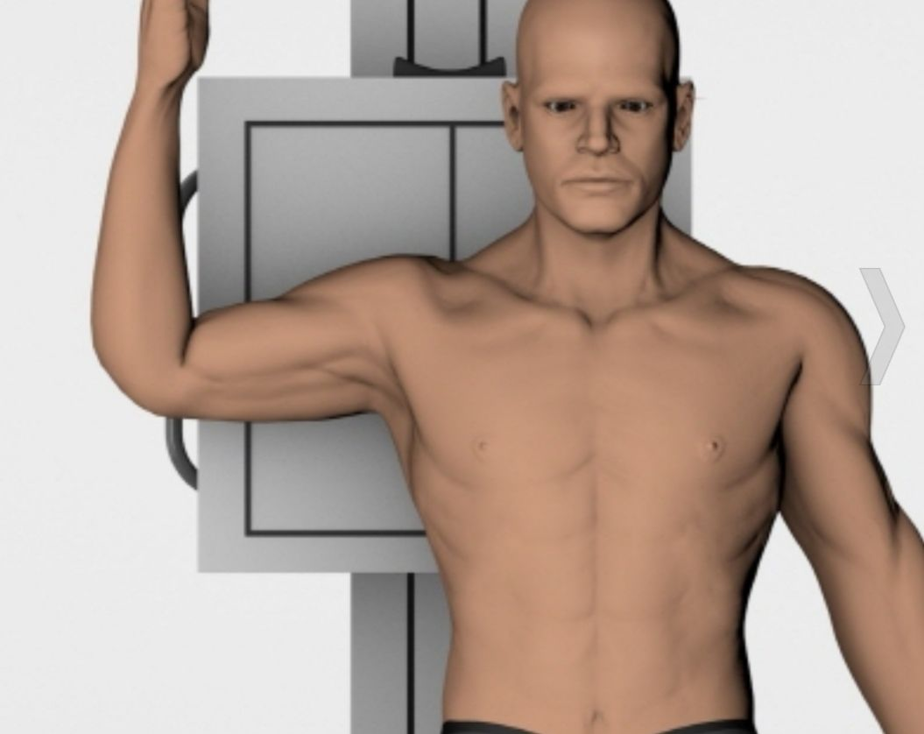
Shoulder lateral

Slide 13
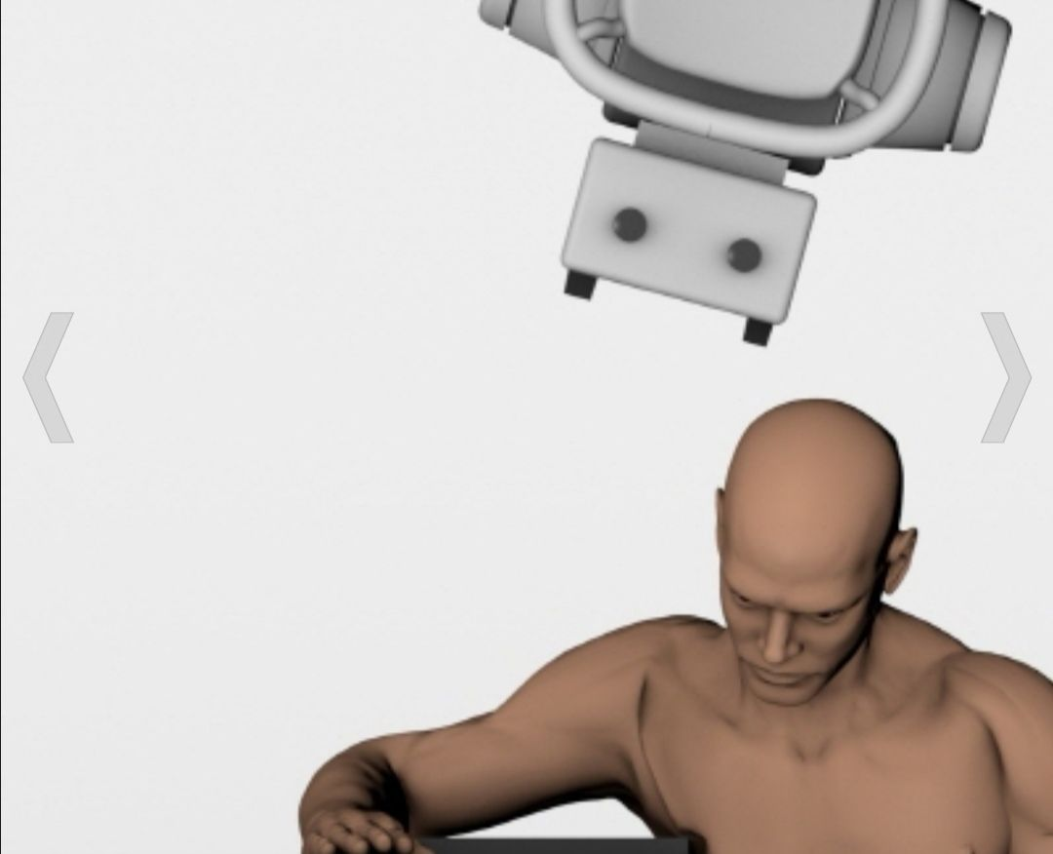
Shoulder Axial

Slide 14
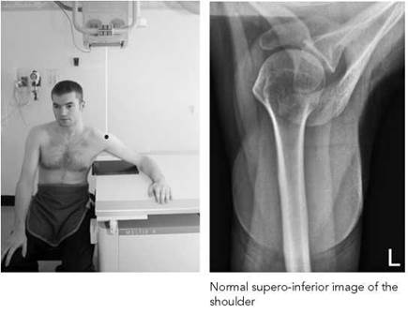

Slide 16
