Slide 1
Maxillofacial truama 2 5th class
Dr.Mohammed A araji

Slide 2
Fractures of the Mandible

Slide 3
Fracture is defined as a break in the continuity of the bone which happens either as a result of violence.

Slide 4
Classification of mandibular fractures According to the type of fracture
Simple/closed: A type of single fracture that does not have communication with the external environment.
Compound/opened: A type of fracture that extends into external environment through skin, mucosa, or periodontal membrane.
Comminuted: When the bone is fragmented into multiple pieces. This usually requires considerably more energy than does a simple fracture.
Greenstick: When only one cortex of the bone is broken with the other cortex being bent, it is found exclusively in children.
Pathologic: Caused by pre-existing pathological condition of bone that leads to fracture from minimal trauma.

Slide 5
Fractures of the mandible can also be classified according to the anatomic site into:
Condyle 30%
Angle 5%
Body 25%
Symphysis/parasymphysis 15%
Ramus 3%
Coronoid 2%

Slide 6
Mandibular fractures classified according to their tendency to displace as a result of the pull of the attached muscles into:
Favorable when the muscles tend to pull the fragments together (minimizing displacement).
Unfavorable when they are significantly displaced by the muscles.

Slide 7
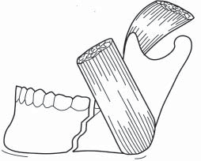
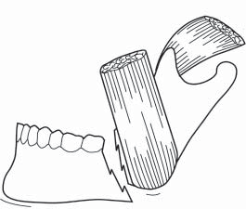
Unfavorable fracture

Slide 8
Clinical features

Slide 9
• Pain: especially on talking and swallowing
• Numbness of the lower lip
• Swelling and drooling
• Trismus and difficulty in moving the jaw
• Bone tenderness over fracture site
• Altered occlusion
• Loosened teeth and gingival bleeding
• Mobility of fractured segment
• Haematoma associated with fracture site, especially sublingual

Slide 10
Imaging
panoramic radiograph (OPG)
posteroanterior (PA) view of the mandible
PA mandible with left and right oblique lateral views
The Townes projection (anteroposterior) and the reverse Townes projection
Occlusal views are valuable for demonstrating midline fractures
CT scan

Slide 11
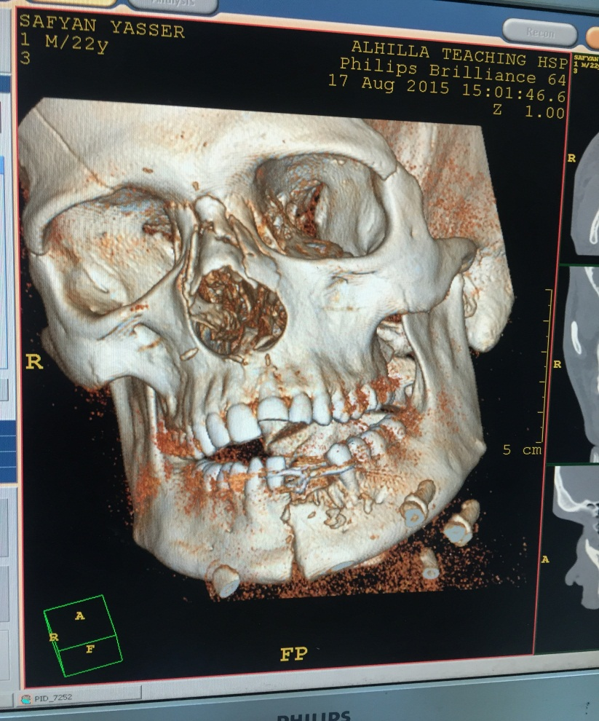
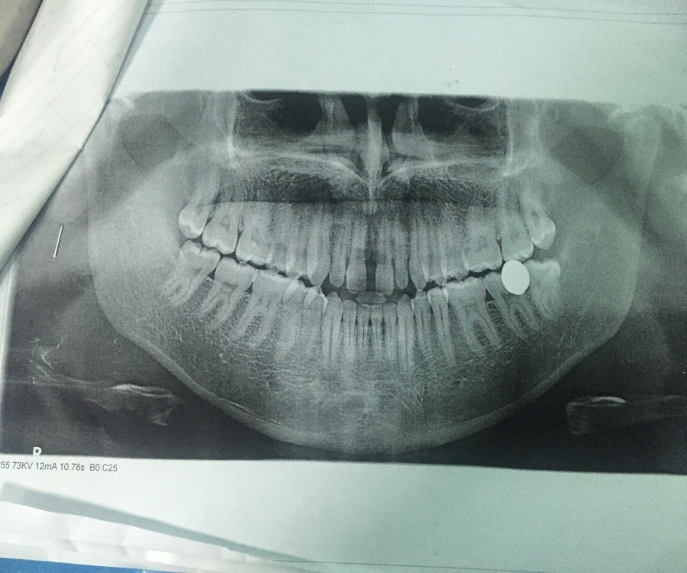

Slide 12
Treatment
The aim of treatment is primarily to restore function,esthetics, namely to restore both the occlusion and pain-free normal movements of both TMJs.

Slide 13
The principles of treatment of fractures are:
✓ Reduction; it is the restoration of functional alignment of the fractured bone fragments.
✓ Fixation.
✓ Immobilization.
✓ Rehabilitation.
Treatment of mandibular fractures can be closed or open

Slide 14
Closed treatment
It consists of closed reduction with indirect fixation and immobilization with intermaxillary fixation (IMF) It Closed reduction is achieved without surgical exposure of the fracture site by manipulation and indirect fixation by place the teeth in normal occlusion and immobilize them in that position thus indirectly reduce the bone fragments. is the traditional conservative treatment of mandibular fractures. (MMF)).

Slide 15
indications of closed treatment
1-Non-displaced favorable fractures, or minimally displaced fractures.
2- Limited resources and facilities for open treatment.
3-Medically compromised patients where conservative line of treatment is required.
4- Grossly infected fractures.
5-Pediatric fractures with mixed dentition phase.
6- Edentulous fractures.

Slide 16
Advantages of closed treatment
Non-invasive
Simple procedure.
Can be performed under local anesthesia.
Less expensive.

Slide 17
Disadvantages of closed treatment
closed treatment may be difficult especially in cases of malocclusion, missing, diseased, or damaged teeth.
The immobilization may not be adequate which delays the healing.
The treatment induces morbidity to the patient due to the IMF affecting feeding and speech.
Closed treatment is contraindicated in some conditions,.

Slide 18
Methods of immobilization

Slide 19
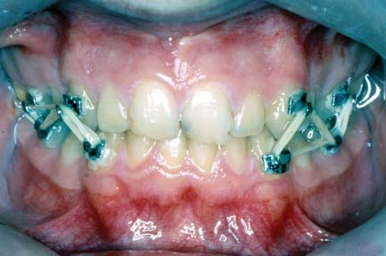
1-Bonded orthodontic brackets
By bonding a number of modified orthodontic brackets onto the teeth and applying light wires or intermaxillary elastic bands.

Slide 20
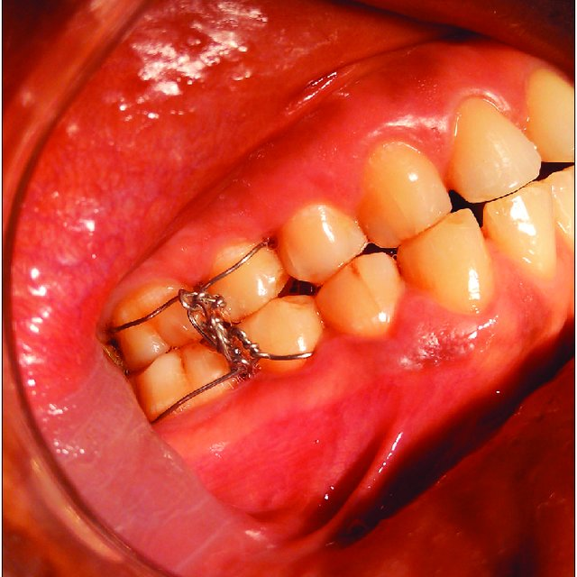
2- Interdental wiring

Slide 21
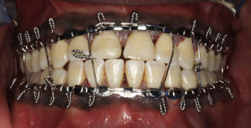
3-Arch bars

Slide 22
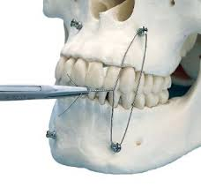
4- IMF screws

Slide 23
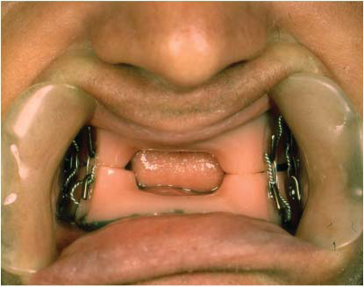
6- Dentures or Gunning-type splints

Slide 24
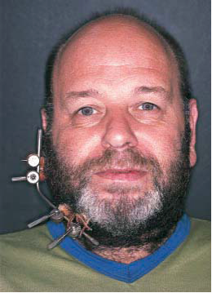
7- External pin fixation

Slide 25
Period of immobilization
With early uncomplicated treatment in a healthy young adult union can on average be achieved after 3 weeks, at which time the fixation can be released. As an empirical guide a further 1-2 weeks should be added for each and any of the following circumstances:
1. Where a tooth is retained in the fracture line. 2. Patients aged 40 years and over. 3. fracture at symphysis . 4. Mobile or comminuted fractures.

Slide 26
Open treatment
In open reduction the fracture site is surgically exposed and the fracture is reduced under direct vision and the fractured fragments are immobilized by different internal direct fixation methods

Slide 27
indications for open treatment
1. Displaced unfavorable fractures.
2. Multiple fractures of the facial bones .
3. Fractures of an edentulous mandible with severe displacement.
5. Special systemic conditions contraindicating IMF.

Slide 28
Methods of internal fixation (osteosynthesis)

Slide 29
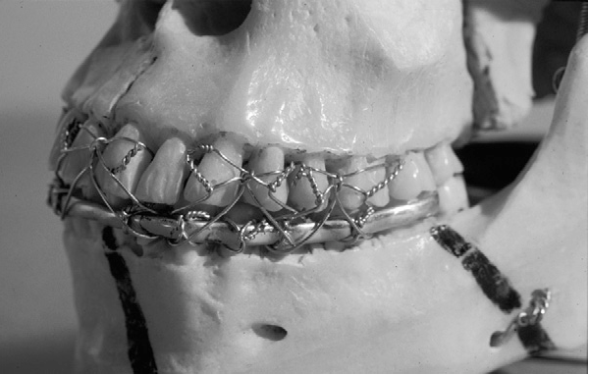
1- Interosseous or Transosseous wiring

Slide 30
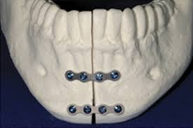
2-Miniplates (miniaturized plates)

Slide 31
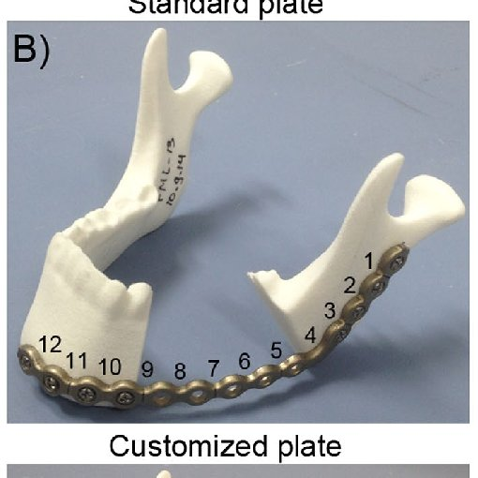
3-Non compression rigid plates (Reconstruction plates)

Slide 32
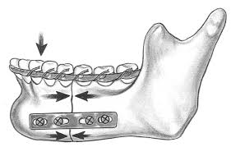
4-Compression plates

Slide 33
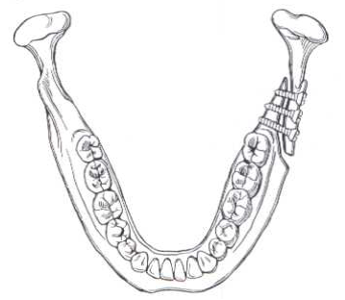
5- Lag screws

Slide 34
6-Bioabsorbable plates and screws
These are made from materials that undergo degradation, so they do not have to be removed after fracture healing. They are mainly indicated in pediatric fractures.

Slide 35
7-K-wire(krishner wire)

Slide 36
indications for removal of a tooth from the fracture line
1-Longitudinal fracture involving the root.
2. Dislocation or subluxation of the tooth from its socket.
3. Presence of periapical infection.
4. Advanced periodontal disease.
5. Already infected fracture line.
6. Where a displaced tooth prevents reduction of the fracture

Slide 37
Mandibular fractures that require special considerations

Slide 38
Pediatric fractures
Bone in young children is resilient and greenstick fracture.
Treatment in children is generally of a conservative nature.
Mandibular fractures may disturb the growth of the mandible
Fractures of the condyle require special consideration.
when fixation is needed a Gunning-type splint for the lower jaw alone may be used.
When sufficient firm erupted deciduous and permanent teeth are present, eyelet wires or arch bars can be used.
When there is significant displacement of fragments, open reduction may be necessary.
Slight imperfection in reduction can be accepted.
Prolonged follow-up is required.

Slide 39
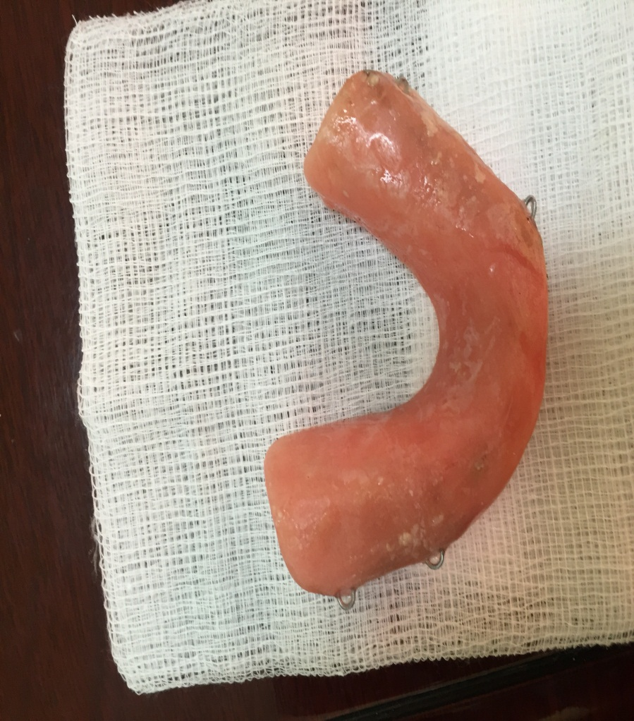
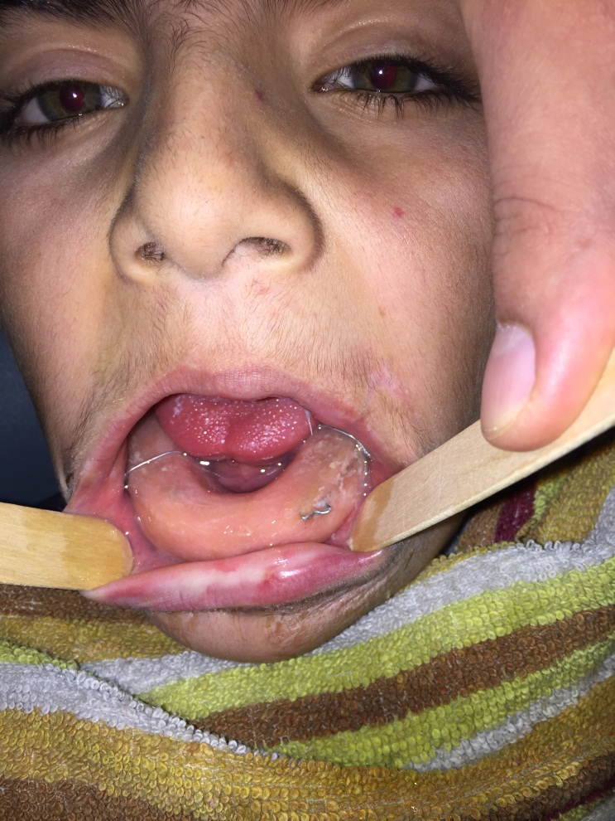

Slide 40
Fractures of the condyle
1- Intracapsular either unilateral or bilateral
2- extracapsular (codylar neck) fracture. either unilateral or bilateral
Treatment of condylar fractures
* All intracapsular fractures and all fractures in growing children should be treated conservatively. Immediate or early mobilization should be encouraged. However, if the occlusion is disturbed IMF is applied and maintained until stable union can be expected to be present; the period of immobilization should not exceed 10-21 days.
*Extracapsular fracture if:
a-unilateral undisplaced or minimally displaced treated by IMF only otherwise ORIF.
b-bilateral treated either by distraction or ORIF

Slide 41
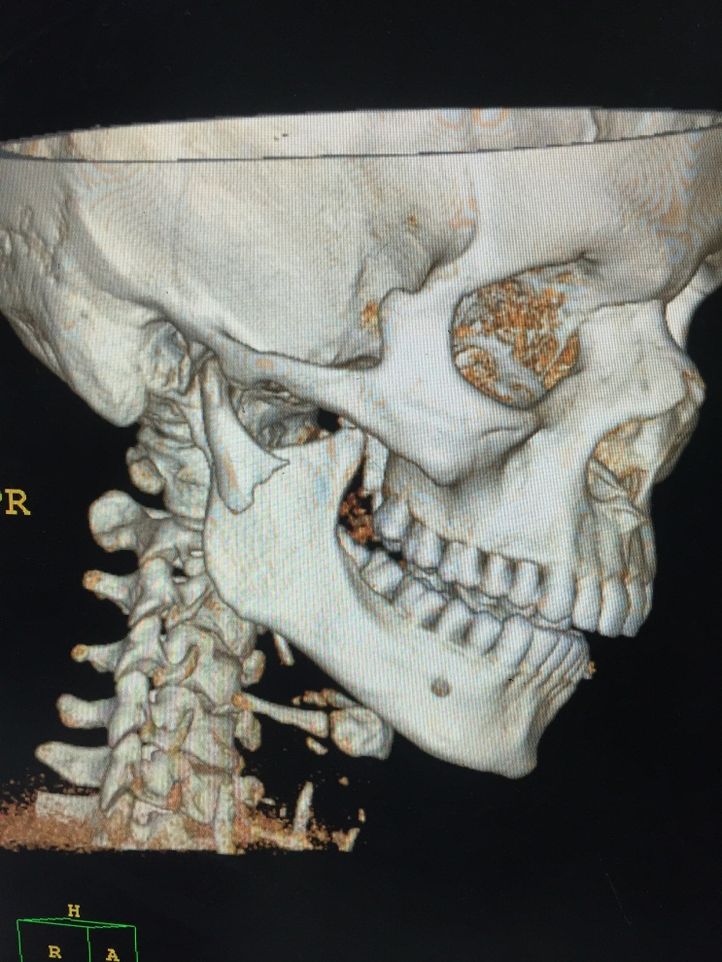
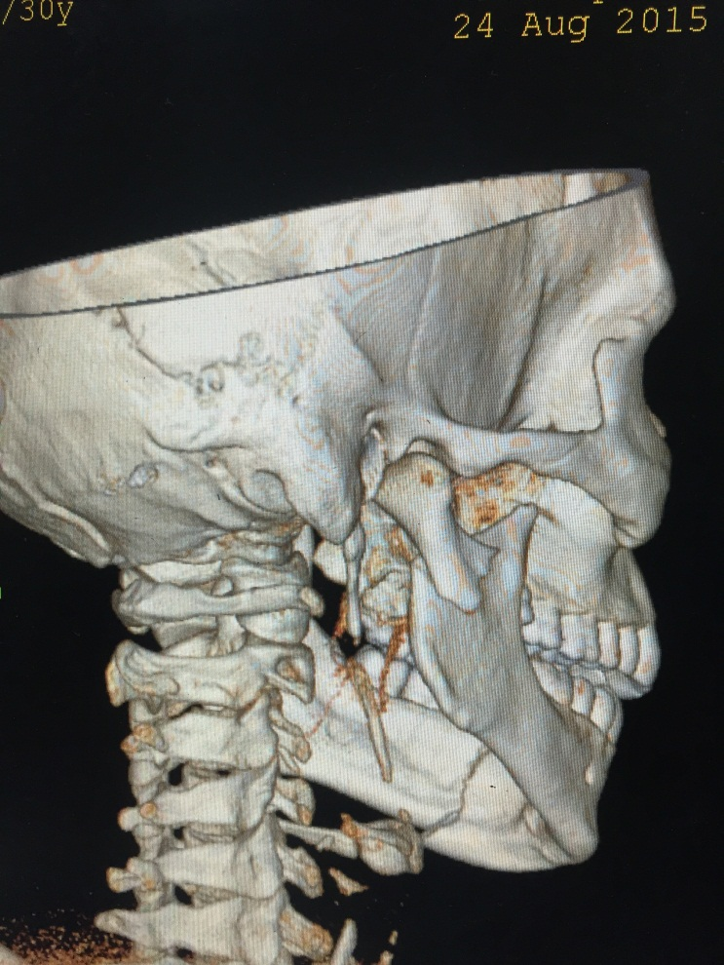

Slide 42
ORIF of condylar fractures
indications:
Displacement of condyle into middle cranial fossa
Impossibility of restoring occlusion with closed treatment.
Invasion by foreign body (e.g. missile)

Slide 43
Fractures of the edentulous mandible
Treatment
.Undisplaced fractures require no active treatment
closed reduction using the Gunning type splint.
Other wise ORIF.
External pin fixation

Slide 44
Comminuted mandibular fractures
traditional method of treatment of these fractures used closed techniques, thereby avoiding periosteal stripping and further devitalizing the bone.
Recently ORIF has been advocated to provide a load bearing fixation and stability across the fracture.

Slide 45
