Slide 1
كلية المستقبل الجامعة الاهلية قسم طب الاسنان المرحلة الثالثة
A Biopsy
Preparation
assistant teacher
Fatima Hakim

Slide 2
Lesson objectives
After the end of the lecture, the student will be able to:-
1-It is known as a Biopsy.
2- It is known as the types of biopsy.
3- It is known as how to prepare for a biopsy.

Slide 3
A Biopsy
A Biopsy is a medical procedure that involves taking a small sample of body tissue so it can be examined under a microscope. A tissue sample can be taken from almost anywhere on or in the body, including the skin, organs and other structures.

Slide 4
A doctor should recommend a biopsy when an early test suggests an area of tissue in the body isn't normal. Doctors may call an area of abnormal tissue a lesion, a tumor, or a mass.

Slide 5
When a biopsy may be needed?
A biopsy can be used to investigate abnormalities, which can be:
functional – such as kidney or liver problems.
structural – such as swelling in a particular organ.
When the tissue sample is examined under the microscope, abnormal cells may be known, which can help to diagnose a specific condition.
If a condition has already been diagnosed, a biopsy can also be used to assess its severity (such as the degree of inflammation) and grade (such as the violence of a cancer).
Examples of conditions where a biopsy may be helpful include:
1-cancer.
2-inflammation, such as in the liver (hepatitis) or kidney (nephritis).
3-infection, such as in lymph nodes – for example, tuberculosis.
4-various skin conditions.

Slide 6
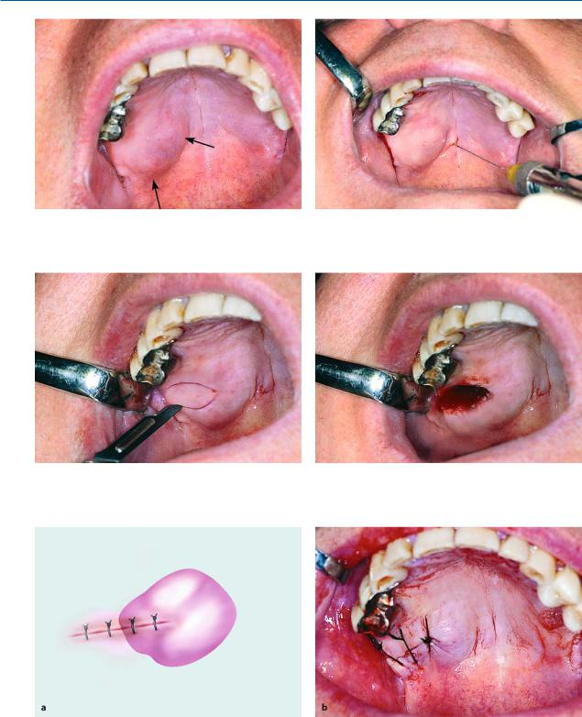
İncisional biopsy

Slide 7
Excision al biopsy

Slide 9
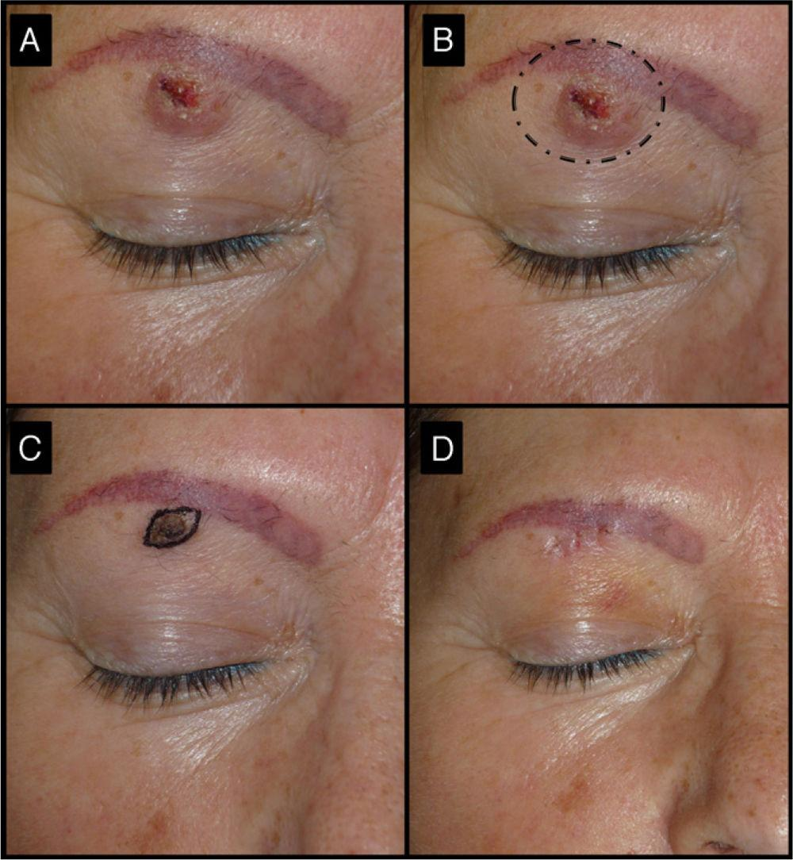
Cautery biopsy

Slide 10
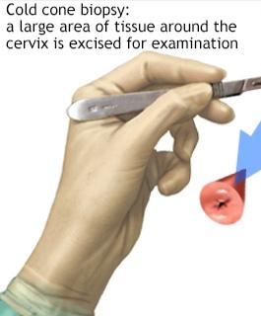
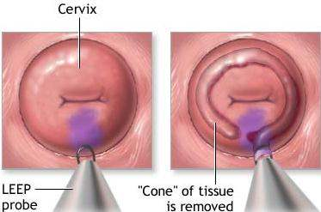
Cone_Biopsy

Slide 11
Core_needle biopsy

Slide 12
Punch biopsy

Slide 13
Punch biopsy

Slide 14
Fixation

Slide 15
Labrotary tissue processing

Slide 17
Types of biopsy
1-Needle biopsy.
2-CT-guided biopsy.
3-Bone biopsy.
4-Bone marrow biopsy.
5-Liver biopsy.
6-Kidney biopsy.
7-Aspiration biopsy.
8-Prostate biopsy.
9-Skin biopsy.
10-Surgical biopsy.
11-Endoscopic biopsy.

Slide 18
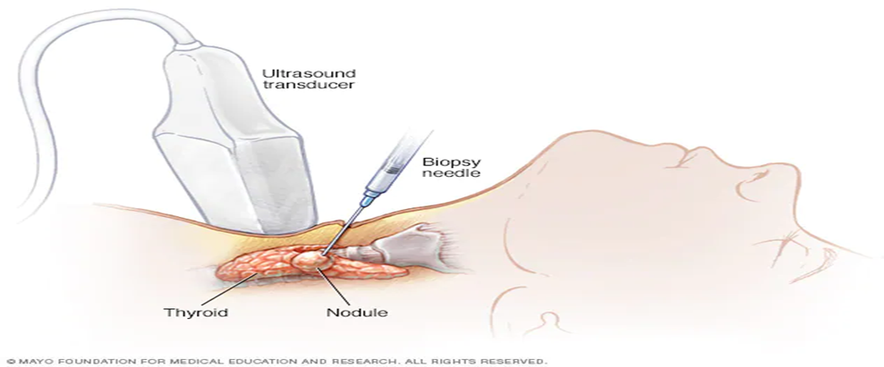
1-Needle biopsy Most biopsies are needle biopsies, meaning a needle is used to access the suspicious tissue. During a needle biopsy, a doctor uses a special needle to extract cells from a suspicious area

Slide 19
2-CT-guided biopsy A person rests in a CT-scanner; the scanner's images help doctors determine the careful position of the needle in the targeted tissue.

Slide 20
3-Bone biopsy A bone biopsy is used to look for cancer of the bones.

Slide 21
4-Bone marrow biopsy A large needle is used to enter the pelvis bone to collect bone marrow

Slide 22
5-Liver biopsy A needle is injected into the liver through the skin on the belly.

Slide 23
6-Kidney biopsy Similar to a liver biopsy, a needle is injected through the skin on the back, into the kidney.

Slide 24
7-Aspiration biopsy A needle withdraws material out of a mass. This simple procedure is also called fine-needle aspiration.

Slide 25
8-Prostate biopsy Multiple needle biopsies are taken at one time from the prostate gland.

Slide 26
9-Skin biopsy A blow biopsy is the main biopsy method.

Slide 27
10-Surgical biopsy Either open or laparoscopic surgery may be necessary to obtain a biopsy of hard-to-reach tissue.

Slide 28
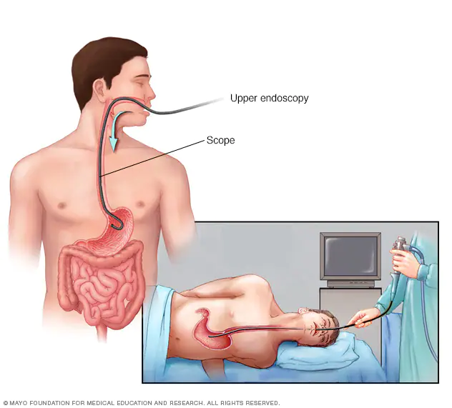
11-Endoscopic biopsy
During endoscopy, a doctor uses a thin, flexible tube (endoscope) with a light on the end to see structures inside the body.

Slide 29
How to prepare for a biopsy?
Biopsies may require some preparation on the part of the patient such as bowel prep, clear liquid diet, or nothing by mouth. a doctor will teach you on what to do before the procedure.
As always before a medical procedure, tell your doctor what medications and additions you take. You may need to stop taking certain drugs before a biopsy, such as aspirin or nonsteroidal anti-inflammatory medications.

Slide 30
Homework
How to do a skin biopsy?

Slide 31
Thank you for listening

