Slide 1
Al-Mustaqbal University College
قسم البصريات
تطبيقات الحاسوب
:By
noor dhyaa

Slide 2
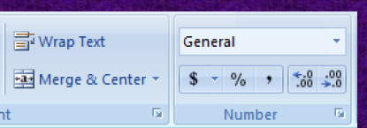
Formatting Cell
The same formatting instruction available in the Word application is in Excel application can be used to format the content of cells.There are instructions for the Excel application only, which are:
Merge & Center: Merge two or more cells and center their content.Wrap Text: wraps the cell's content around itContent display cell.Change the format of cell content numbers, texts, currency, ordate...etc.

Slide 3
Insert & Delete
From Insert in the Home tab, you can add:New cell Enter the cell.Newline Insert sheet row.New Column Insert the paper columnNew worksheet Insert a sheet.As for deleting in the Home tab, deleting:A cell or group of cells deletes the cell.A line or group of lines Delete a sheet row.Column or group of columns Delete sheet columnworksheet delete sheet

Slide 4
Formula
There are 5 basic functions in the Excel application, which are:1 - Min function: to calculate the lowest value within a set of values.
2 - Max function: to calculate the highest value within a set of values.
3 - Count function: to count the number of values.
4 - Sum function: to calculate the sum of the values.
5 - Avg function: to calculate the average of values (the sum of the values over their number).
Basic arithmetic operations (addition, subtraction, multiplication) can be usedAnd division (and any mathematical function or operation must be preceded by a = () signThe cell content is the result of an equation.When performing arithmetic operations, the cell address is given instead of its content.For example =A4+B6 means summing the values of cells A4 and B6

Slide 5
Some types of errors
1-#### :This error means that the cell is small in relation to its sizeText.
-2 #NAME? : This error means that there is a text with a number.
3 - #DIV/0 : This error means division by zero is not allowed

Slide 6
Change the orientation of the worksheet when printing
The printing orientation (landscape or portrait) can be selected not only inExcel application, but in other applications of MicrosoftOffice, and this is done either from the printing settings at the instructionPrint or
from Orientation in the Page Layout tab

Slide 7
Prepare the page for printing
These settings include all Office applications, not just an applicationIn Excel, the printing direction (landscape or portrait) can be selected fromPrinting settings at the command of Print or fromOrientation in the Page Layout tab

Slide 8
You can also change the paper size from the Size tool or change the spacingleft from the leaf borders from the Margins tool and also selectThe range of cells to be printed from the Print Area tool

Slide 9
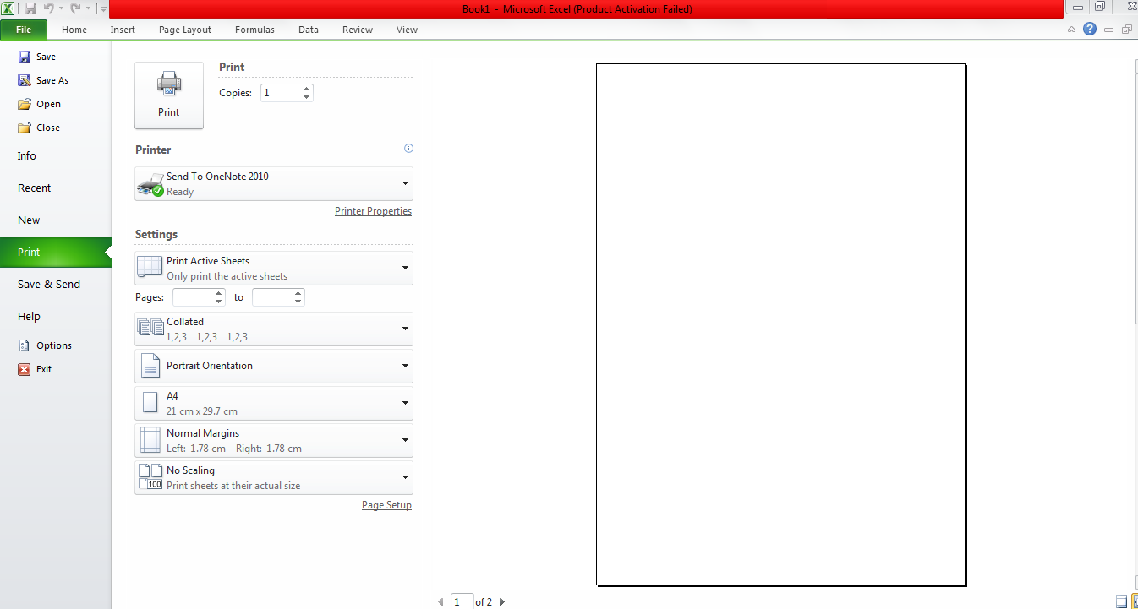
print worksheet
The same instructions in the Word application

