Slide 1
Biliribbin Metabolism
Dr. Shaimaa Munther

Slide 2
Basic Anatomy
• liver unequally divided
into 2 lobes
• it has a dual blood supply
– Portal vein
– Hepatic artery
It has an excretory system for bile excretion
Notes:
Liver is largest and most complex internal organ
All blood flow from intestine and pancreas reaches liver via portal venous system
Liver is a multifunctional organ that is involved in diverse body functions.
Metabolic Functions
Liver actively participates in carbohydrate metabolism, lipid, protein, mineral and vitamin metabolisms.
Excretory Functions
Bile pigments, bile salts and cholesterol are excreted in bile into intestine. Protective functions & detoxification
Kupffer cells of liver perform phagocytosis to eliminate foreign compounds. For example ammonia is detoxified to urea and metabolism of xenobiotics (detoxification).
Clearance of hormones such as insulin, parathyroid hormone, oestrogen, cortisol
Hematological and synthetic functions
Liver participates in formation of blood (particularly in embryo)
Synthesis of plasma proteins (albumin and prothrombin), hormones e.g angiotensinogen, insulin-like growth factor and triiodothyronine.
Destruction of erythrocytes (Bilirubin)
5. Storage functions
Glycogen, vitamins A, D and B₁₂
6. Serum enzymes
Acting as markers of liver damage

Slide 3
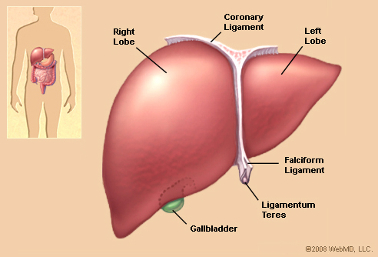
Gross anatomy of the liver

Slide 4
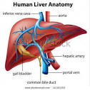
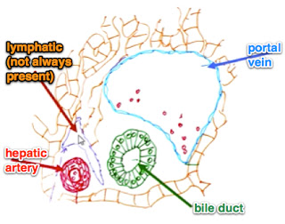
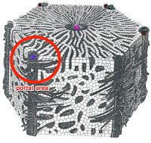

Slide 5
Blood supply to the liver
There are two main blood vessels supplying the liver.
a) Hepatic artery a branch of the aorta :
Carrying oxygenated blood that contribute to about 20% of the blood supply
Provides most of the O₂ requierments .
b) Hepatic portal vein carrying blood(deoxygenated) from the gut that:
Drains the GI tract.
Transports the most recently absorbed material from the intestine to the liver .
Note :
Blood leave the liver through hepatic vein

Slide 6
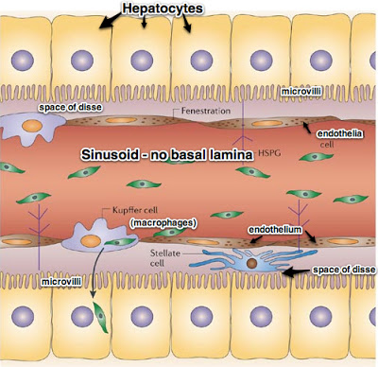
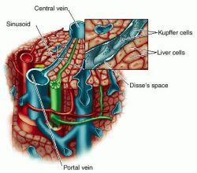
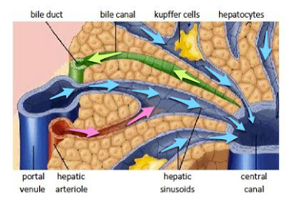

Slide 9
Bilirubin Metabolism
Under physiologic conditions in the human adult, 1–2 × 108 erythrocytes are destroyed per hour. Thus, in 1 day, a 70-kg human turns over approximately 6 g of hemoglobin.
When hemoglobin is destroyed in the body, globin is degraded to its constituent amino acids, which are reused, and the iron of heme enters the iron pool, also for reuse. The iron-free porphyrin portion of heme is also degraded, mainly in the reticuloendothelial cells of the liver, spleen, and bone marrow. The catabolism of heme from all of the heme proteins appears to be carried out in the microsomal fractions of cells by a complex enzyme system called heme oxygenase.
bilirubin formation in human adults is approximately 250–350 mg, deriving mainly from hemoglobin but also from ineffective erythropoiesis and from various other heme proteins such as cytochrome P450.
The chemical conversion of heme to bilirubin by reticuloendothelial cells can be observed in vivo as the purple color of the heme in a hematoma is slowly converted to the yellow pigment of bilirubin.

Slide 10
Bilirubin Metabolism
Hemoglobin
Heme + Globin
Bilirubin+ Iron
• Iron reused
• Globin reused

Slide 12
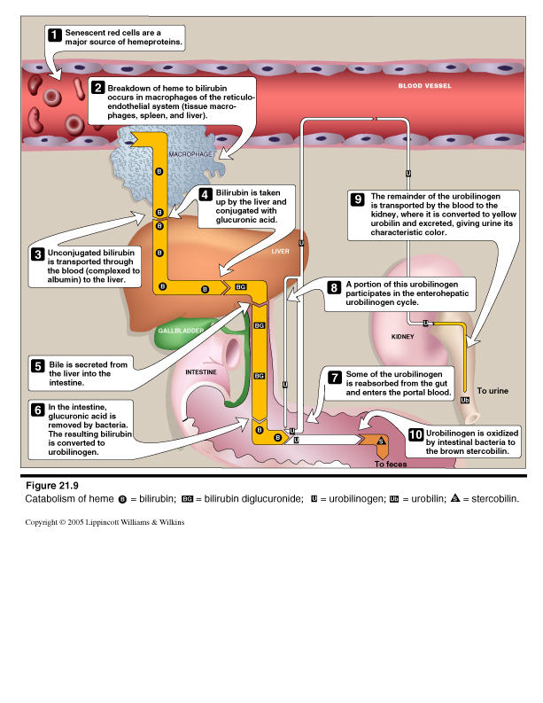

Slide 13
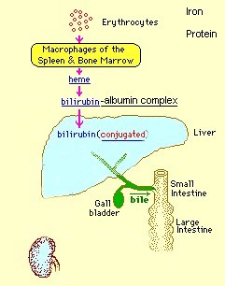
Bilirubin Metabolism
1- Unconjugated bilirubin
– Not water soluble
– Toxic to cells
– Bound to albumin making it soluble in plasma
– Transported through plasma to liver for conjugation
– Bilirubin-albumin complex too large to pass glomerular filtering membrane

Slide 14
Bilirubin Metabolism
2- Albumin dissociates from unconjugated bilirubin
• Then the enzyme: glucuronyl transferase form conjugated bilirubin in the liver
• Conjugated bilirubin
– Water soluble
– Less toxic to cells
– Can pass glomerular filtering membran

Slide 15
Bilirubin Metabolism
3- Conjugated bilirubin
– Excreted into bile
– Not found in plasma unless
• Liver cell injury
• Obstruction
Then will be found in urine
Note:
– Only this form of bilirubin will be found in urine
4- Conjugated bilirubin
– Excreted into bile
– In intestine, bacteria convert
bilirubin to urobilinogen
– Majority of urobilinogen remains in intestine and further reduced to sterocobilin giving feces characteristic color
– Approx 20% UBG reabsorbed via portal vein and small amount found inurine

Slide 16
Laboratory Analysis of Bilirubin
1- Total Bilirubin: measures both forms of bilirubin
(unconjugated and conjugated)
2- Direct Bilirubin: measures only conjugated form
3- Indirect bilirubin Calculated by :
Total – direct = (indirect)
Unconjugated represent indirect bilirubin
Conjugated represent direct bilirubin
Notes:
Total bilirubin: 0.2 – 1.0 mg/dl
• Conjugated bilirubin: 0.0 - 0.2 mg/dl
• Unconjugated bilirubin: 0.2 – 0.8 mg/dl
• Critical: >15.0 mg/dl
• Urine bilirubin: negative

Slide 17
Expected Values: Adults
• Total bilirubin: 0.2 – 1.0 mg/dl
• Conjugated bilirubin: 0.0 - 0.2 mg/dl
• Unconjugated bilirubin: 0.2 – 0.8 mg/dl
• Critical: >15.0 mg/dl
• Urine bilirubin: negative

Slide 18
Some example of liver dysfunction
Jaundice
Hepatocellular disease
Cholestasis (obstruction of bile flow)
Cirrhosis
Hepatitis
Liver cancer

Slide 20
Jaundice
• Increased plasma bilirubin results in condition called jaundice (yellow pigmented skin & sclera)
• Jaundice categorized as:
– Pre-hepatic (Hemolytic Jaundice)
– Hepatic ( Hepatocellular Jaundice)
– Post-hepatic (Obstructive Jaundice )

Slide 22
Pre-hepatic (Hemolytic Jaundice)
occurs when the problem causing the jaundice occurs prior to liver metabolism.
In This type of jaundice unconjugated bilirubin is increased only & it caused by :
1- Acute and chronic hemolytic anemias, e.g sickle cell anemia & thalassemia
2- Blood transfusion reaction
3-Malaria
4- Drugs competing for glucuronide

Slide 23
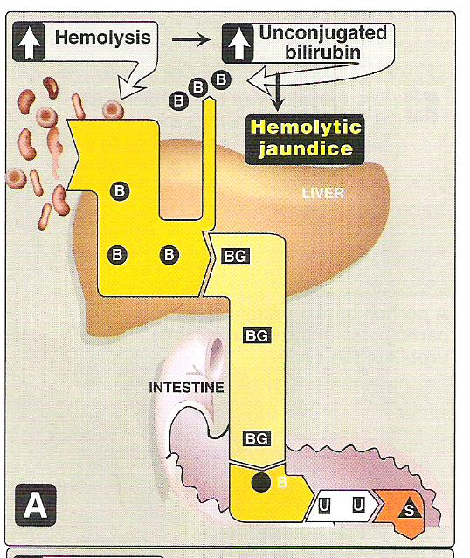
Hemolytic jaundice

Slide 24
Hepatic jaundice
Hepatic jaundice occurs when the primary problem causing the jaundice resides in the liver (intrinsic liver defect or disease). It caused by :
1- Disorders of bilirubin metabolism and transport defects, e.g. :
Crigler-Najjar syndrome
Dubin- Johnson syndrome
Gilbert disease
Neonatal physiologic jaundice of the newborn
2- Diseases resulting in hepatocellular injury or destruction, e.g.:
Cirrhosis
Tumors
Infection
Toxins
In hepatic jaundice either unconjugated bilirubin or conjugated bilirubin or the both will be increased

Slide 25
Hepatic jaundice
Crigler-Najjar syndrome, and physiologic jaundice of the newborn are hepatic causes of jaundice that result in elevations in unconjugated bilirubin.
Conditions such as Dubin-Johnson and Rotor syndrome are hepatic causes of jaundice that result in elevations in conjugated bilirubin.
Gilbert syndrome,, is a benign hereditary disorder that characterized by intermittent unconjugated hyperbilirubinemia in the absence of hemolysis and underlying liver disease due to a defective conjugation system
Notes:
Gilbert syndrome, first described in the early twentieth century, is a benign hereditary disorder that affects
approximately 5% of the U.S. population.5 Of the many causes of jaundice, Gilbert syndrome is the most common cause and, interestingly, it carries no morbidity or mortality in the majority of those affected and carries generally no clinical consequences. It is characterized by intermittent unconjugated hyperbilirubinemia in the absence of hemolysis and underlying liver disease due to a defective conjugation system. The hyperbilirubinemia usually manifests during adolescence or early adulthood. Total serum bilirubin usually fluctuates between 20–50 _mol/L, and it rarely exceeds 85 _mol/L. The molecular basis of Gilbert syndrome (in whites) is related to
the UGT (uridine diphosphoglucose glucuronyltransferase) superfamily, which is responsible for encoding enzymes that catalyze the conjugation of bilirubin. The UGT1A1 (the hepatic 1A1 isoform of UGT) contributes substantially to the process of conjugating bilirubin. The UGT1A1 promoter contains the sequence (TA)6TAA. The insertion of an extra TA in the sequence, as seen in Gilbert syndrome, reduces the expression of the UGT1A1 gene to 20%–30% of normal values. That is, the liver’s conjugation system in Gilbert syndrome is working at approximately 30% of normal.6,7 Crigler-Najjar syndrome was first described by Crigler and Najjar in 1952 as a syndrome of chronic nonhemolytic unconjugated hyperbilirubinemia.8 Crigler- Najjar syndrome, like Gilbert syndrome, is an inherited disorder of bilirubin metabolism resulting from a molecular defect within the gene involved with bilirubin conjugation. Crigler-Najjar syndrome may be divided into two types: type 1, where there is a complete absence of enzymatic bilirubin conjugation, and type II, where there is a mutation causing a severe deficiency of the enzyme responsible for bilirubin conjugation. Unlike Gilbert syndrome, Crigler-Najjar syndrome is rare and is a more serious disorder.9
While Gilbert disease and Crigler-Najjar syndrome are characterized as primarily unconjugated hyperbilirubinemias, Dubin-Johnson syndrome and Rotor syndrome are characterized as conjugated hyperbilirubinemias. Dubin-Johnson syndrome is a rare inherited disorder caused by a deficiency of the canalicular multidrug resistance/ multispecific organic anionic transporter protein (MDR2/cMOAT). In other words, the liver’s ability to uptake and conjugate bilirubin is functional; however, the removal of conjugated bilirubin from the liver cell and the excretion into the bile are defective. This results in accumulation of conjugated and, to some extent, unconjugated bilirubin in the blood, leading to hyperbilirubinemia and bilirubinuria. Dubin-Johnson is a condition that is obstructive in nature, so much of the conjugated bilirubin circulates bound to albumin. This type of bilirubin (conjugated bilirubin bound to albumin) is referred to as delta bilirubin. An increase in delta bilirubin poses a problem in laboratory evaluation because the delta bilirubin fraction reacts as conjugated bilirubin in the laboratory method to measure conjugated or direct bilirubin. A distinguishing feature of Dubin-Johnson syndrome is the appearance of dark-stained granules (thought to be pigmented lysosomes) on a liver biopsy sample. Usually the total bilirubin concentration remains between 2–5 mg/dL with more than 50% due to the con jugated fraction. This syndrome is a relatively mild in nature with an excellent prognosis. People with Dubin- Johnson have a normal life expectancy, so no treatment
is necessary.10,11
Rotor syndrome is clinically similar to Dubin-Johnson syndrome but the defect causing Rotor syndrome is not known.12 It is hypothesized to be due to a reduction in the concentration or activity of intracellular binding proteins such as ligandin. Unlike in Dubin-Johnson syndrome, a liver biopsy does not show dark pigmented granules. Rotor syndrome is seen less commonly than Dubin-Johnson syndrome; it is a relatively benign condition and carries an excellent prognosis, and therefore treatment is not warranted. However, an accurate diagnosis is required to aid in distinguishing it from more serious liver diseases that require treatment.

Slide 26
Inherited Hyperbilirubinemias
Liver
Gilbert Syndrome
Reduction in the activity of UDP-glucoronyl transferase
Crigler-Najjar syndrome
Defective UDPG-transferase
Dublin-Johnson disease
Post-conjugation failure

Slide 27
Post-hepatic (Obstructive Jaundice )
Posthepatic jaundice is results from biliary obstructive disease
In This type of jaundice, conjugated bilirubin is increased only & it caused by :
1-Physical obstructions (gallstones or tumors)
2- Cholestasis
3- Biliary atresia
Notes:
Water soluble
~Excreted into bile
~Only form found in urine
when urine bilirubin
Positivephysical obstructions (gallstones or tumors), that prevent the flow of conjugated bilirubin into the bile canaliculi. Since the liver cell itself is functioning, bilirubin is effectively conjugated; however, it is unable to be properly excreted from the liver. Since bile is not being brought to the intestines, stool loses its source of normal pigmentation and becomes clay-colored.

Slide 28
Physiologic Jaundice of Newborn
Many factors contribute to physiologic jaundice of Newborn :
• Increased bilirubin load due to shortened RBC lifespan
• Relative lack of conjugating enzyme
• Decreased binding to albumin leading to increased liver uptake
Physiologic jaundice has an increased potential risk of kernicterus:
– Neurologic syndrome due to bilirubin neurotoxicity
– Lethargy with seizures
Physiologic jaundice prevented by phototherapy, exchange transfusion
Notes:
Physiologic jaundice of the newborn is a result of a deficiency in the enzyme glucuronyl transferase, one of the last liver functions to be activated in prenatal life since bilirubin processing is handled by the mother of the fetus. In premature births, infants may be born without glucuronyl transferase, the enzyme responsible for bilirubin conjugation. This deficiency results in the rapid buildup of unconjugated bilirubin, which can be life threatening. When this type of bilirubin builds up in the neonate, it cannot be processed and it is deposited in the nuclei of brain and nerve cells, causing kernicterus. Kernicterus often results in cell damage and death in the newborn, and this condition will continue until glucuronyl transferase is produced. Infants with this type of jaundice are usually treated with ultraviolet radiation to destroy the bilirubin as it passes through the capillaries of the skin. In extreme cases, some infants require an exchange transfusion. Because this condition is so serious, bilirubin levels are carefully and frequently monitored so the dangerously high levels of unconjugated bilirubin (approximately 20 mg/dL) can
be detected and treated.13

