Slide 1
The Knee Joint PART I
Dr Zaid Saad Al-Nasrawi
Trauma and Orthopaedics Surgery

Slide 2
The knee joint
The knee joint is a synovial hinge joint
Articular surfaces These are the condyles and the patellar surfaces of the femur, the tibial articular surfaces on the tibial plateau, and the deep surface of the patella
Capsule This is attached at the margins of the articular surface, except superiorly where the joint cavity communicates with the suprapatellar bursa (between quadriceps femoris muscle and the femur) and posteriorly where it communicates with the bursa under the medial head of gastrocnemius (semimembranosus bursa)
The synovium lines the capsule and its associated bursae

Slide 3
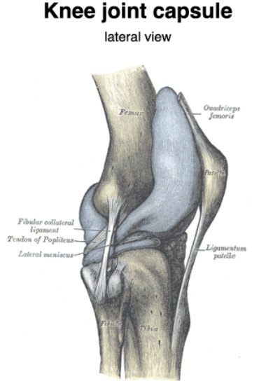
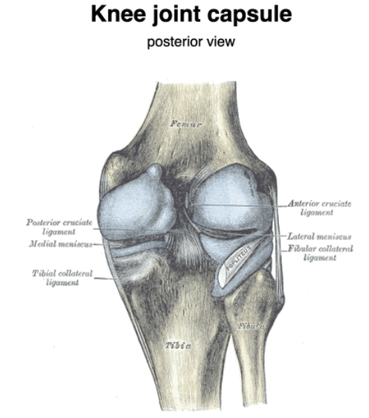

Slide 4
Ligaments
These are as follows:
• The medial (tibial) collateral ligament
• The lateral collateral ligament is attached to the fibula
• The ligamentum patellae and medial and lateral patellar retinacula
• The oblique popliteal ligament posteriorly

Slide 5
Anterior and posterior cruciate ligaments
arise from the anterior and posterior parts of the intercondylar area of the tibia and are named by their tibial origin
They are inserted into the inner aspect of the lateral and medial femoral condyles, respectively.
The anterior cruciate ligament resists hyperextension of the knee and the posterior cruciate resists hyperflexion

Slide 6
The medial and lateral menisci (or semilunar cartilages)
are two crescentic structures, triangular in cross-section, which slightly deepen the articular surface of the tibiaEach is attached peripherally to the tibia and to the capsule
The upper and lower surfaces of the menisci are free Each is described as having an anterior and posterior horn attached to the intercondylar area of the tibia
The medial meniscus is bigger, less curved and thinner
The lateral meniscus is smaller, more curved (nearly circular rather than semicircular) and more uniform in thickness
The lateral meniscus is less well attached to the capsule than the medial .

Slide 7
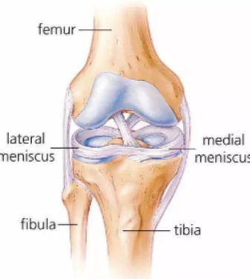
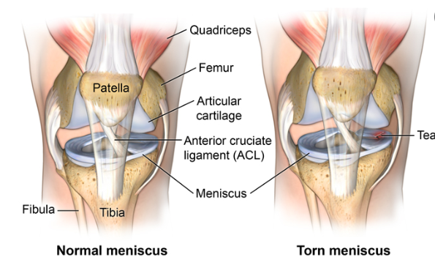

Slide 8
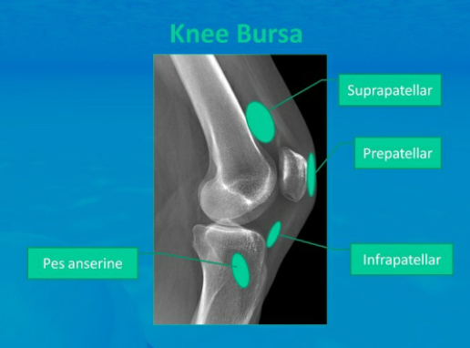
Plain radiographs of the knee joint
The suprapatellar bursa is best seen on radiographs when distended with fluid.
Routine imaging includes AP, semiflexed lateral, tunnel and skyline views

Slide 9
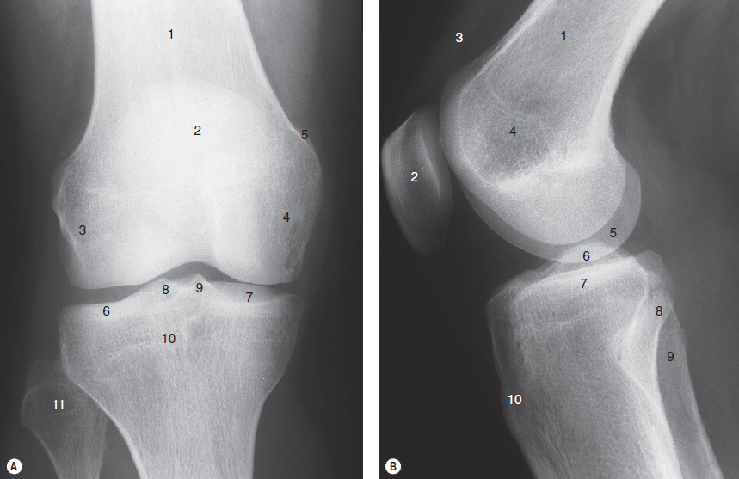
(A)
Femur
Patella
Lateral epicondyle
Medial epicondyle
Adductor tubercle
Lateral tibial plateau
Medial tibial plateau
Lateral tibial spine (intercondylar eminence)
Medial tibial spine (intercondylar eminence)
Fused growth plate, proximal tibia
Head of fi bula
(B) 1. Distal femur 2. Patella 3. Quadriceps tendon 4. Epicondyles (superimposed) 5. Femoral condyle 6. Tibial spines (superimposed) 7. Tibial plateaux (superimposed) 8. Head of fi bula 9. Neck of fi bula 10. Tibial tuberosity

Slide 10
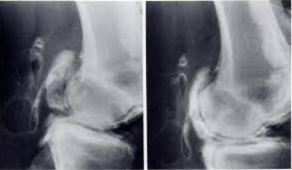
Arthrography of the knee joint
Contrast medium and air are introduced into the joint deep to the patella and allow visualization of the synovial cavity and some or all of the associated bursae.
Baker ’ s cyst represents a medial outpouching between the medial head of the gastrocnemius and thesemimembranosus and semitendinosus tendons

Slide 11
Question??

