Slide 1
lec 7
Pharmaceutical Technology II
Pharmaceutical Incompatibilities
3rd stage / 2nd course
Dr. Ameer S. Sahib

Slide 2
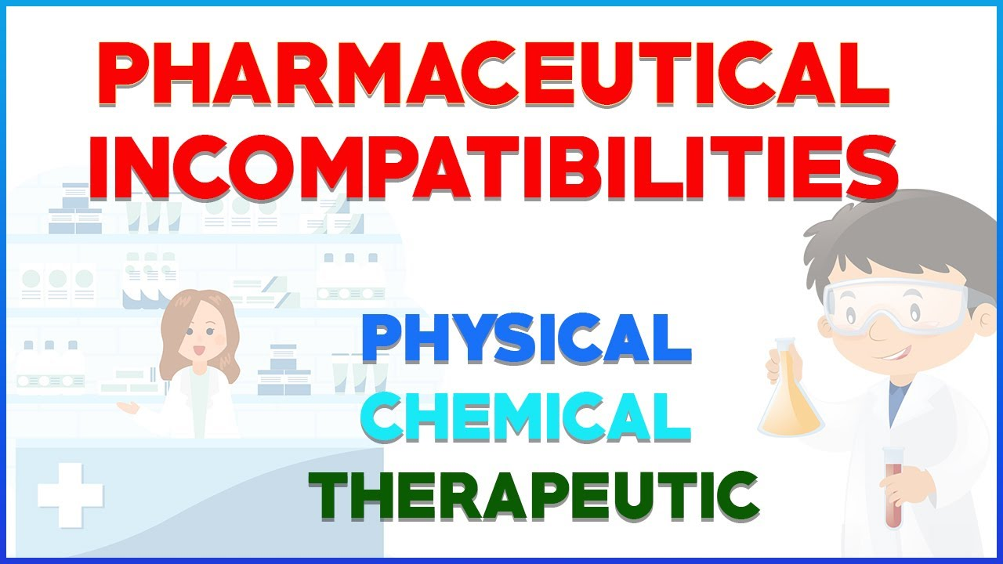
Incompatibilities
Incompatibilities is the problem or undesired change in the physical, chemical or therapeutic properties that usually develop or result of using two or more (or even single) substances.

Slide 3
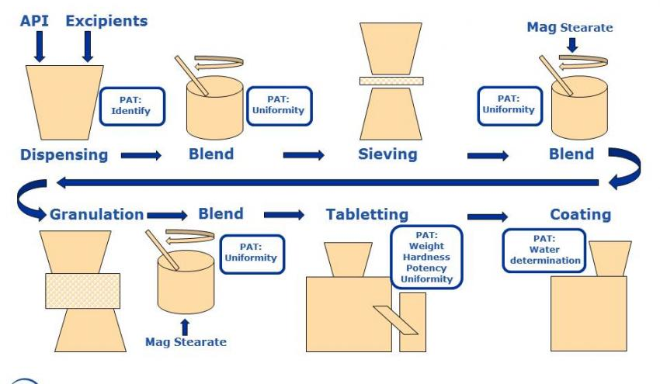
Site of incompatibility
The term incompatibility may be applied to prescription when certain problems arise during one or more of the following steps:
Compounding
Formulation
Manufacturing
Packaging
Dispensing
Storage
Administration
Incompatibilities are easier to be prevented than to be corrected, this will save time, materials and money.

Slide 4
Classification of incompatibilities
Pharmaceutical incompatibilities: which is of two general types
Physical incompatibility: physical properties including appearance, texture, color, odor, melting point, boiling point, density, solubility, state of matter, and many others.
Chemical incompatibility: chemical interaction, chelation and others.
2. Therapeutic incompatibility: it is an unintentional change in pharmacodynamic (drug action) or pharmacokinetic (ADME) parameters that take place in vivo after administration of medicinal products.
If pharmaceutical incompatibility is not corrected, it may lead to therapeutic incompatibility, i.e., therapeutic effectiveness may be delayed or reduced.

Slide 5
Pharmaceutical incompatibility
Pharmaceutical incompatibility is a condition in the formula that will result in an unsatisfactory product.
Pharmaceutical incompatibility may be instantaneous (immediate) or delayed.
Most instantaneous incompatibilities are recognised by visible changes as precipitate or effervescence. Complexation and other reactions may occur and not readily visible. Delayed incompatibility need time and may not be visible.
Incompatibility is an undesirable reaction that occurs between:
drug and the solution,
drug and the container
drug and another drug (Drug –drug interactions )
Drug -excipient interaction

Slide 6
Physical incompatibility
When two or more substances are combined together, a physical change takes place and an unacceptable product is formed. This may lead to change in color, odor, taste, viscosity, morphology, meting point, boiling point, and any other physical properties. It is divided into:
Insolubility: in this case the solvent maybe insufficient or it is the wrong solvent. The use of heat in this case to increase the solubility is not useful, because the substance may dissolve at high temperature but precipitate on cool.
Examples of insolubility
Insolubility of silicon in water.
Insolubility of gums in alcohol.
Insolubility of resins in water.
Insolubility of phenobarbital in water

Slide 7
Solubility decrease of drugs
Addition of high concentration of a strong electrolyte leading to decreasing solubility and then precipitation:
to saturated solutions of volatile oils (eg aromatic water)
to tinctures or fluidextracts of slightly soluble active constituents
to colloidal dispersion (effect on zeta potential)
to saturated solution of a weak electrolyte (common ion effect)
Also addition of alcohol to syrups and colloidal dispersions may cause ppt..

Slide 8
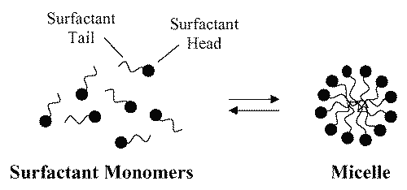
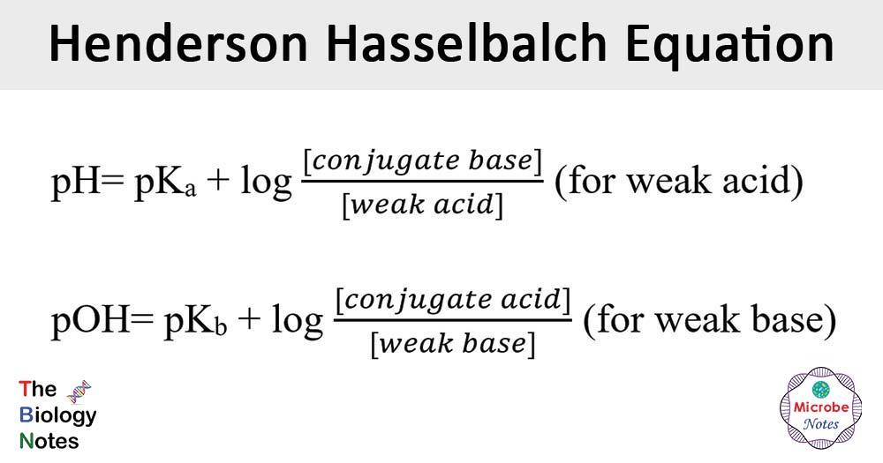
Solubility decrease of drugs
Precipitation at the site of injection due to
Solvent dilution or alteration of pH after i.v. injection. (avoid i.v. route) (Henderson–Hasselbalch equation?)
Drugs like phenytoin, digoxin and, diazepam are formulated in non aqueous but water miscible solvent (alcohol-water mixture) or micellar system (?), addition of the formulation to water may result in ppt.. depending on the final concentration of the drug and the solvent
Diazepam injection may contain propylene glycol /alcohol / sodium benzoate / benzoic acid / benzyl alcohol.
Upon dilution of the injection both the drug and the co-solvent is diluted, ppt. will depend on the solubility of the drug in the diluted system which mostly depend on the initial concentration of the drug in co-solvent mixture.

Slide 9
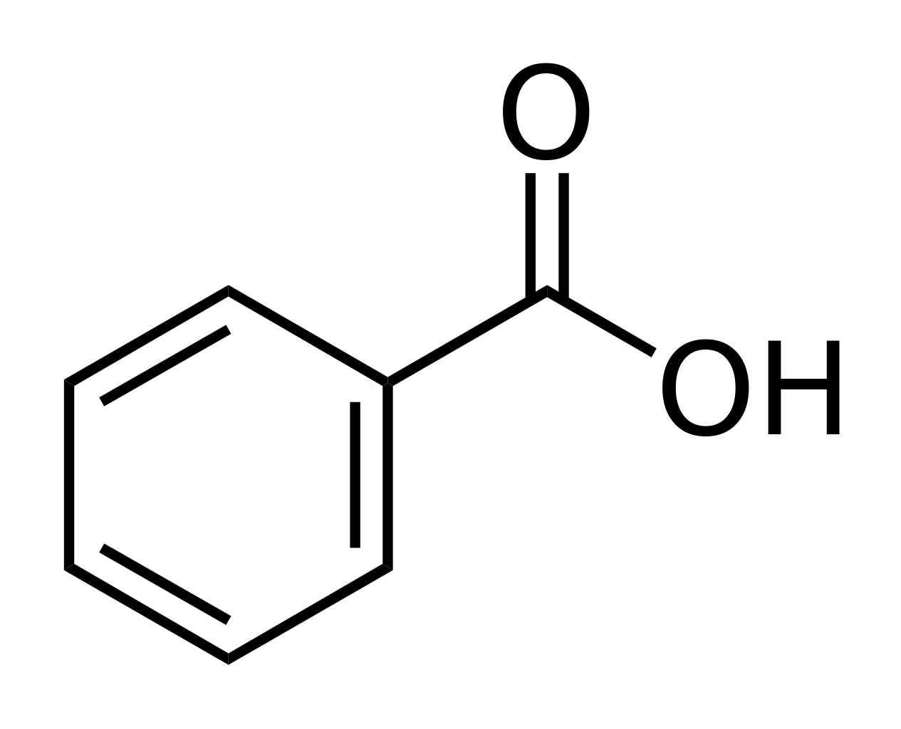
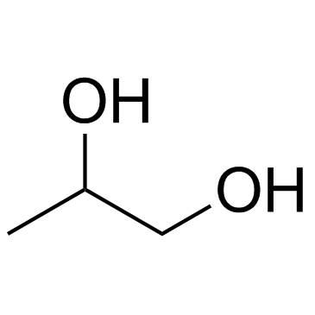
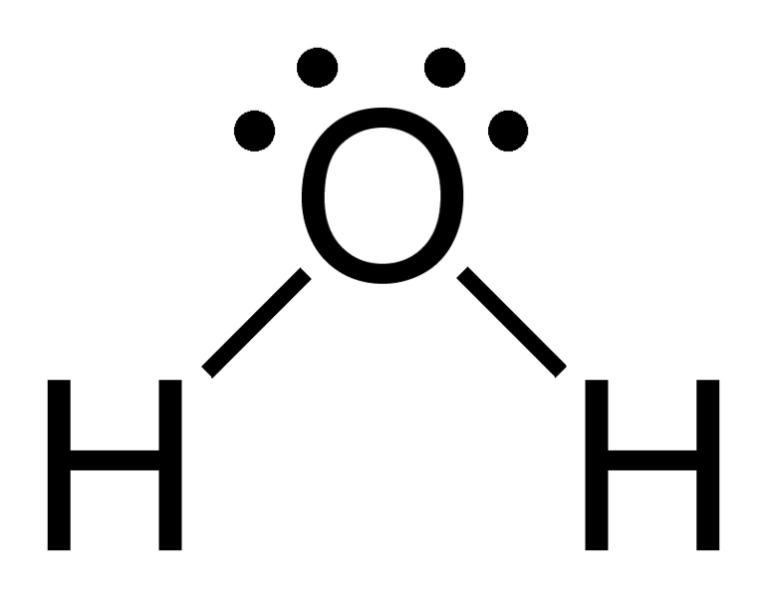
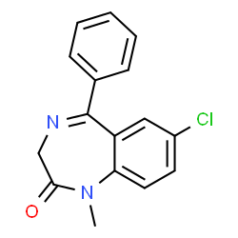
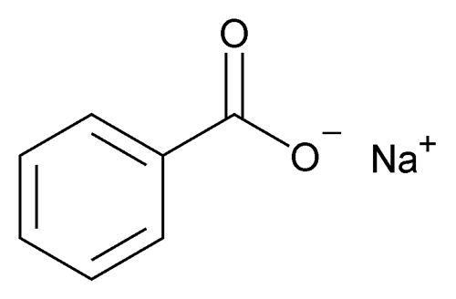
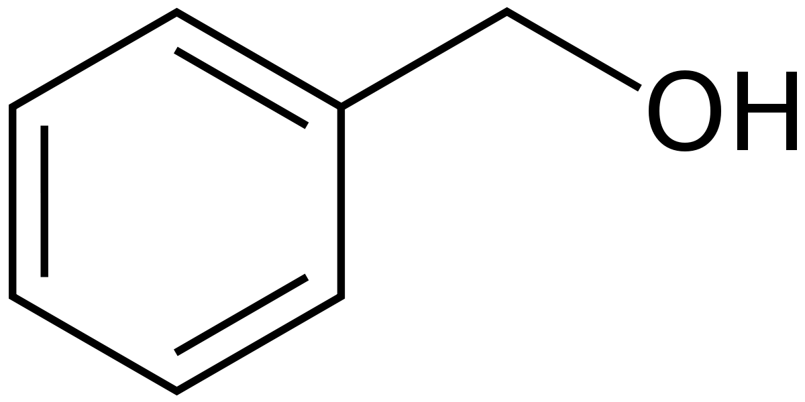
Benzoic acid
Propylene glycol
Non-aqueous water miscible solvents
Diazepam
Sod benzoate
Benzyl alcohol

Slide 10
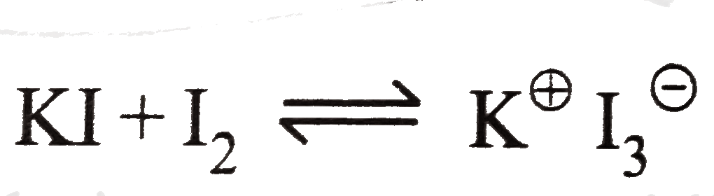
Correction of this incompatibility (go to lec1 in 1st course)
Alteration of the solvent used, for example use of alcohol instead of water.
Change in the form of ingredients, for example use of sodium phenobarbital (solubility 1g/1ml water) instead of phenobarbital (solubility 1g/1000ml water).
Alteration of the volume of prescription or solvent, as increase the volume of alcohol in elixir, or increase volume of water. In such correction the dose should increased.
Suspension formation using suspending agent
Addition of complexing agent such as addition of KI to dissolve I₂ in water.

Slide 11
Physical incompatibility
Precipitation: example of such incompatibility is salting out of camphor and volatile oils from aromatic waters when a salt is dissolved in the aromatic water.
Separation of immiscible liquids: example of this incompatibility, oils dissolved in alcohol are separated as a layer when water is added. This can be corrected or solved by using emulsifying agent and emulsion formation.
Liquefaction of solid ingredients: this incompatibility occur due to the formation of eutectic mixture, (https://youtu.be/Qy1X7tjWTHQ) e.g., when aspirin and aminopyrene are mixed, menthol and thymol, camphor and menthol. The prescription is corrected by adding light magnesium oxide or magnesium carbonate as adsorbent and diluent.
In other cases, physical incompatibility are corrected by
Addition or omission of therapeutically inactive substances.
Change the dosage form dispensed e.g., instead of solution formation, one can prepare solid dosage form as capsule or packets (aspirin is example of drug that can not be prepared as solution)

Slide 12
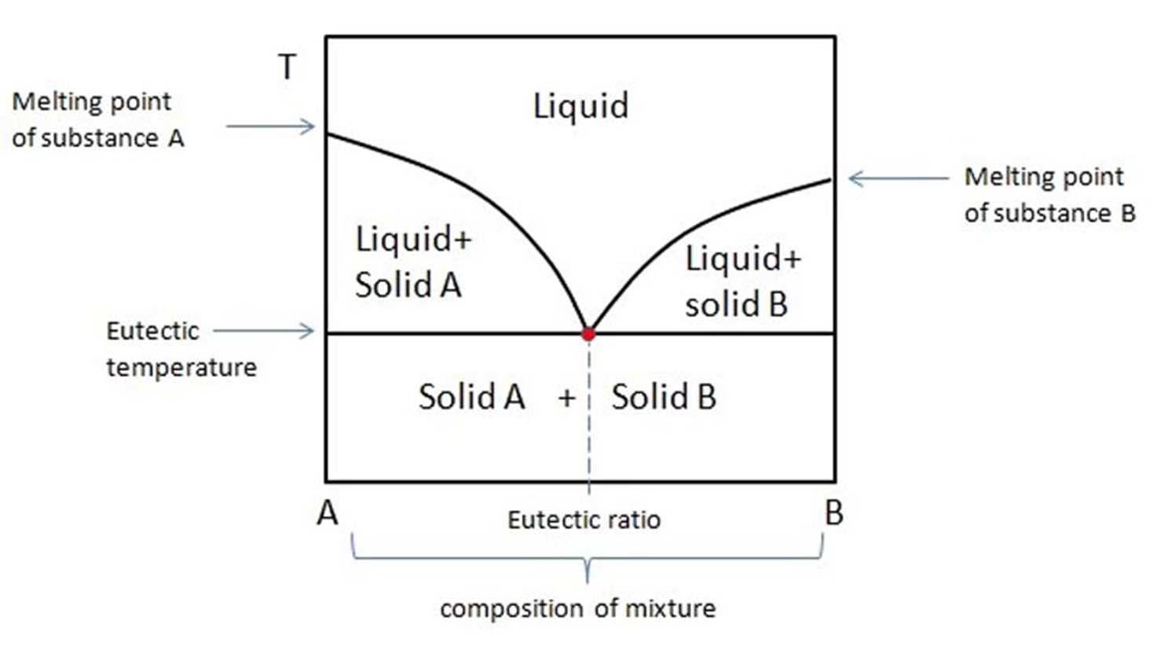
Eutectic diagram

Slide 13
pH effect in GIT
Gastric pH is between (1-3) in normal subjects
Administration of antacid, food and weak electrolytes will change the pH of the stomach
Weakly acidic drug unionized in the stomach are absorbed by passive diffusion
Increasing the pH of the stomach increasing ionization and reducing absorption (Tetracycline, Nalidixic acid , Nitrofurantoin, Benzyl pencillin , sulfonamides)
Increasing gastric pH may lead to enhance gastric emptying
This will be of advantage for acid labile drugs like levodopa

Slide 14
Chemical incompatibility
Chemical incompatibility usually occur as a result of chemical interaction among ingredients of the prescription.
The usual chemical incompatibility occur immediately upon compounding so called immediate incompatibility, are readily apparent due to effervescence, precipitation or color changes, etc. Sometimes chemical incompatibility may delayed and this type may or may not result in loss of therapeutic activity.

Slide 15
Types of chemical incompatibility
Oxidation: (it is the loss of electrons) certain prescription mixtures may be oxidized if exposed to air, excessive storage temperature, light, over dilution, incorrect pH adjustment or presence of catalysts like heavy metal ions as (Fe⁺³, Fe⁺², Cu⁺², Cr⁺³ ---) also the bacterial or mold enzymes.
examples:
Compounds undergo oxidation by heat, e.g., adrenalin, phenyl ephrine and dextrose.
Compounds undergo oxidation by light and catalysts, e.g., sulfacetamide eye drop, sulfonamide injection.
Compounds undergo auto-oxidation, e.g., oils and fats, phenolic substances, aldehydes and vitamins. They are sometimes used as antioxidant themselves.
What the management of these cases?

Slide 16
Types of chemical incompatibility
Reduction: (it is the gaining of electrons) it is less common in prescriptions although silver salts may be reduced by light to metallic form.
Racemization: the conversion of an optically active form (R or S isomer) to optically inactive form (racemic mixture, R and S) without changing the chemical composition. This usually produced pharmacological activity. Examples: adrenaline, dextroamphetamine. (what is chiral centre?)
Precipitation: when two or more pharmaceuticals are combined, a chemical change may take place with the formation of an insoluble substance which precipitate from solution.
Flocculent precipitation which develop several days after prescription is prepared may be due to delayed incompatibility, but more frequently are evidence of growth of yeast, mold, or bacteria. Such growth may be due to indirectly to a chemical incompatibility, if preservation system is inactivated by chemical reaction.

Slide 17
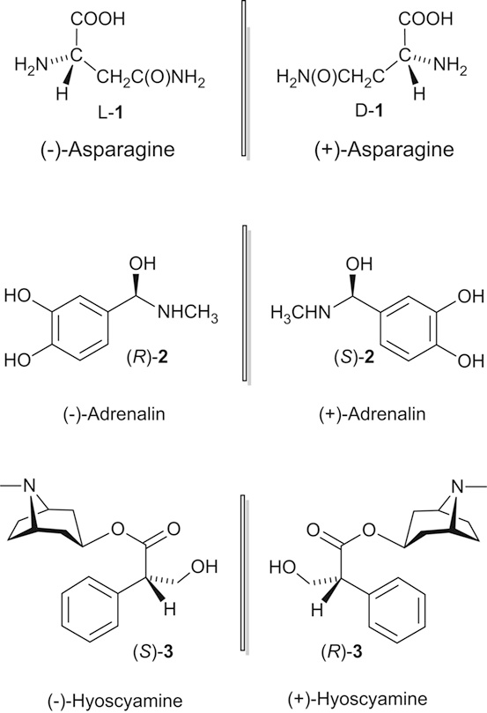
RACEMIZATION

Slide 18
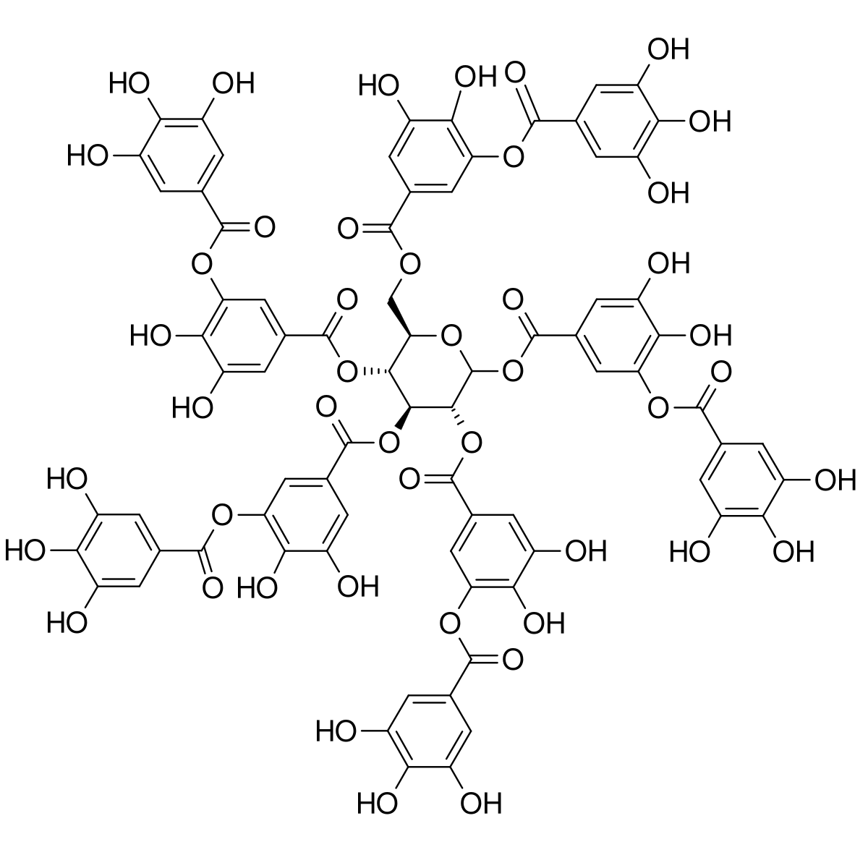
Types of chemical incompatibility
Alkaloids are precipitate in presence of tannins. Tannins are found in cardamon, hamamelis, cinchona, cinnamon and tea. So for poisoning with alkaloid we use tea in high concentration to precipitate alkaloid and prevent its absorption.
Iron salt is precipitate in presence of tannic acid, the precipitate is dark in color depending on the amount of tannic acid present.

Slide 19
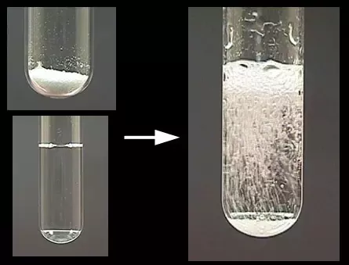
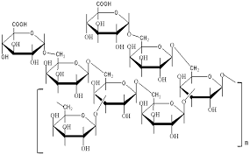
Types of chemical incompatibility
Evolution of a gas: a gas may be formed by a chemical reaction between ingredients. Examples are the effervescence caused by the liberation of CO2 from:
The reaction of carbonate and acids in aqueous media.
Decomposition of syrups of para-amino salicylic acid.
Gelatinization: sol may form a gel when combined with certain substances. Examples: acacia sol are gelatinized by ferric salts since acacia possesses hydroxyl groups which may be cross-linked by trivalent ferric ions to form cross-linked polymer chain.

Slide 20
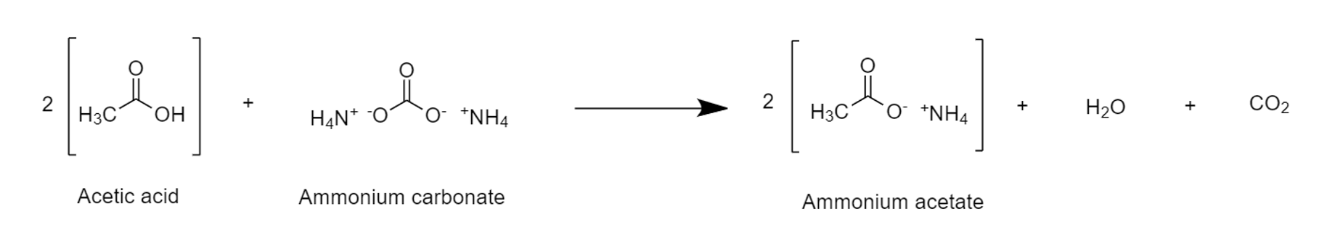
The following R_{x} have chemical incompatibility
R_{x1}
Ammonium carbonate or bicarbonate
Oxymel
Water
Incompatibility: formation of gas CO2 due to acid-base reaction. Since oxymel is weak acid due to acetic acid present in it. Oxymel is a combination of honey and acetic acid.
Correction: this problem can be solved by controlling the reaction during mixing, as using open container until a reaction stopped or finished.

Slide 21
R_{x2}
Sodium salicylate 5 gm
Syrup of lemon 20 ml
Water Q.S to 75 ml
Incompatibility: one of the component of syrup lemon is citric acid and this will convert sodium salicylate to salicylic acid, due to decrease the pH and salicylic acid has low solubility in water so it will precipitate.
Correction: to prevent this we use Tr. of lemon with simple syrup instead of syrup of lemon or we change the syrup to suspension using suspending agent.
Other examples:
1- precipitation of barbituric acid from its salt solution in presence of acid or any preparation containing acid like syrup glycerophosphate.
2. Sulphacetamide sodium eye drop is salt of weak acid and precipitate in acidic media forming free acid.

Slide 22
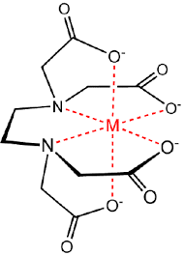
Chelation (complexation)
The term chelation derived from the Greek chele meaning lobster’s claw referring to the interaction between a metal atom or ion and another species known as a ligand
Chelation changes the physical and chemical characteristics of both the metal ion and the ligand
These complexes are too large to penetrate the cell membrane,
activity of the drug may be reduced
Act as a reservoir of drug to prolong drug release
Reduced irritancy and improve stability (Povidone iodine)

Slide 23
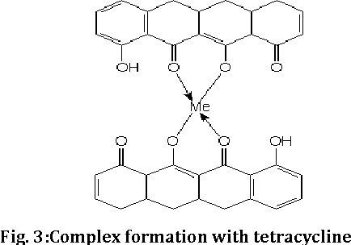
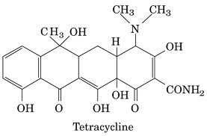
Chelation
Tetracyclines
Polyvalent cations such as Fe and Mg , Calcium , Al, and anions such as phosphate interfere with the absorption of tetracycline's
Tetracycline is responsible teeth discoloration or bone deformation in growing babies

Slide 24
Therapeutic incompatibility
Therapeutic incompatibility may occur in:
an over dose or improper dose of single drug e.g., the infant take 125 mg antibiotic while children and adult should take 250 mg; or higher dose 500 mg for adult, so we should not give the adult dose to the infant. Also Tetracycline may precipitate in the teeth causing a discoloration, so should not give this antibiotic for children under 8 years old.
As an additive combination of two drugs
As an antagonist combination of two drugs
Prescribing wrong drug.
Contraindicated drug.
Adverse drug reaction.

Slide 25


