Slide 1

AL-Mustaqbal university college
Pharmacy department
Pharmaceutical calculation
Ghada Ali PhD candidate
Dhelal Fouad Mohammed
ghada.ali@mustaqbal-college.edu.iq
dhilal.foad@mustaqbal-college.edu.iq

Slide 2
Isotonic and buffer solutions
Lec 2

Slide 3
When a solvent passes through a semipermeable membrane from a dilute solution into a more concentrated one, the concentrations become equalized and the phenomenon is known as osmosis. The pressure responsible for this phenomenon is termed osmotic pressure and varies with the nature of the solute.
If the solute is a nonelectrolyte, its solution contains only molecules and the osmotic pressure varies with the concentration of the solute. If the solute is an electrolyte, its solution contains ions and the osmotic pressure varies with both the concentration of the solute and its degree of dissociation. Thus, solutes that dissociate present a greater number of particles in solution and exert a greater osmotic pressure than undissociated molecules

Slide 4
Like osmotic pressure, the other colligative properties of solutions, vapor pressure, boiling point, and freezing point, depend on the number of particles in solution. Therefore, these properties are interrelated and a change in any one of them will result in a corresponding change in the others.
Two solutions that have the same osmotic pressure are termed isosmotic. Many solutions intended to be mixed with body fluids are designed to have the same osmotic pressure for greater patient comfort, efficacy, and safety. A solution having the same osmotic pressure as a
specific body fluid is termed isotonic (meaning of equal tone) with that specific body fluid

Slide 5
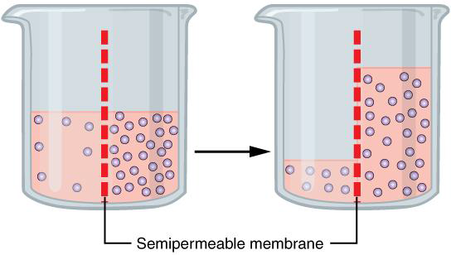
Osmosis
Osmosis:
2 solutions of different concentrations are separated by a semi-permeable membrane (only permeable to the solvent) the solvent will move from the solution of lower conc. to that of higher conc

Slide 6
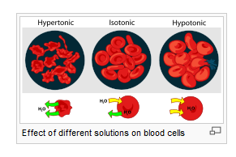
Types of Tonicity
Solutions of lower osmotic pressure than that of a body fluid are termed hypotonic, whereas those having a higher osmotic pressure are termed hypertonic. Pharmaceutical dosage forms intended to be added directly to the blood or mixed with biological fluids of the eye, nose, and bowel are of principal concern to the pharmacist in their preparation and clinical application
The calculations involved in preparing isotonic solutions may be made in terms of data relating to the colligative properties of solutions

Slide 7
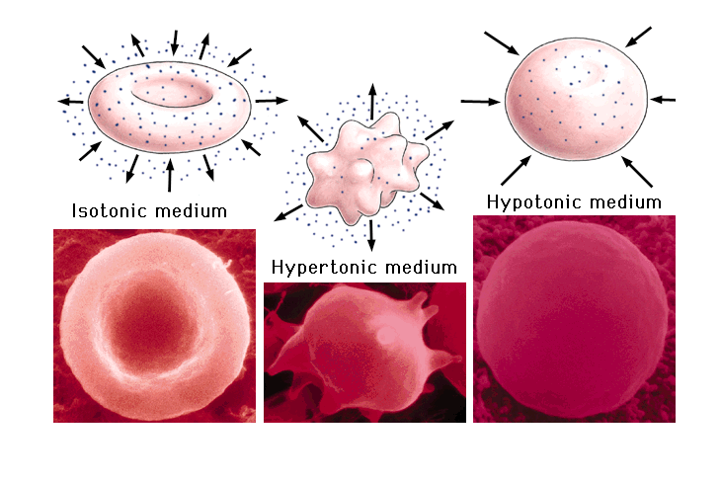

Slide 8
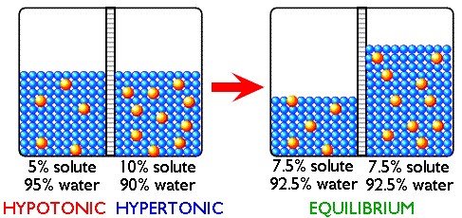

Slide 9
Why using isotonic solutions?

Slide 10
Isotonicity & Route of Administration
Subcutaneous injection:
    not necessarily “small dose” but isotonicity reduce pain.
Hypodermoclysis
    should be isotonic “Large volume”
Intramuscular injection
    should be isotonic or slightly hypertonic to increase penetration
Intravenous injection
    should be isotonic “Large volume ”
    Hypotonic cause haemolysis
    Hypertonic solution may be administered slowly into a vein
    Hypertonic large volume administered through a cannula into large vessels.
Notes:
subcutaneous infusion, is the subcutaneous administration of fluids to the body. This would often be in the form of a saline or glucose solution

Slide 11
Isotonicity & Route of Administration
Intrathecal injestion
      Should be isotonic
Eye drops
      Rapid diluted by tear, but most of it is isotonic to decrease irritation
Eye lotions
      Preferably isotonic
Nasal drops
      Isotonic, but not essentially

Slide 12
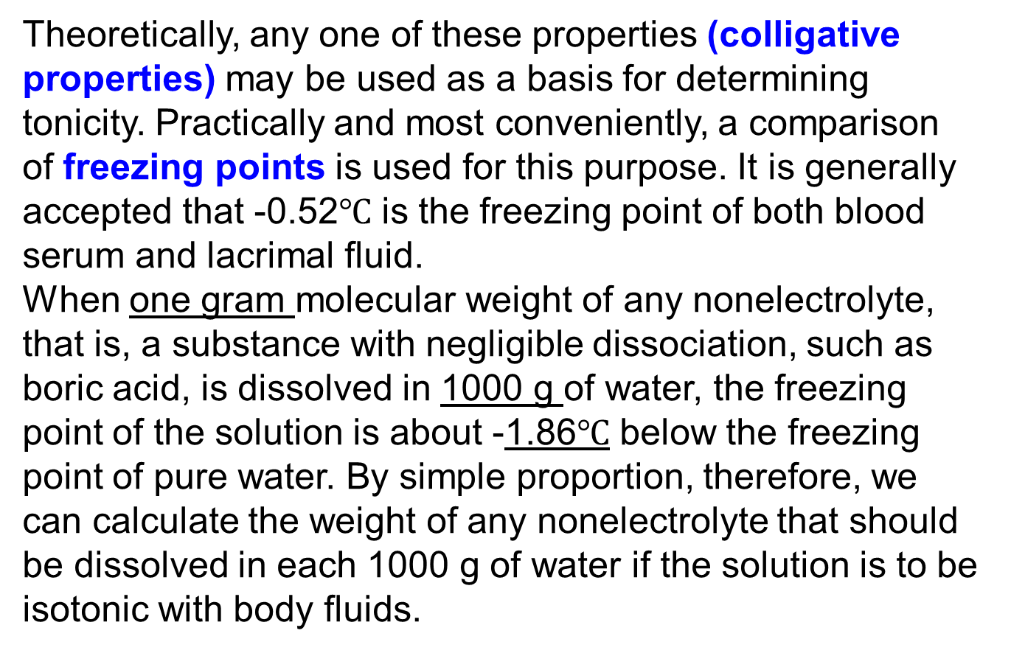
Theoretically, any one of these properties (colligative properties) may be used as a basis for determining tonicity. Practically and most conveniently, a comparison of freezing points is used for this purpose. It is generally accepted that -0.52$℃$ is the freezing point of both blood serum and lacrimal fluid.
When one gram molecular weight of any nonelectrolyte, that is, a substance with negligible dissociation, such as boric acid, is dissolved in 1000 g of water, the freezing point of the solution is about -1.86$℃$ below the freezing point of pure water. By simple proportion, therefore, we can calculate the weight of any nonelectrolyte that should be dissolved in each 1000 g of water if the solution is to be isotonic with body fluids.

Slide 13

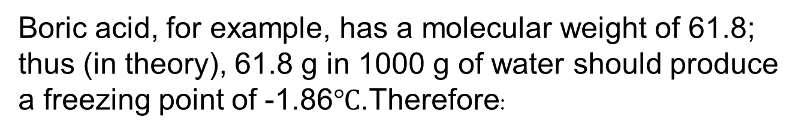
Boric acid, for example, has a molecular weight of 61.8; thus (in theory), 61.8 g in 1000 g of water should produce a freezing point of -1.86$℃$.Therefore:
In short, 17.3 g of boric acid in 1000 g of water, having a weight-in-volume strength of approximately 1.73%, should make a solution isotonic with lacrimal fluid.

Slide 14
With electrolytes, the problem is not so simple. Because osmotic pressure depends more on the number than on the kind of particles, substances that dissociate have a tonic effect that increases with the degree of dissociation; the greater the dissociation, the smaller the quantity required to produce any given osmotic pressure. If we assume that sodium chloride in weak solutions is about 80% dissociated, then each 100 molecules yields 180 particles, or 1.8 times as many particles as are yielded by 100 molecules of a nonelectrolyte. This dissociation factor,
commonly symbolized by the letter i, must be included in the proportion when we seek to determine the strength of an isotonic solution of sodium chloride (m.w. 58.5):

Slide 15
Hence, 9.09 g of sodium chloride in 1000 g of water should make a solution isotonic with blood or lacrimal fluid. In practice, a 0.90% w/v sodium chloride solution is considered isotonic with body fluids. Simple isotonic solutions may then be calculated by using this formula
The value of i for many a medicinal salt has not been experimentally determined. Some salts (such as zinc sulfate, with only some 40% dissociation and an i value therefore of 1.4) are exceptional, but most medicinal salts approximate the dissociation of sodium chloride in weak
solutions. If the number of ions is known, we may use the following values, lacking better information:

Slide 16
Nonelectrolytes and substances of slight dissociation1.0
Substances that dissociate into 2 ions: 1.8
Substances that dissociate into 3 ions: 2.6
Substances that dissociate into 4 ions: 3.4
Substances that dissociate into 5 ions: 4.2
The procedure for the calculation of isotonic solutions with sodium chloride equivalents may be
outlined as follows:

Slide 17
Step 1. Calculate the amount (in grams) of sodium chloride represented by the ingredients in
the prescription. Multiply the amount (in grams) of each substance by its sodium chloride equivalent.
Step 2. Calculate the amount (in grams) of sodium chloride, alone, that would be contained in an isotonic solution of the volume specified in the prescription, namely, the amount of sodium chloride in a 0.9% solution of the specified volume. (Such a solution would contain 0.009 g/mL.)

Slide 18
Step 3. Subtract the amount of sodium chloride represented by the ingredients in the prescription
(Step 1) from the amount of sodium chloride, alone, that would be represented in the specific
volume of an isotonic solution (Step 2). The answer represents the amount (in grams) of sodium
chloride to be added to make the solution isotonic.
Step 4. If an agent other than sodium chloride, such as boric acid, dextrose, or potassium nitrate,
is to be used to make a solution isotonic, divide the amount of sodium chloride (Step 3) by
the sodium chloride equivalent of the other substance.

Slide 19
Example Calculations of the i Factor
Zinc sulfate is a 2-ion electrolyte, dissociating 40% in a certain concentration. Calculate its dissociation (i) factor.
On the basis of 40% dissociation, 100 particles of zinc sulfate will yield:
Because 140 particles represent 1.4 times as many particles as were present before dissociation,
the dissociation (i) factor is 1.4, answer

Slide 20
Zinc chloride is a 3-ion electrolyte, dissociating 80% in a certain concentration. Calculate its dissociation
(i) factor.
On the basis of 80% dissociation, 100 particles of zinc chloride will yield:
Because 260 particles represents 2.6 times as many particles as were present before dissociation,
the dissociation (i) factor is 2.6, answer.

Slide 21

Example Calculations of the Sodium Chloride Equivalent
The sodium chloride equivalent of a substance may be calculated as follows:
Papaverine hydrochloride (m.w. 376) is a 2-ion electrolyte, dissociating 80% in a given concentration.
Calculate its sodium chloride equivalent.
Because papaverine hydrochloride is a 2-ion electrolyte, dissociating 80%, its i factor is 1.8.

Slide 22
Calculate the sodium chloride equivalent for glycerin, a nonelectrolyte with a molecular weight of 92.2
Glycerin, i factor 1.0

Slide 23
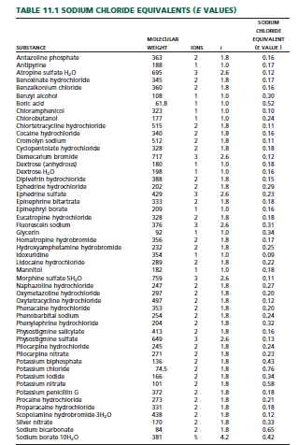
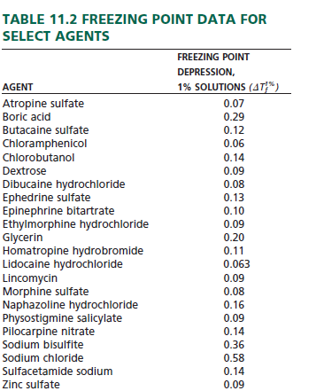

Slide 24

Example Calculations of Tonicic Agent Required
How many grams of sodium chloride should be used in compounding the following prescription?
Step 1. 0.23 x 0.3 g = 0.069 g of sodium chloride represented by the pilocarpine nitrate
Step 2. 30 x 0.009= 0.270 g of sodium chloride in 30 mL of an isotonic sodium chloride solution
Step 3. 0.270 g (from Step 2) -0.069 g (from Step 1)
=0.201 g of sodium chloride to be used, answer.

Slide 25

Example Calculations Using Freezing Point Data
How many milligrams each of sodium chloride and dibucaine hydrochloride are required to prepare 30 mL of a 1% solution of dibucaine hydrochloride isotonic with tears?
To make this solution isotonic, the freezing point must be lowered to -0.52. From Table
it is determined that a 1% solution of dibucaine hydrochloride has a freezing point lowering of 0.08. Thus, sufficient sodium chloride must be added to lower the freezing point an additional 0.44 (0.52 - 0.08).
Also from Table it is determined that a 1% solution of sodium chloride lowers the freezing point by 0.58. By proportion

Slide 26
x = 0.76% (the concentration of sodium chloride
needed to lower the freezing point by 0.44,
required to make the solution isotonic
Thus, to make 30 mL of solution,
30 mL x 1%= 0.3 g= 300 mg dibucaine hydrochloride, and
30 mL x 0.76% = 0.228 g= 228 mg sodium chloride, answers

Slide 27


