Slide 1
practical Lecture RF coils
Third stage
Dr. safa hasan mohammed
Almustaqbal university college

Slide 2
RF Coils
The radiofrequency (RF) system comprises the set of components for transmitting and receiving the radiofrequency waves involved in exciting the nuclei, selecting slices, applying gradients and in signal acquisition.
Coils are a vital component in the performance of the radiofrequency system (figure 1 shows RF coils.

Slide 3
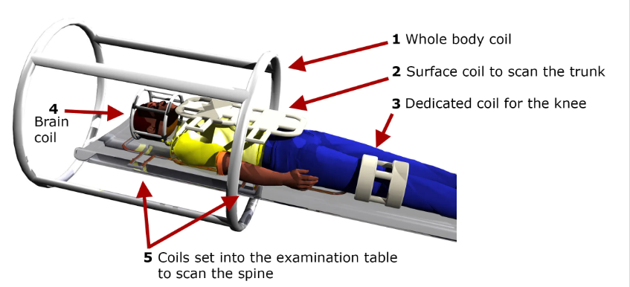
RF Coils
Figure1: RF coils.

Slide 4
RF Coils
RF coils are made for either:
Receive only.
Transmit only.
Transmit and receive

Slide 5
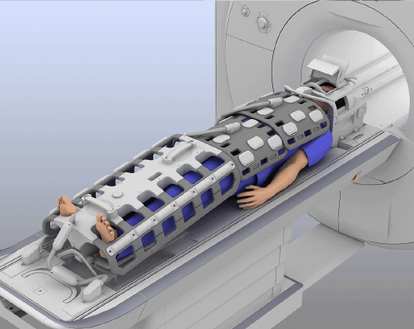
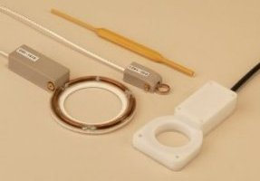
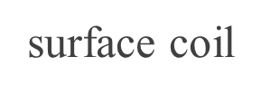
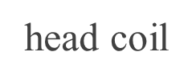
RF Coils
It should be close to the imaging part. Types of RF coils includes (Figure 2).

Slide 6
RF Coils
Figure2: (A) Body coil, (B) Knee coil, (C) Head and shoulder coil, and (D) Head coil

Slide 7
Sending and Receiving Coils
The sending coil of an MRI system is usually built into the bore of the magnet (Figure 3).
Figure 3: (a); The radio-frequency (RF) coil for sending is usually located within the bore of the magnet, while the RF coil for receiving is located on the patient table.
(b); a set of RF “surface coils” for imaging various body parts. (Courtesy of Siemens Medical Systems.)

Slide 8
RF transmit coils
To stimulate the MR spin system, an RF-coil must produce a time-varying excitation field B1(t) with the following characteristics: ✔ B1(t) must have components that rotate near the resonant frequency (ωo), and ✔ B1(t) must have components perpendicular to the static magnetic field (Bo)

Slide 9
RF transmit coils
The simplest form of such an RF-transmit coil is a single loop oriented at right angles to the main magnetic field (see figure in next slide). By driving a sinusoidal alternating current through this loop at the Larmor frequency, an oscillating magnetic field perpendicular to Bo isproduced. Somewhat more sophisticated variations of this coil can be easily imagined, such as 2-loop (Helmholz) or multi-loop (solenoid) configurations.

Slide 10
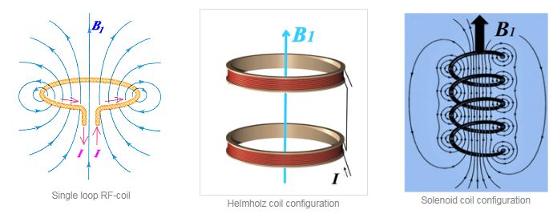
RF transmit coils

Slide 11
RF transmit coils
Because they generate an oscillating B1 field in only a single dimension, single-loop, Helmholz, and solenoid RF-coils are called linearly polarized (LP). Although not immediately obvious, this configuration is highly inefficient for MRI in that half of the transmitted power is wasted.

Slide 12
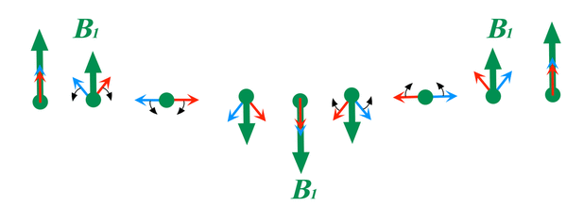
Linear polarization
a field like B1 (depicted as a big green arrow) oscillating at the resonance frequency (ωo)
decomposed into two counter rotating subfields (red and blue arrows), each half as large.
One of these subfields (red arrow) rotates in the same direction and frequency (ωo) as the spins undergoing MR; the other subfield (blue arrow) rotates in the opposite direction and frequency (−ωo).
Only the subfield associated with red arrow is effective at inducing net nuclear transitions and a change in net nuclear magnetization required for MRI.
Figure shows a linearly oscillating B1 field (green arrow) can be considered the sum of two fields half as large (red and blue arrows) rotating in opposite directions. The blue subfield rotates opposite the spin system and is inefficient/wasted.

Slide 13
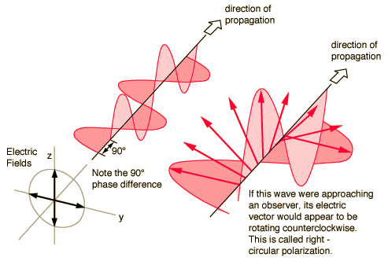
Circular Polarization
Circular polarization: the electric field of the electromagnetic wave consists of two linear components that are perpendicular to each other, equal in amplitude, but have a phase difference of π/2. The resulting electric field rotates in a circle around the direction of propagation and, depending on the rotation direction, is called left- or right-hand circularly polarized wave

Slide 14
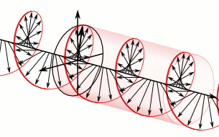
Circular Polarization
Figure 4: circular polarization; circular polarization of an electromagnetic wave is a polarization state in which, at each point, the electromagnetic field of the wave has a constant magnitude but its direction rotates at a constant rate in a plane perpendicular to the direction of the wave.

Slide 15
Linear and circular polarization
The electric field of linearly polarized light is confined to the y-z plane (left) and the x-z plane (right), along the direction of propagation.
the electric field of linearly polarized light (left) consists of two perpendicular, equal in amplitude, linear components that have no phase difference. The resultant electric field wave propagates along the y = x plane. The electric field of circularly polarized light (right) consists of two perpendicular, equal in amplitude, linear components that have a phase difference of π/2 or 90°. The resultant electric field wave propagates circularly.

Slide 16
Linear and circular polarization

Slide 17
Discussion
What is circular polarization?
What is the difference between linear polarization and circular polarization?
What are the types of RF coils according to imaging part?

Slide 18
Thank you

