Slide 1
practical Lecture Relaxation, T1 Relaxation and T2 Relaxation
Third stage
Dr. safa hasan mohammed
Almustaqbal university college

Slide 2
relaxation
The relaxation means the return of a perturbed system into the original situation "equilibrium" and each relaxation process can be characterization by a relaxation time. The relaxation process can be divided into two parts: T1 and T2 relaxation.

Slide 3
T1 Relaxation
T1 relaxation describes what happens in the Z direction.
T1 is spin-lattice relaxation time which relates to the recovery of the magnetization along z direction after RF pulse.
We can say that this as the time it takes tissue to recover from an RF pulse so you can give another pulse and still get signal.
T1 is called the spin-lattice relaxation time because it refers to the time it takes for the spins to give the energy they obtained from the RF pulse back to the surrounding tissue (lattice) in order to go back to their equilibrium state.

Slide 4
T1 Relaxation
after a little while, the situation is exactly as before we sent an RF pulse into the patient.
the RF pulse is turned off. Therefore, after the RF pulse is turned off, two things will occur:
1. The spins will go back to the lowest energy state.
2. The spins will get out of phase with each other.

Slide 5
T1 Relaxation
The Protons are return to its original situation "equilibrium" by the releasing the absorbed energy in the form of "very little" warmth and RF waves.
That means, in principle the net magnetization rotates back to align itself with the Z-axis.
After the stops of the RF excitation pulse, the net magnetization will re-grow along the Z-axis, while emitting radio-frequency waves,.

Slide 6
T1 Relaxation
Figure 1: The net magnetization will re-grow along the Z-axis after the stops of the RF excitation pulse

Slide 7
T1 Relaxation
The recovery of MZ versus time is given by the relation:
MZ (t) = Mo(1${\text{−}e}^{−t/T1}$)
where, MZ is the longitudinal magnetization that recovers after a time t, with relaxation constant T1.
When t = T1, then 1-$e^{−1}$= 0.63 and MZ = 0.63 Mo.
Full longitudinal recovery depends on the T1 time constant. Time equal to 3 × T1, after 90° pulse, 95% of the equilibrium magnetization is established. It takes 5 × T1 time, to return back to the full magnetization.

Slide 8
T1 Relaxation
T1 relaxation is a time constant.
T1 is defined as the time it takes for the longitudinal magnetization (MZ) to reach 63 % of the original magnetization.
Figure 2: Spin-lattice relaxation time. Longitudinal magnetization
undergoes exponential growth with time. T1 corresponds to the time, that have 63% growth of Mz

Slide 9
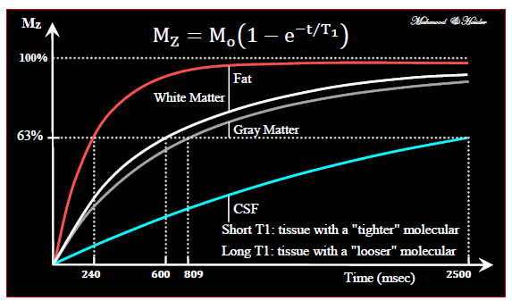
T1 Relaxation
T1 relaxation happens to the protons in the volume that experienced the 90o-excitation pulse. However, not all the protons are bound in their molecules in the same way. This is different for each tissue. One 1H atom may be bound very tight, such as in fat tissue, while the other has a much looser bond, such as in water. Tightly bound protons will release their energy much quicker to their surroundings than protons, which are bound loosely. The rate at which they release their energy is therefore different. The rate of T1 relaxation can be depicted as shown in Figure 3.
Figure 3: Example T1 curves for four tissues found in the head.

Slide 10
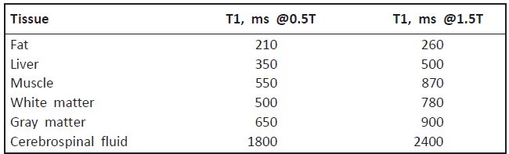
T1 Relaxation
Table 1. Variation of T1 time with magnetic field strength, for various biological tissues

Slide 11
T2 Relaxation
T2 relaxation describes what happens in the X-Y plane.
right after the 90o RF pulse the net magnetization vector (now called transverse magnetization) is rotating in the X-Y plane around the Z-axis at the Larmor frequency (figure 4).
transverse magnetization formed by tilting the longitudinal magnetization into the transverse plane by using a radiofrequency pulse.
The transverse magnetization induces an MR signal in the radiofrequency coil immediately after its formation, it has a maximum magnitude, and all of the protons are in phase.

Slide 12
T2 Relaxation
Therefore the vectors all point in the same direction because they are in-Phase.
The transverse magnetization starts decreasing in magnitude immediately as protons start going out of phase. This process of de-phasing and reduction in the amount of transverse magnetization is called transverse relaxation.
It is the time taken to reduce the transverse magnetization vector to 37% of the peak value (figure 5).

Slide 13
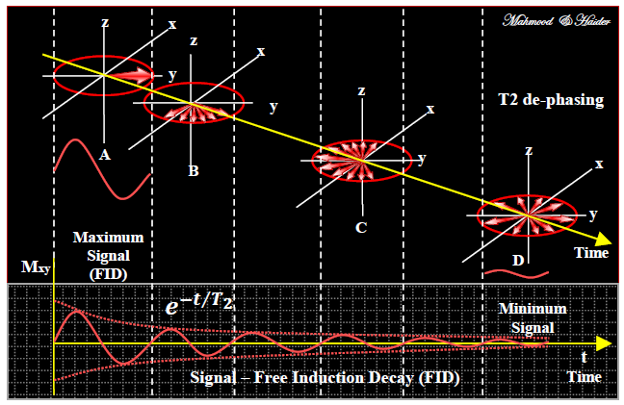
T2 Relaxation
Figure 4: De-phasing and free induction decay (FID).

Slide 14
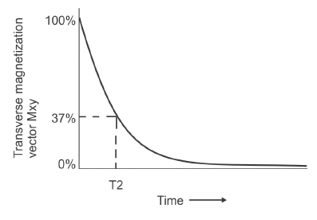
T2 Relaxation
The transverse and equilibrium vector is given by the relation,
MXY(t) = Mo$e^{−t/T2}$
time representing the decay of the signal by 1/e, or 37%, is called the T2 relaxation time. 1/T2 is referred to as the transverse relaxation rate. This process of getting from a total in-phase situation to a total out-of-phase situation is called T2 relaxation.
Figure 4 : Spin-spin relaxation: Transverse magnetization undergoes exponential decay.T2 corresponds to time that have 37% of Mxy

Slide 15
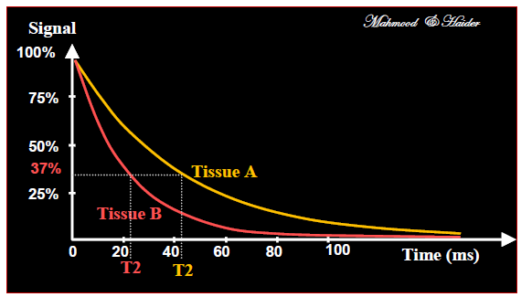
T2 Relaxation
The rate of de-phasing is different for each tissue. Fat tissue will de-phase quickly, while water will de-phase much slower (figure 6).
Figure 6: Transverse magnetization decay (T2)

Slide 16
Remarks
T2: it happens much faster than T1 relaxation.
T2 relaxation happens in tens of milliseconds, while T1 can take up to seconds.
T2 relaxation is also called spin–spin relaxation because it describes interactions between protons in their immediate surroundings (molecules).

Slide 17
T2* Relaxation Time
Extrinsic magnetic inhomogeneities make loss of phase coherence more rapidly than from spin-spin interactions. When external magnet’s (Bo)
inhomogeneity is considered, the spin-spin decay constant T2 is reduced to T2* (figure 7).
The T2* depends on the homogeneity of the main magnetic field and presence of susceptibility agents (contrast material) in the tissue.

Slide 18
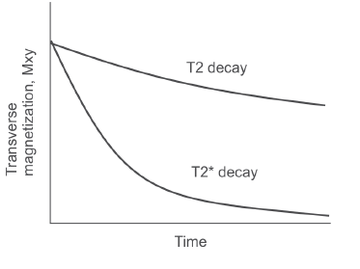
T2* Relaxation Time
Figure 6: T2 decays with intrinsic magnetic in-homogeneities and T2* decays with both intrinsic and extrinsic magnetic inhomogeneities

Slide 19
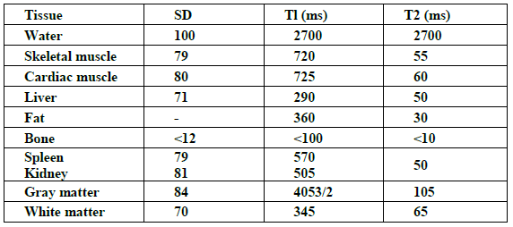
Table 2: Approximate spin density (SD) and relaxation times (Tl, T2) for various tissues.

Slide 20
Discussion
Q1: What are T1 and T2?
Q2: why T1 is called spin-lattice relaxation?
Q3: Why T2 is called spin- spin relaxation ?
Q4: What is the reason that the T1 are different from tissue to another?
Q5: Why T1 for fat is shorter that T1 for water?
Q6: why T1 increases with increasing magnetic field

Slide 21
Thank you

