Slide 1
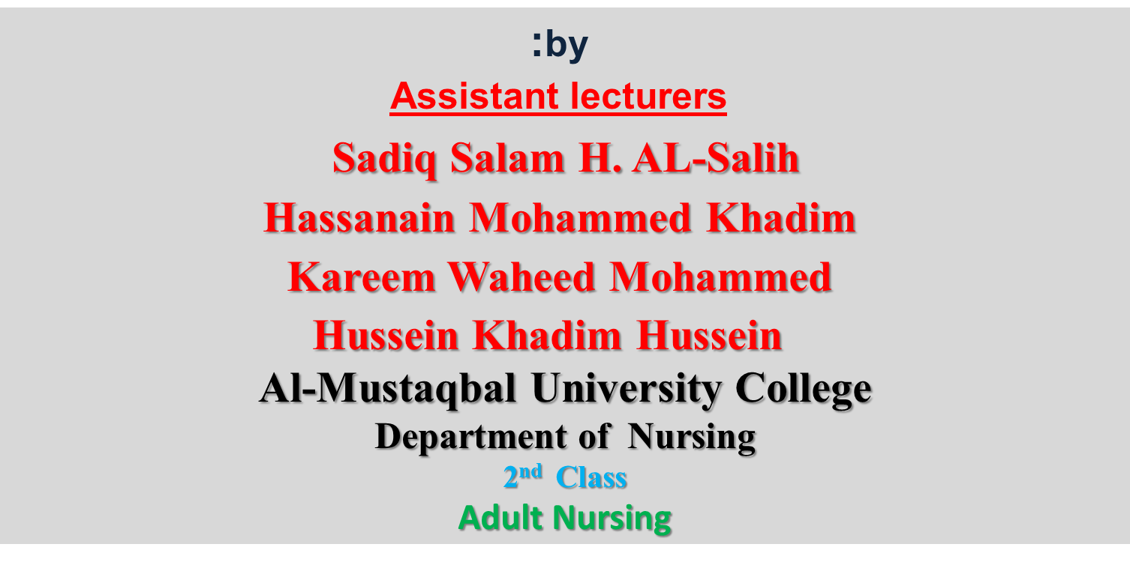
Lecture - 14 - Valvular Disease Of The Heart

Slide 2
Definition:
The function of normal heart valves is to maintain the forward flow of blood from the atria to the ventricles and from the ventricles to the great vessels.
Valvular damage may interfere with valvular function by stenosis or by impaired closure that allows backward leakage of blood (valvular insufficiency, regurgitation, or incompetence).

Slide 3
Valvular Disorders
Mitral stenosis
Mitral regurgitation
Mitral valve prolapse
Aortic stenosis
Aortic regurgitation

Slide 5
Mitral Stenosis
Most common cause: rheumatic fever
Results from rheumatic carditis
Causing valve thickening by fibrosis and calcification
Non-rheumatic causes
Atrial tumor
Calcium accumulation

Slide 6
Diagnostics
Echocardiogram
Chest X ray
EKG
Cardiac catheterization

Slide 7
Clinical Manifestations
Mild stenosis
Asymptomatic
Beginning
Dyspnea on exertion (DOE)
Orthopnea
Paroxysmal nocturnal dyspnea (PND)
Dry cough
Later
Hemoptysis(Cough with Blood)
Pulmonary edema
Right-sided heart failure
Hepatomegaly (Enlargement of the liver)
Neck vein distention (JVD)
Pitting edema
Apical diastolic murmur

Slide 8
Mitral Regurgitation
Mitral Regurgitation (Insufficiency)
Fibrotic and calcific changes prevent the mitral valve from closing completely during systole.
End result left atrial and ventricular dilation and hypertrophy.
Causes
Rheumatic heart disease
Degenerative calcification
Left ventricular hypertrophy
MI
Congenital defects

Slide 9
Clinical Manifestations
Progresses slowly
Asymptomatic for decades
Chief complaints
Fatigue
Chronic weakness
DOE
Orthopnea
Normal blood pressure
Atrial fibrillation (75% of all clients).
Changes in respiratory patterns
High pitched systolic murmur at apex
Third heart sound (S3 or S4)

Slide 10
Surgical management
Valve replacements
Prosthetic
Biologic
Surgical repairs
Balloon valvuloplasty –cath lab
Reconstructive or “Valvuloplasty”:
a. Open commissurotomy
b. Annuloplasty repairs

Slide 11
Pre-Operative Care
Similar to CABG surgery
Pain
Incisional care
Prevent pulmonary complications
- STOP oral anticoagulants 72 hours before procedure
Post-Operative Care
Respiratory care
Monitor for hemorrhage
Cardiac output reduction
Discharge teaching

Slide 12
Complications
Fluid & Electrolyte imbalances
Hypotension
Bleeding
Cardiac tamponade
Altered cerebral perfusion
Hypothermia
Hypertension
Infection

Slide 13
Client Education
Disease process
Medications
Anticoagulants
Prophylactic antibiotics
Rest and activity plan

