Slide 1
Diseases of esophagus
Esophageal cancer
Lab. 8

Slide 2
Esophageal cancer
Esophageal cancer is cancer that occurs in the esophagus — a long, hollow tube that runs from your throat to your stomach. Your esophagus helps move the food you swallow from the back of your throat to your stomach to be digested.
Esophageal cancer usually begins in the cells that line the inside of the esophagus. Esophageal cancer can occur anywhere along the esophagus. More men than women get esophageal cancer.
Esophageal cancer is the sixth most common cause of cancer deaths worldwide.

Slide 3
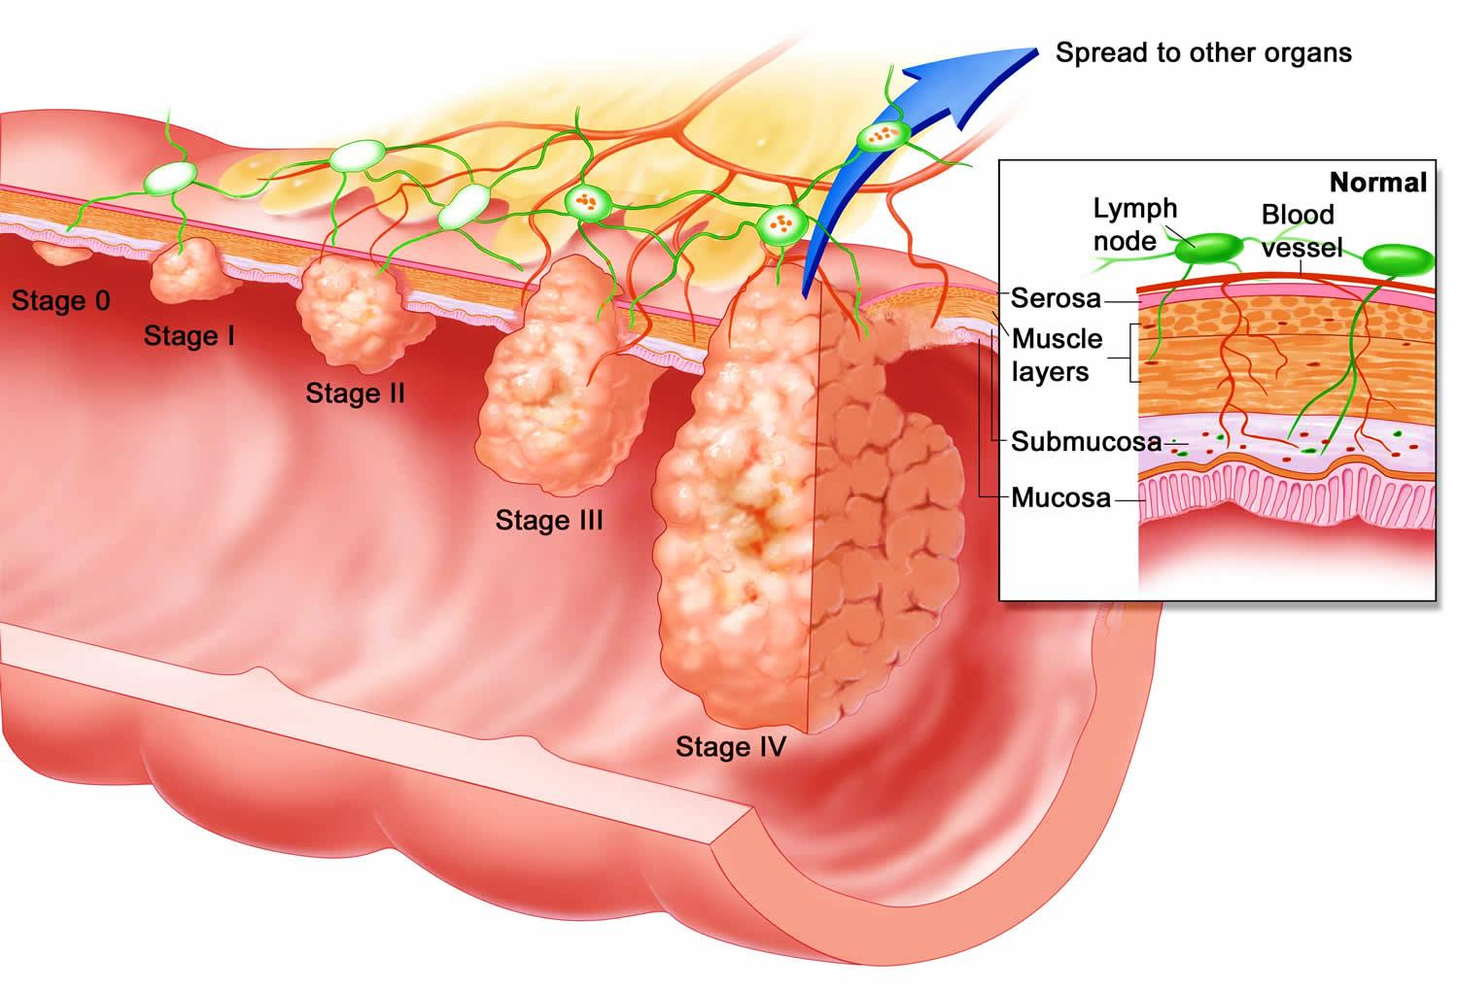

Slide 4
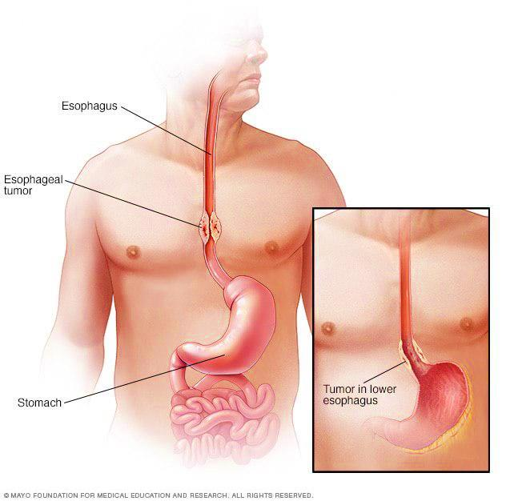

Slide 5
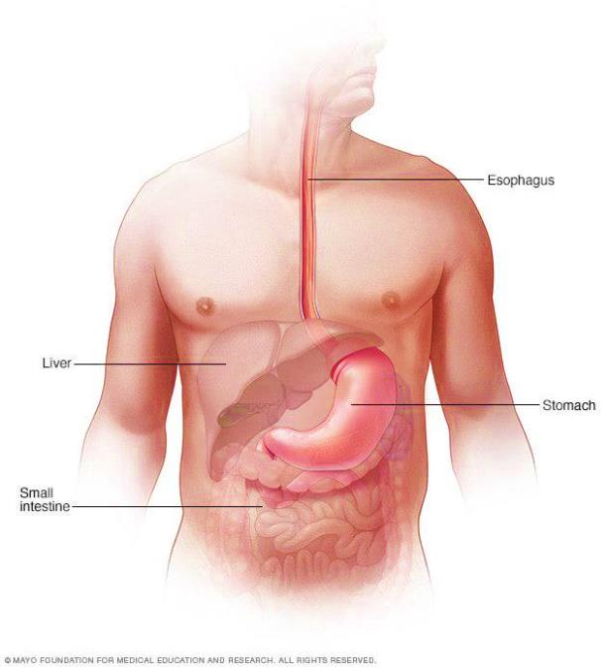
Symptoms
Difficulty swallowing (dysphagia)
Weight loss without trying
Chest pain, pressure or burning
Worsening indigestion or heartburn
Coughing or hoarseness
Early esophageal cancer typically causes no signs or symptoms.

Slide 6
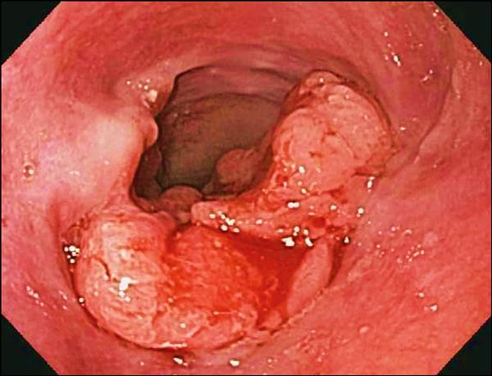
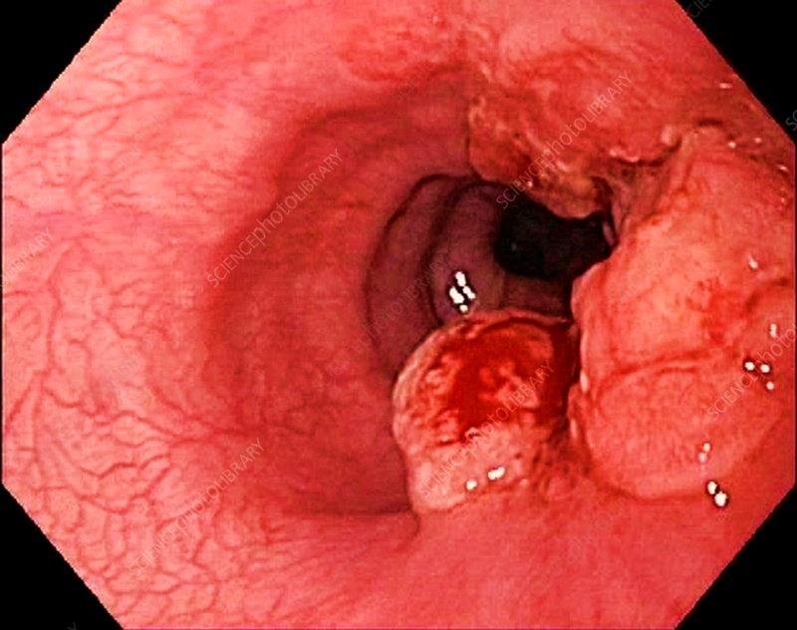
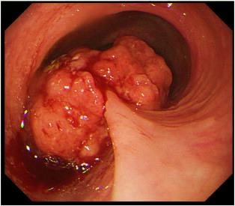

Slide 7
Causes
It's not exactly clear what causes esophageal cancer.
Esophageal cancer occurs when cells in your esophagus develop errors (mutations) in their DNA. The errors make cells grow and divide out of control. The accumulating abnormal cells form a tumor in the esophagus that can grow to invade nearby structures and spread to other parts of the body.

Slide 8
Types of esophageal cancer
Esophageal cancer is classified according to the type of cells that are involved.
Adenocarcinoma. Adenocarcinoma begins in the cells of mucus-secreting glands in the esophagus. Adenocarcinoma occurs most often in the lower portion of the esophagus. Adenocarcinoma is the most common form of esophageal cancer in the United States, and it affects primarily white men.
Squamous cell carcinoma. The squamous cells are flat, thin cells that line the surface of the esophagus. Squamous cell carcinoma occurs most often in the upper and middle portions of the esophagus. Squamous cell carcinoma is the most prevalent esophageal cancer worldwide.

Slide 9
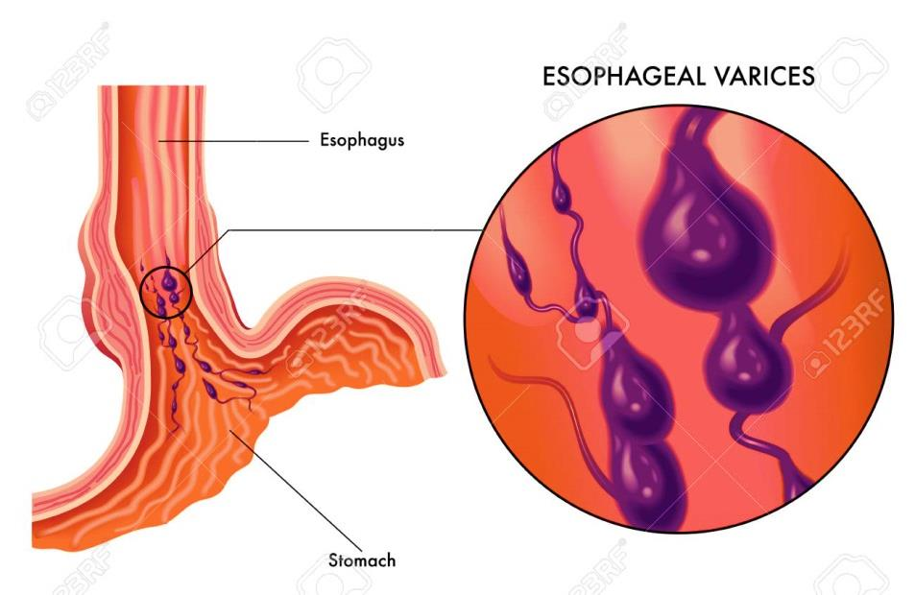
Types of esophageal cancer
3. Other rare types. Some rare forms of esophageal cancer include small cell carcinoma, sarcoma, lymphoma, melanoma and choriocarcinoma.

Slide 10
Risk factors
Having gastroesophageal reflux disease (GERD)
Smoking
Having precancerous changes in the cells of the esophagus (Barrett's esophagus)
Drinking alcohol
Having bile reflux
Having a steady habit of drinking very hot liquids
Not eating enough fruits and vegetables
Undergoing radiation treatment to the chest or upper abdomen

Slide 11
Complications
As esophageal cancer advances, it can cause complications, such as:
Obstruction of the esophagus. Cancer may make it difficult or impossible for food and liquid to pass through your esophagus.
Pain. Advanced esophageal cancer can cause pain.
Bleeding in the esophagus. Esophageal cancer can cause bleeding. Though bleeding is usually gradual, it can be sudden and severe at times.

Slide 12

THANK YOU

