Slide 1
Chest auscultation
Dr Mohammed sami

Slide 2
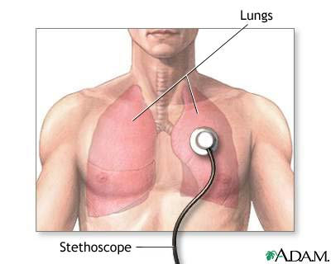
Listening to lung sounds
How?
Where?
What are you listening for ?

Slide 3
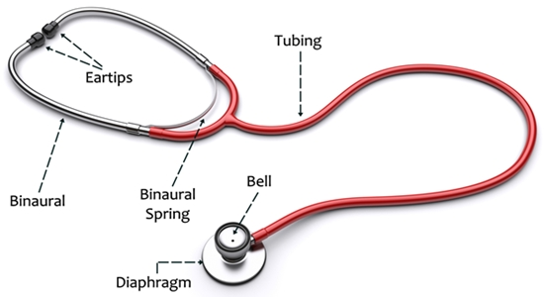

Slide 4
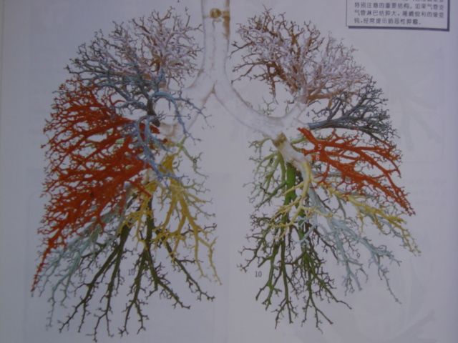

Slide 5
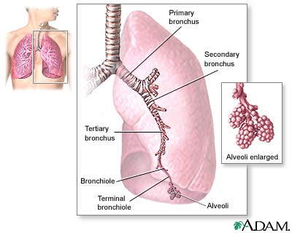
Imagine what you
are hearing

Slide 6
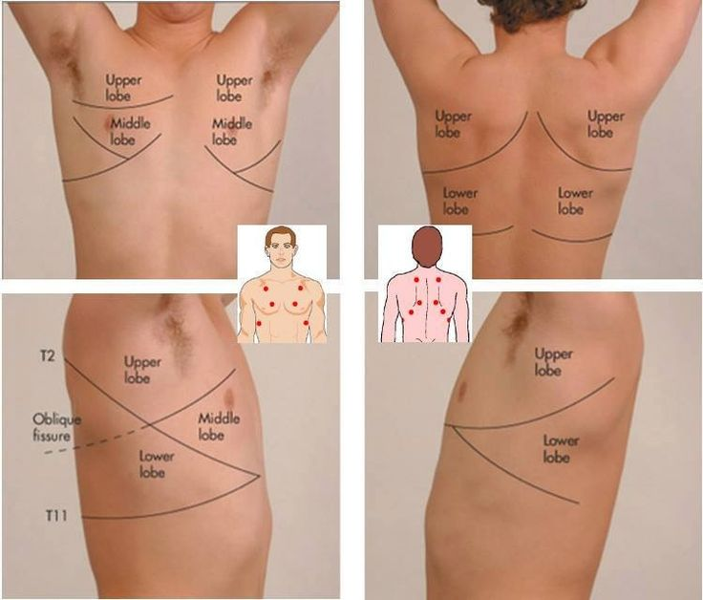
Where do you listen
There at least 4 separate areas on both sides of the body, top & bottom, front & back, right & left.
Each area should be listened to in both inspiration & exhalation phases

Slide 7
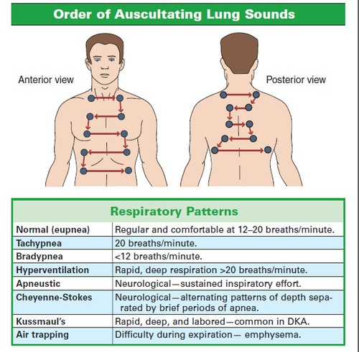

Slide 8
Listening
Be sure to listen to each full cycle of inspiration and expiration before moving your stethoscope
You should hear breath sounds over all lung tissue, and the quality of the breath sounds should be similar as you listen from side to side.

Slide 9
Use of the Stethoscope
The diaphragm- most suitable for listening to high-pitched sounds & murmurs.
The bell- is best suited for low-pitched sounds & murmurs.

Slide 10
Breath sounds
Breath sounds result as air moves through the airways of the respiratory tract. The diameter of the airway, pressure changes in the airway, and vibrations of solid tissue all affect the sound produced.

Slide 11
Sound characteristics
Frequency— measured in hertz — refers to the number of vibrations occurring per unit of time. Different frequencies produce the different sounds heard during auscultation. the term pitch is used to describe sound frequency. High-pitched sounds have higher frequencies; low-pitched sounds have lower frequencies
Intensity : the loudness or softness of the vibrations that produce breath sounds. Intensity can be measured electronically by recording amplitude. Several factors affect intensity, including the type of structure that's vibrating as well as the distance and type of substance through which the vibrations must travel.
Duration the vibrations that produce breath sounds can be measured in milliseconds. However, during auscultation, you'll note sounds as being long or short and as continuous or discontinuous.

Slide 12
When its not normal
Diminished or hard-to-hear lung sounds are most common with thick chest walls (in either muscular or obese patients), or when the patient is not taking deep breaths. However, diminished breath sounds can also be associated with disease.
Absent sounds this can result from airway obstruction, with collapse of lung tissue (such as pneumothorax)

Slide 13
Wheezes
Wheezes are continuous sounds caused by air moving through constricted airways. Airways can be narrowed by a number of causes: the bronchial constriction that accompanies asthma, bronchial inflammation, mucus accumulation or mucous plugs, or tumors.
Wheezes can be: high-pitched, which is common with asthma
low-pitched with almost a snoring quality.
Low-pitched wheezes are sometimes called rhonchi.
Mild wheezing is often limited to the expiratory phase of respiration, while more severe wheezing can be heard throughout the respiratory cycle.
Both wheezing and crackles may clear with coughing, so ask the patient to take a deep breath and cough a couple of times, then listen again

Slide 14
Stridor is a high-pitched sound typically generated when a larger airway is blocked by a foreign body, severe inflammation, or a mass.
A friction rub may result when the pleural membranes covering the lungs and lining the thoracic cavity are inflamed. A friction rub is a scratching or squeaking sound that persists throughout the respiratory cycle and does not clear with coughing.
The characteristics of a friction rub can be imitated by pressing the palm of one hand over the ear and then lightly and slowly rubbing the back of the hand with the fingers of the other hand.

Slide 15
Vesicular
The vesicular breath sound is believed to be the result of movement of air in the bronchioles and alveoli.
Variously described as sighing or a gentle rustling,vesicular breathing is a soft, relatively low-pitched sound.
The normal vesicular respiration is longer in the inspiratory than in the expiratory phase by a ratio of approximately 5:2.

Slide 16
Vesicular
It should be emphasized that expiration as heard in vesicular breathing is not actually shorter than inspiration --only that much of expiration is not audible.
Inspiration is higher in pitch and louder than expiration. In fact, expiration occasionally may be inaudible.
Vesicular breath sounds heard from normally over most of the lungs.

Slide 17
Bronchovesicular
In certain areas where the trachea and major bronchi are in proximity to the chest wall,there is heard a mixture of both tracheobronchial and vesicular elements that is termed bronchovesicular breath sound.

Slide 18
Bronchovesicular
This type of breath sound is heard normally on each side of the sternum in the first and second interspaces,between the scapulae, and over the apices anteriorly and posteriorly,but are more prominent on the right than on the left.
When heard in other locations, brochovesicular breathing is abnormal and is indicative of some disease process.

Slide 19
Vesicular and bronchovesicular are the two types of breath sounds heard normally over the lungs.

Slide 20
Bronchial breathing
Bronchial breath sounds are in general higher in pitch than vesicular or bronchovesicular sounds.
Expiration usually longer than inspiration in length.

Slide 21
Bronchial breathing
Bronchial breathing is not normally heard over the lungs. Therefore,its presence over the lungs always indicates disease.
It occurs only with pulmonary consolidation,an increased conducting mechanism.

Slide 22
Bronchovesicular breathing
Bronchovesicular breathing is abnormal when heard in any area of the lungs that normally have vesicular breath sounds.
An admixture of consolidated and aerated lung produces a mixture of bronchial and vesicular breathing--bronchovesicular breath sounds.

Slide 23
Elongated expiratory breath sound
Occurs because of partial obstruction,spasm or stricture of the lower respiratory tract,
happening in bronchitis,bronchial asthma etc.
Because of lowering elasticity of pulmonary tissue,happening in COPD etc.

Slide 24
Decreased or absent breath sounds
l. fluid in the pleural space.
2.air in the pleural space(pneumothorax)causes a diminution in the breath sounds.
3. If there is thickened pleura caused by fibrosis -which may follow effusion,hemothorax, and empyema-or by actual tumor involvement of the pleura,decrease in breath sounds is noted

Slide 25
Decreased or absent breath sounds
4. Breath sounds are commonly decreased in emphysema because of the decreased air velocity and sound conduction.
5. Breath sounds are markedly diminished or absent in complete bronchial obstruction.
6.If there is definite decrease in expansion, such as that commonly noted in painful pleurisy with its attendant shallow breathing, the breath sounds are diminished because of the decreased ventilation.

Slide 26
Rales حشرجة
They result from the passage of air through secretions in the respiratory tract and from reinflation of the alveoli and bronchioles, the walls of which have become adherent as the result of moisture. Rales,therefore,are produced by air flow plus abnormal moisture.

Slide 27
Rhonchi
Rhonchi are continuous sounds produced by the passage of air through the trachea, bronchi, and bronchioles that have been narrowed, irrespective of the cause. As long as air passes the obstruction, the sound will be produced.

Slide 28
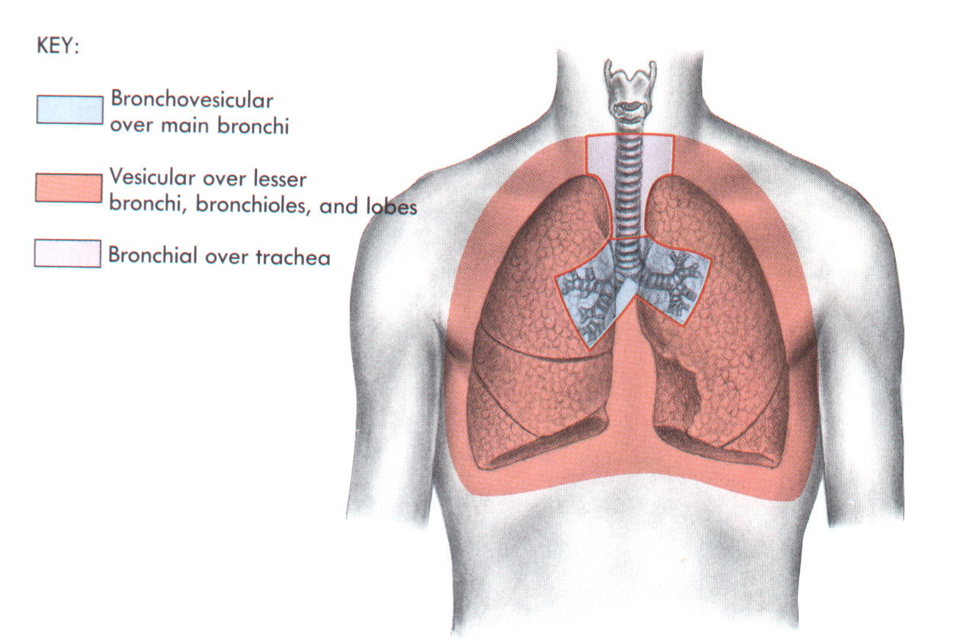
Normal Lung Sounds

Slide 29
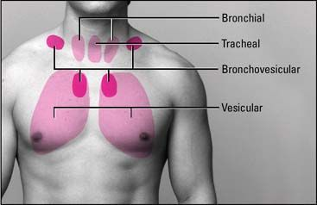

Slide 30
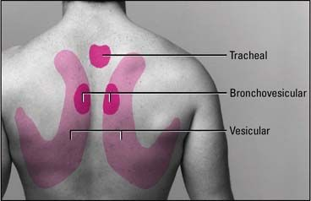

Slide 32
Auscultation finding in pneumonia
In the early stages of lobar pneumonia, the breath sounds may be diminished or suppressed. Fine crepitant rales may be heard.
With the development of frank consolidation, the crepitant rales disappears, the breath sounds become bronchial .

Slide 33
Auscultation Pulmonary emphysema
On auscultation the breath sounds are vesicular and generally diminished in intensity or almost inaudible.
Expiration is commonly prolonged.
Rhonchi are normally widespread, but may be most marked at the bases of the lung.

Slide 34
Pulmonary atelectasis
occurs when an area of lung tissue is not ventilated. The signs and symptoms that follow depend upon the amount of lung tissue involved and vary from an asymptomatic shadow on an X-ray to acute respiratory distress.
When a sufficient amount of lung is involved, there are signs of respiratory distress
The breath sounds are usually absent over the affected area.

