Slide 1
Practical Physiology Light Microscopy Session 1
MSc. Doua’a S. Altaee
قسم تقنيات الاشعة
المرحلة الاولى

Slide 2
Light Microscopy
A light microscope:- Is a high precision optical instrument or tool, that uses a lens or a combination of lenses to produce highly magnified images very small specimens or objects especially when they are too small to be seen by the naked eye .
Light microscopy is used to make small structures and samples visible by providing a magnified image of how they interact with visible light, their absorption, reflection and scattering. This is useful to understand what the sample looks like and what it is made of .

Slide 3
Light Microscopy
They use lenses to focus light on the specimen, magnifying it thus producing an image. The specimen is normally placed close to the microscopic lens.

Slide 4
Light Microscopy
Microscopic magnification varies greatly depending on the types and number of lenses that make up the microscope. Depending on the number of lenses, there are two types of microscopes i. e Simple light microscope (it has low magnification because it uses a single lens) and the Compound light microscope (it has a higher magnification compared to the simple microscope because it uses at least two sets of lenses, an objective lens, and an eyepiece).

Slide 5
Light Microscopy
The functioning of the light microscope is based on its ability to focus a beam of light through a specimen, which is very small and transparent, to produce an image. The image is then passed through one or two lenses for magnification for viewing. Specimens can vary from bacterial to cells and other microbial particles.

Slide 6
Types of light microscopes
used to view specimens are both simple and compound light microscopes, all using lenses. The difference is simple light microscopes use a single lens for magnification while compound lenses use two or more lenses for magnifications. This means, that a series of lenses are placed in an order such that, one lens magnifies the image further than the initial lens.
The modern types of Light Microscopes include:
Bright field Light Microscope
Phase Contrast Light Microscope
Dark-Field Light Microscope
Fluorescence Light Microscope
Electron microscope (TEM, SEM)
Atomic force microscope

Slide 7
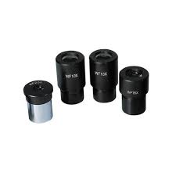
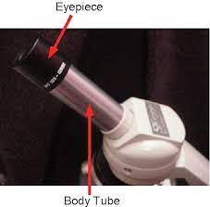
Parts of a microscope and their uses
It is composed of:
Eyepiece lens :- contains the ocular lens which the user looks through to see the magnified specimen .
Eyepiece tube:- connects the eyepiece and ocular lens to the objective lenses.

Slide 8
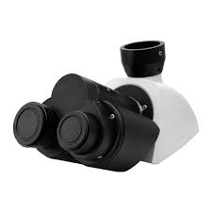
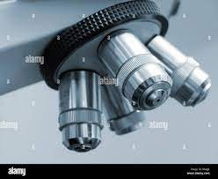
Parts of a microscope and their uses
The nosepiece:- Has about three to five objective lenses with different magnifying power. It can move round to any position depending on the objective lens to focus on the image.
Objective lens:- combine with the eyepiece lens to increase magnification levels.

Slide 9
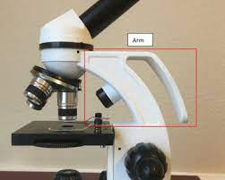
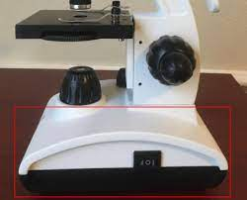
Parts of a microscope and their uses
Microscope arm:- connects the eyepiece tube to the base.
Microscope base:- provides stability and support for the microscope
The arm and the base hold all the parts of the microscope

Slide 10
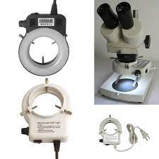
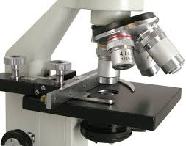
Parts of a microscope and their uses
Microscope illuminator:- its light source for viewing.
The stage:- where the specimen is placed, allowing movement of the specimen around for better viewing with the flexible knobs and it is where the light is focused on.

Slide 11
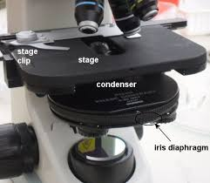
Parts of a microscope and their uses
The condenser:- is mounted below the stage its works with the diaphragm to focuses a beam of light onto the specimen. It can be fixed or movable, to adjust the quality of light, but this entirely depends on the microscope.

Slide 12
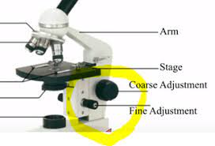
Parts of a microscope and their uses
Two focusing knobs The fine adjustment knob and The coarse adjustment knob, found on the microscopes’ arm,
The coarse adjustment knob used to raises and lowers the stage or the nosepiece to focus on the image.
The fine adjustment knob are the smaller knobs and are also used to raised and lower the stage but more slowly and in a more controlled manner under higher magnification

Slide 13
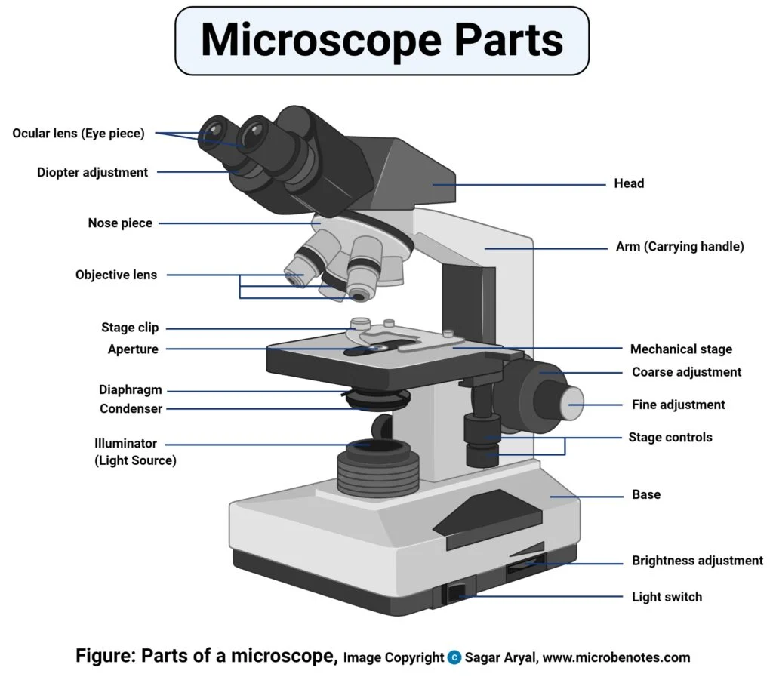

Slide 14
Light microscopy is a powerful tool for examining small samples across a large range of applications. By adapting the illumination and imaging technique used to the specific use case, high-resolution images can be obtained, providing insight into microscopic structures and processes in the sample. In this article, we have discussed the features, strengths and weaknesses of various light microscopy techniques, which differ in the way light impinges and is collected.

Slide 15
THANK YOU

