Slide 1
Adrenergic drugs
By : Lec. Dr. Zahraa M. Ayad
Al-mustaqbal University College Department of Nursing
2nd Class
Pharmacology /2nd semester

Slide 2
Adrenergic drugs (Sympathomimetic)
Adrenergic drugs stimulate adrenergic receptors, thereby activating the sympathetic nervous system and inducing symptoms characteristic of the fight-or-flight response (sympathetic stimulation).
** Adrenergic agonists stimulate adrenergic receptors of sympathetic nerves.
** Adrenergic antagonists inhibit the sympathetic division of the autonomic nervous system.

Slide 3
Adrenergic Receptors
- Alpha receptors (α) are subdivided into: (α1) and (α2)
- Beta receptors (β)are subdivided into: (β1), (β2) (β3).
- Dopamine receptor.
Neurotransmitters
Epinephrine.
Norepinephrine
* Adrenergic receptors are inactivated by:
- Reuptake of norepinephrine into presynaptic vesicles. inactivation by the enzymes:
monoamine oxidase (MAO).
Catechol-O-methyltransferase (COMT).

Slide 4
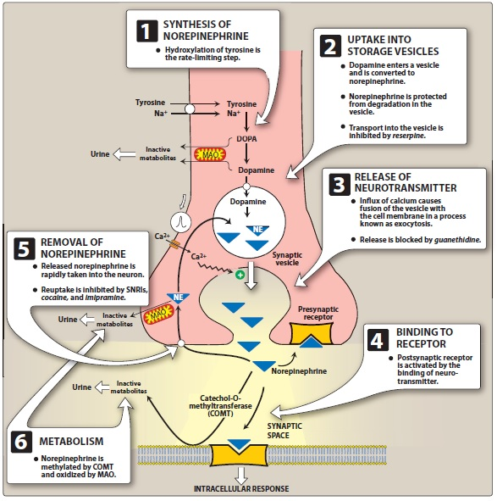
Thanks
For Listening

Slide 5
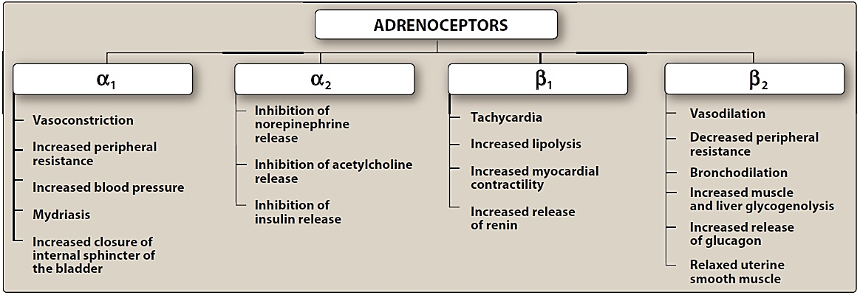
Activation of adrenergic receptors leads to:
Thanks
For Listening

Slide 6
Adrenergic agonist
Adrenergic agonists, also called sympathomimetics, are agents that activate adrenergic receptors in the sympathetic nervous system.
Mechanism of action of adrenergic agonists
Direct-acting agonists.
Indirect-acting agonists.
Mixed-action agonists.

Slide 7
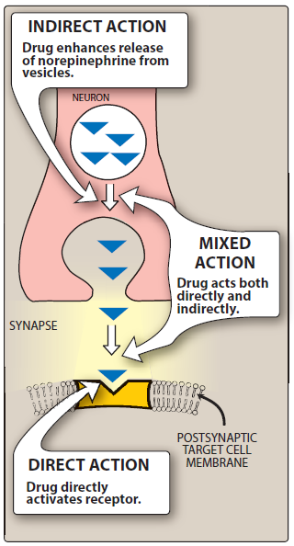
Sites of action of direct
Indirect
mixed-acting adrenergic agonists.

Slide 8
Direct acting agonist
- Mechanism of action: Direct-acting agonists act by binding to adrenergic receptors on effector organs causing sympathetic stimulation.
- 2 types of Direct acting agonist:
1) Catecholamines (epinephrine, norepinephrine, dopamine, and dobutamine)
All catecholamines have three properties:
they cannot be used orally.
they have a brief duration of action.
they cannot cross the blood-brain barrier.

Slide 9
A. Epinephrine (Adrenaline) stimulates both alpha and beta receptors (non-selective), it is indicated for:
Bronchospasm.
Anaphylactic shock.
Cardiac arrest.
Anesthetics (with local anesthetic cause vasoconstriction).
B. Norepinephrine: stimulates alpha1, alpha2 and beta1 receptors, it is indicated for: shock and hypotension.
Thanks
For Listening

Slide 10
C. Dopamine: can activate α- (high doses) and β-adrenergic receptors (low doses). In addition,
D1 and D2 dopaminergic receptors >>>> vasodilation.
it is indicated for :
Shock (drug of choice, given by continuous infusion).
mild renal failure: low doses dilates renal arteries.
D. Dobutamine: it is a β1 receptor agonist. it is only indicated for congestive heart failure.
Thanks
For Listening

Slide 11
2) Non-Catecholamines: differ from the catecholamines in three important respects
half-lives of noncatecholamines are much longer than those of catecholamines.
they can be given orally, whereas catecholamines cannot.
Noncatecholamines are considerably less polar than catecholamines, and hence are more able to cross the blood-brain barrier.
Thanks
For Listening

Slide 12
*** e.g. of Non-Catecholamines:
Albuterol [Salbutamol] (Ventolin) Albuterol is the short-acting β2 agonist of choice for the management of acute asthma symptoms.
Phenylephrine: stimulates alpha1 receptors, it is indicated as local nasal decongestant and for short-term treatment of shock. Phenylephrine is also used in ophthalmic solutions for mydriasis.
*** Adverse Reactions of Direct Adrenergic Agonists:
(arrhythmias, tachycardia, anxiety, dizziness, insomnia, palpitation, headache, hypertension, angina).
Thanks
For Listening

Slide 13
Indirect-acting adrenergic agonists
Indirect-acting adrenergic agonists cause the release, inhibit the reuptake, or inhibit the degradation of epinephrine or norepinephrine. They potentiate the effects of epinephrine or norepinephrine produced endogenously, but do not directly affect postsynaptic receptors.
e.g:
- Amphetamine: Its actions are mediated primarily through an increase in release of catecholamines such as dopamine and norepinephrine from nerve terminals.
- Tyramine: it inhibits the enzyme monoamine oxidase (MAO).
Thanks
For Listening

Slide 14
Mixed-acting Adrenergic Agonist
Mechanism of action: They not only release stored norepinephrine from nerve endings but also directly stimulate both α and β receptors.
e.g.: Ephedrine and pseudoephedrine
indication: Pseudoephedrine is primarily used orally to treat nasal and sinus congestion.
Adverse Reactions of indirect-acting adrenergic drugs: (Anxiety, insomnia, tenseness, dysuria).
Thanks
For Listening

Slide 15
Adrenergic Antagonist
Drugs that block adrenergic receptors or interfere with action or release of catecholamines.
A-Direct action
1-Beta blocker:
a-Atenolol: block β1, mainly used in hypertension and angina.
b-Practolol: β1 blocker
c-Propranolol: block β1 and β2 used in treatment of tachycardia hypertension and shock.
Thanks
For Listening

Slide 16
2-Alpha blocker:
A- Reversible Alpha blocker:
a-Prazosin: α1 blocker for hypertension and shock.
b-Phentolamin: α1 and α2 blocker.
c-Yohembin: α2 blocker used as a sexual stimulant and in the treatment of erectile dysfunction. Its use in the treatment of these disorders is not recommended, due to lack of demonstrated efficacy.
B- Irreversible Alpha blocker:
a-Phenoxybenzamine: α1 and α2 blocker
b-Dibenamine: α1 and α2 blocker (long action) used for hypertension.
Thanks
For Listening

Slide 17
B- Indirect action
1-Reserpine: Prevent storage of NE in vesicles used for hypertension.
2-Quanethidin: Prevent release of NE from vesicles.
Thanks
For Listening

Slide 18
Thanks
For Listening
Thanks
For Listening

