Slide 1
Fundamental of Nursing
PARENTERAL MEDICATIONS
Lec: 3
Lecturer Burhan Hadi

Slide 2
Parenteral administration of medications (injection): is a common nursing procedure.
Nurses give parenteral medications as:
1- Intra-dermally (ID).
2- Subcutaneously (SC).
3- Intramuscularly (IM).
4- Intravenously (IV)

Slide 3
Figure (2) Injection Techniques

Slide 4
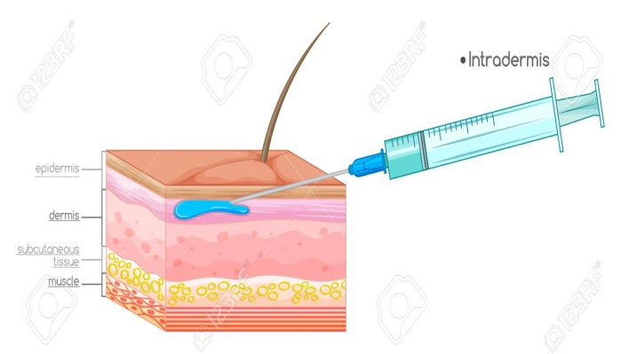
Intradermal Injections
An intradermal (ID) injection is the administration of a drug into the dermal layer of the skin.
Figure (2)Intradermal Injections

Slide 5
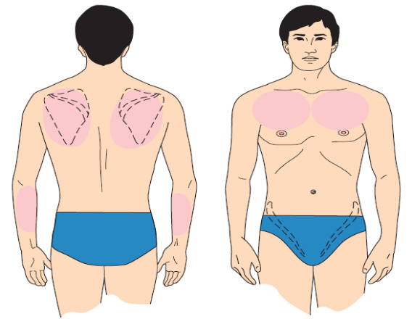
Usually only a small amount of liquid is used, for example, 0.1 mL.
- Used for allergy testing and tuberculosis (TB) screening.
Figure (3) Body sites commonly used for intradermal injections

Slide 6
2. Subcutaneous Injections:
Many kinds of drugs administered subcutaneously (just beneath the skin) are: vaccines, insulin, and heparin.
These areas are convenient and normally have good blood circulation.

Slide 7
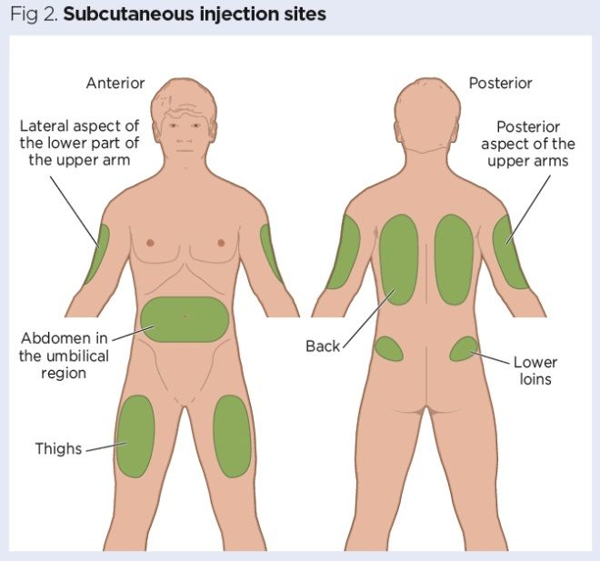
Figure (4) Common sites for subcutaneous injections

Slide 8
3. Intramuscular Injections
Intramuscular (IM) injections: injections into muscle tissue.
Which are absorbed more quickly than subcutaneous injections because of the greater blood supply to the body muscles.
Muscles can also take a larger volume of fluid without discomfort than subcutaneous.

Slide 9
A major consideration in the administration of IM injections is the selection of a safe site located away from large blood vessels, nerves, and bone.
Contraindications for using a specific site include tissue injury and the presence of nodules, lumps, abscesses, tenderness, or other pathology.

Slide 10
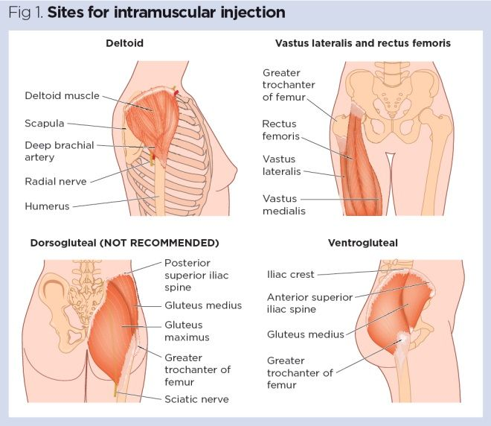
Figure (5) Intramuscular (IM) injections

Slide 11
4. Intravenous Medications
Because IV medications enter the client’s bloodstream directly by way of a vein, they are appropriate when a rapid effect is required.
This route is also appropriate when medications are too irritating to tissues to be given by other routes.

Slide 12
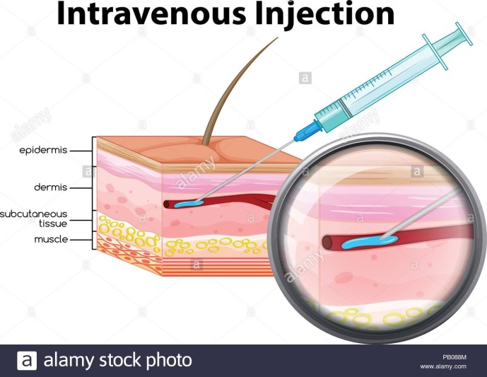
Figure (5) Intravenous (IV) administration

Slide 13
THANK YOU FOR ATTENTION

