Slide 1
Carbohydrates lecture 2 F.I.C.M.S Path Dr. Ammar Hatem M.Sc. Zaenab M. Najem

Slide 2
Glucose metabolism
Glycolysis
is the sequence of reactions that converts glucose into pyruvate in the presence of oxygen (aerobic) or lactate in the absence of oxygen (anaerobic) with the production of ATP.
It is a unique pathway since it can utilize oxygen if available, or it can function in the total absence of oxygen
Location
Glycolysis is the major pathway for the utilization of glucose and is found in cytosol of all cells.

Slide 3
Under aerobic condition
pyruvate is taken up into mitochondria and after conversion to acetyl-CoA is oxidized to CO 2 and H2 O by citric acid cycle with production of ATP.
Anaerobic Glycolysis
• Tissues that function under hypoxic conditions produce lactate, e.g. exercising skeletal muscle and erythrocytes.
• In erythrocytes even under aerobic conditions, glycolysis produce lactate because of absence of mitochondria.

Slide 4
Gluconeogenesis
The synthesis of glucose from noncarbohydrate precursors is called gluconeogenesis
Precursors for gluconeogenesis include:
• Lactate
• Glycerol
• Glucogenic amino acids
Location of Gluconeogenesis
Gluconeogenesis occurs mainly in the cytosol. Liver is the major tissue for gluconeogenesis. During starvation, the kidney is also capable of making glucose by gluconeogenesis.

Slide 5
Diabetes mellitus
Diabetes mellitus is a group of diseases in which blood glucose levels are elevated. Diabetes is the most common disorder of carbohydrate metabolism
Diabetes is the leading cause of
end-stage renal disease
non traumatic amputations,
blindness.
atherosclerotic disease.
deaths

Slide 6
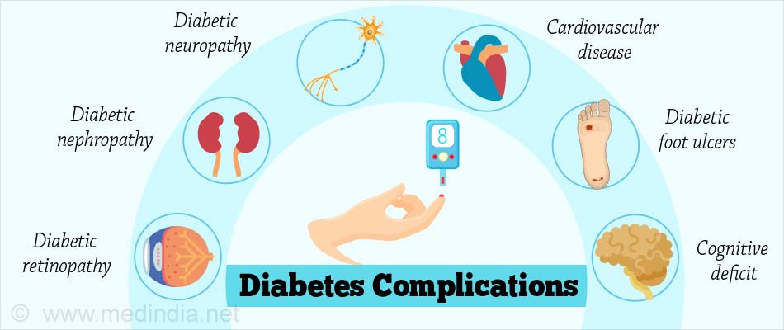

Slide 7
Pathophysiology
Carbohydrates and glucose in particular are an important source of energy for most living organisms.
What happens after a meal ?
After carbohydrates digestion and absorption the blood glucose elevated which stimulates the pancreas to release insulin that facilitate glucose inertance inside the cells to use it as source of energy or in another metabolic processes

Slide 8
In diabetes mellitus, metabolism of all the main foodstuffs is altered. The basic effect on glucose metabolism is insulin deficiency or insulin resistance

Slide 9
Classification
type 1 diabetes mellitus, which is caused by an absolute or near absolute deficiency of insulin,
represents approximately 10% of all cases of diabetes.
There usually is an autoimmune destruction of insulin-producing beta cells in the islets of the pancreas
type 2 diabetes mellitus, which is characterized by the presence of insulin resistance with an inadequate compensatory increase in insulin secretion which usually end with relative or absolute deficiency in insulin secretion.
Type 2 diabetes is the most common type of diabetes, affecting approximately 90% of cases. Many of them are obese

Slide 10
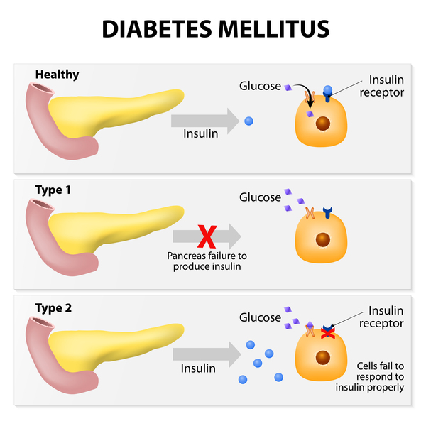

Slide 11
In addition, women who develop diabetes during their pregnancy are classified as having gestational diabetes.
Specific types of diabetes which are caused by infections, drugs, endocrinopathies, and genetic defects.

Slide 12
Diagnosis of Diabetes
Any of the followings tests is diagnostic to DM:
Fasting blood glucose ≥ 126
Random blood glucose or 2 Hrs. post prandial blood glucose ≥ 200 mg/dl
HbA1c ≥ 6.5%
To confirm the diagnosis repeat the same test in different day

Slide 13
Glycated hemoglobin
Glycated hemoglobin (HbA1c) is the term used to describe the formation of a hemoglobin compound produced when glucose reacts with the globin part of hemoglobin.
HbA1c testing provides an index of average blood glucose levels over the past 2 to 4 months ( depending on RBC life span )
Conditions associated with shortened red blood cell survival such as hemolysis and pregnancy will lower the HbA 1c level .

Slide 14
Thank you for your listening

