Slide 1
2nd Stage
Unit 3
It all went wrong
Dr. Raneen S. Abd Ali
Raneen.sami.abdali@mustaqbal-college.edu.iq
Engineering of Refrigeration and Air Conditioning Technologies
Al-Mustaqbal University College
12/2021

Slide 2
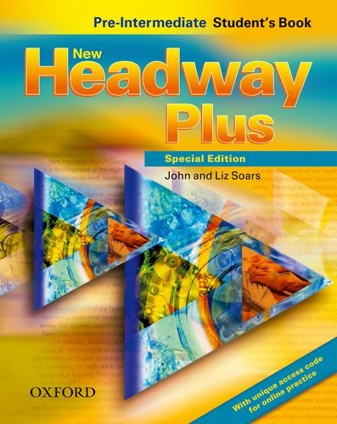
Engineering of Refrigeration and Air Conditioning Technologies, Al-Mustaqbal University College
https://elt.oup.com/student/headway/preint4/download?cc=global&selLanguage=en

Slide 3
Engineering of Refrigeration and Air Conditioning Technologies, Al-Mustaqbal University College
Unit 3
Irregular Verbs
Present Past
Are were
See saw
Go went
Tell told
Say said
Has have/had
Take took
Give gave
Get got
Can could
Make made
Do does/did
Present Past
wake woke
hear heard
find found
keep kept
leave left
hold held
think thought
catch caught

Slide 4
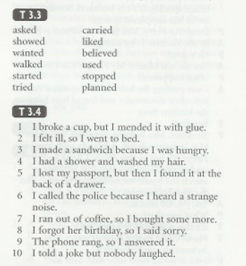
Engineering of Refrigeration and Air Conditioning Technologies, Al-Mustaqbal University College
Unit 3

Slide 5
Engineering of Refrigeration and Air Conditioning Technologies, Al-Mustaqbal University College
Unit 3
Noun | Verb
Communication | Communicate
Discussion | Discuss
Government | Govern
Invitation | Invite
Development | Develop
Explanation | Explain
Education | Educate
decision | Decide
Enjoyment | Enjoy
Organization | Organize
Improvement | Improve
employment | Employ

Slide 6
Engineering of Refrigeration and Air Conditioning Technologies, Al-Mustaqbal University College
Unit 3
Noun | Adjective
Science | Scientific
Friend | Friendly
Happiness | Happy
Difference | Different
Danger | Dangerous
Use | Useless
Help | Helpful
Specialty | Special
Care | Careful
Noise | Noisy
Industry | Industrial
ambition | Ambitious

Slide 7
Engineering of Refrigeration and Air Conditioning Technologies, Al-Mustaqbal University College
Unit 3
positive | Negative
Pack | Unpack
Possible | Impossible
Agree | Disagree
Tidy | Untidy
Fair | Unfair
Like | Dislike
Appear | Disappear
Employed | Unemployed
Legal | Illegal
Polite | Impolite

Slide 8
Engineering of Refrigeration and Air Conditioning Technologies, Al-Mustaqbal University College
Unit 3
Time expression
At six o’clock
At the weekend
On Monday
On January 18
On Saturday
In December
In summer
In the evening
In 1995

