Slide 1
Fundamentals of Mass Transfer Processes, Molar Flux
Assist. Profess. Dr. Eng. Alaa D. Jawad Al-Bayati

Slide 11
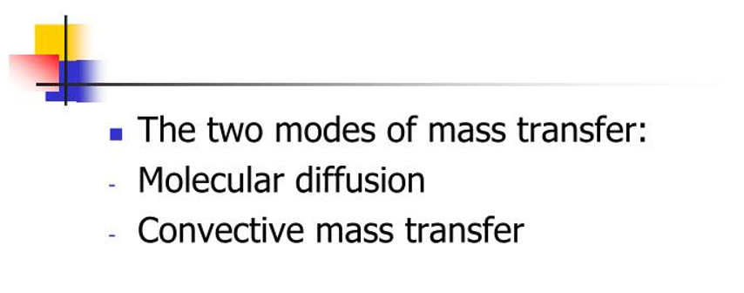

Slide 18
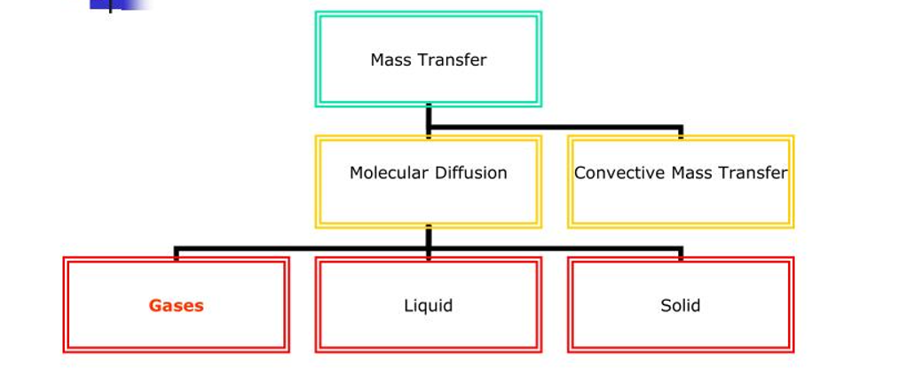

Slide 24
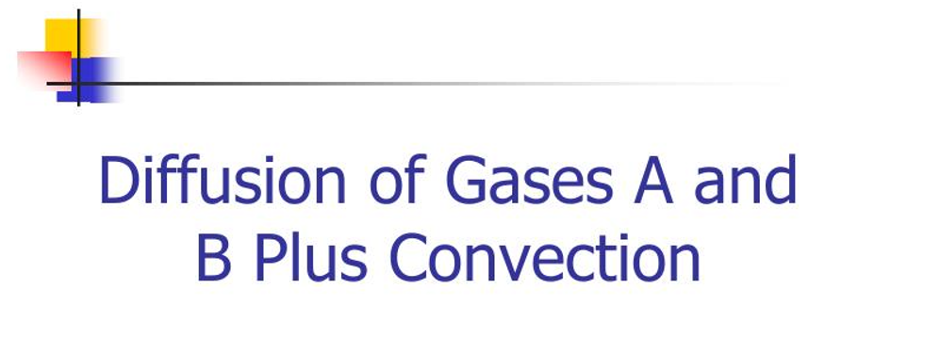

Slide 38
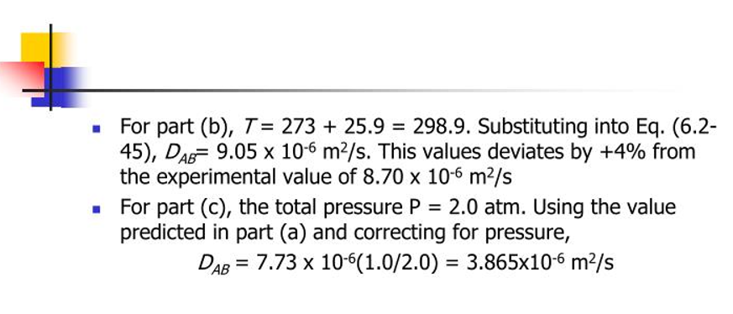

Slide 41
