Slide 1
Al-Mustaqbal University College Department of Medical Laboratory Techniques
Independent Samples T- Tests in SPSS
Lecture 18
2020-2021
Israa SAleh

Slide 2
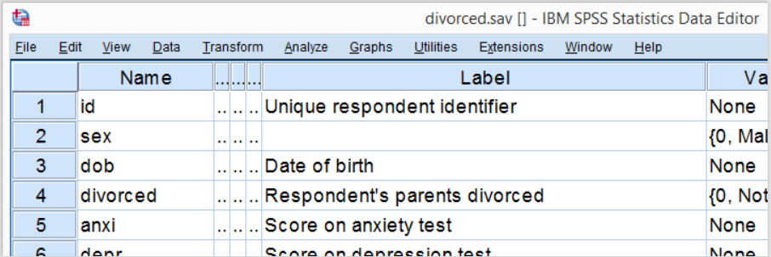
SPSS Independent T-Test Example
A scientist wants to know if children from divorced parents score differently on some psychological tests than children from non divorced parents. The data collected are in divorced.sav, part of which is shown below.

Slide 3
Independent Samples T-Test - Assumptions
Conclusions from an independent samples t-test can be trusted if the following assumptions are met:
Independent observations. This often holds if each case in SPSS represents a different person or other statistical unit. This seems to hold for our data.
Normality: the dependent variable must follow a normal distribution in the population. This is only needed for samples smaller than some 25 units. We'll see the actual samples sizes used for our t-test after running it so we won't bother about normality until then.

Slide 4
Independent Samples T-Test - Assumptions
Homogeneity: the standard deviation of our dependent variable must be equal in both populations. We only need this assumption if our sample sizes are (sharply) unequal.
SPSS tests if this holds when we run our t-test. If it doesn't, we can still report corrected test results.

Slide 5
Quick Data Check
The data at hand have been prepared and are good to go.
However, if you run a t-test on other data, you should at least inspect some histograms of your dependent variable(s).
Make sure their distributions look plausible. If they contain any extreme values, specify them as user missing values.

Slide 6
Quick Data Check

Slide 7
Quick Data Check

Slide 8
Quick Data Check

Slide 9
SPSS Output for an Independent Samples T-Test
Children from divorced parents have an average anxiety score of 22.8 whereas the other children score 21.5.

Slide 10
note that the sample sizes used for our t-test are 49 and 34. Since both are larger than 25, we don't need to bother about the normality assumption.

Slide 11
Independent Samples T-Test Output

Slide 12
Independent Samples T-Test Output
Note that we have two lines of t-test results: equal variances assumed and equal variances not assumed. So which line should we report? Well, this depends on Levene's test for equal variances which tests the aforementioned homogeneity assumption.
As a rule of thumb, if Sig. > 0.05, we conclude that the assumption of equal variances holds. Since Sig. = 0.159 here, we report the first line of t-test results, denoted as equal variances assumed.

Slide 13
Independent Samples T-Test Output
If Sig. (2-tailed) > 0.05, we usually conclude that our population means are equal.
“Sig.” is called a p-value (or just “p”) in reports. P indicates how likely our sample result is if our population means are really equal. In our case, p = 0.055 (a 5.5% probability) and that's not unlikely enough for rejecting our null hypothesis.

