Slide 1
Surgical Hand Washing
Dr. Kareem Waheed Abu Kheta
Al-Mustaqbal University College Department of Anesthesiology
Nursing
Lecture: 7. practical

Slide 2
PURPOSES
To reduce the number of microorganisms on the hands
To reduce the risk of transmission of microorganisms to clients
To reduce the risk of cross contamination among clients
To reduce the risk of transmission of infectious organisms to oneself.

Slide 3
Hands must be washed according to the (WHO) for this causes:
Before touching a patient
Before an aseptic procedure( Using a surgical scrub brush if possible).
After exposure to body fluid
After touching a patient.
After touching patient surroundings

Slide 4
Equipment
Surgical scrub items (antimicrobial soap,
two brushes, and nail file)
Surgical shoe covers (booties) and cap, face
mask, sterile gown, and proper-size gloves.
Sterile towel.

Slide 5
Pre-scrub wash
1. Wear surgical shoe covers and cap to cover
hair and ears completely.
2. Wear mask.
3. Open the package containing the nail brush/scrub sponge and nail pick.

Slide 6
4. Rinse the hands and arms thoroughly, allowing the water to run from the hands to the elbows.
5. Clean under the nails with the nail pick.
6. scrub the spaces under the fingernails by the nail brush.

Slide 7
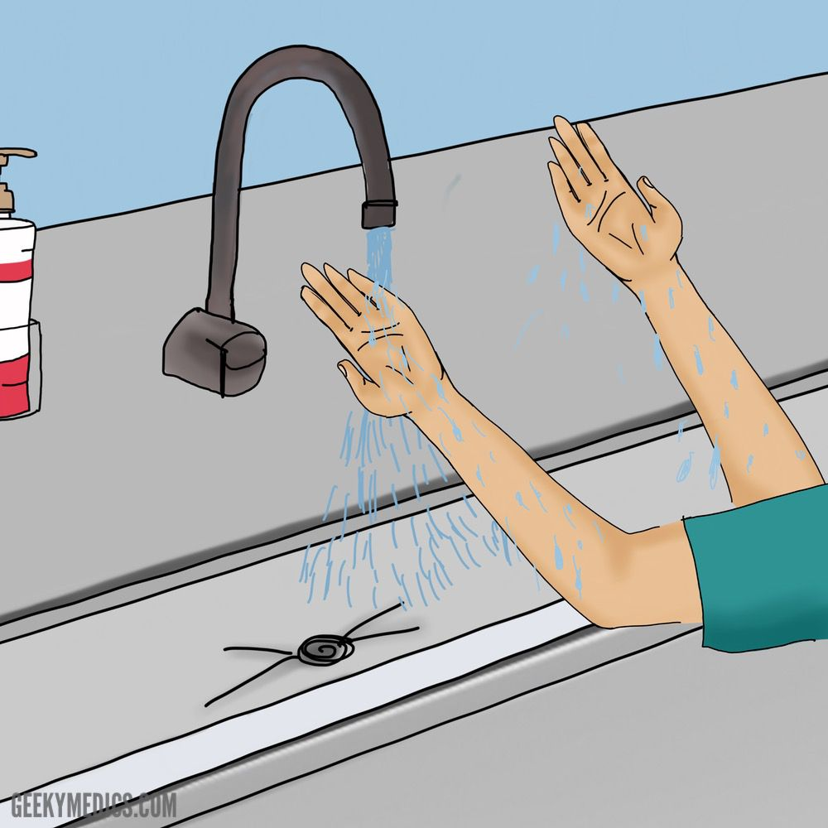
Step 1
Wet the hands and forearms.
Rub palm to palm.

Slide 8
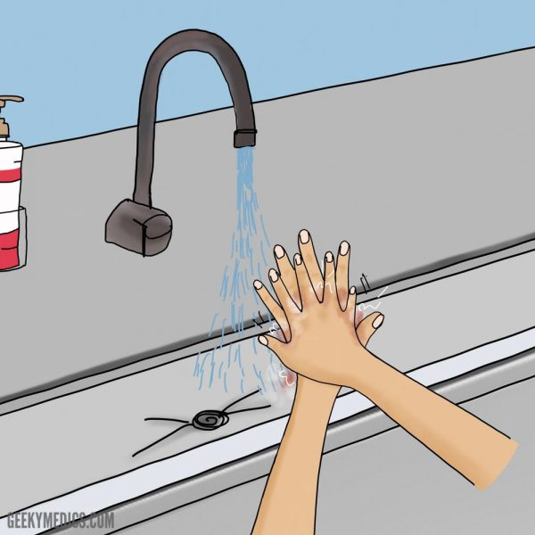
Step 2
Rub the palm over the back of other hand with the fingers interlaced.

Slide 9
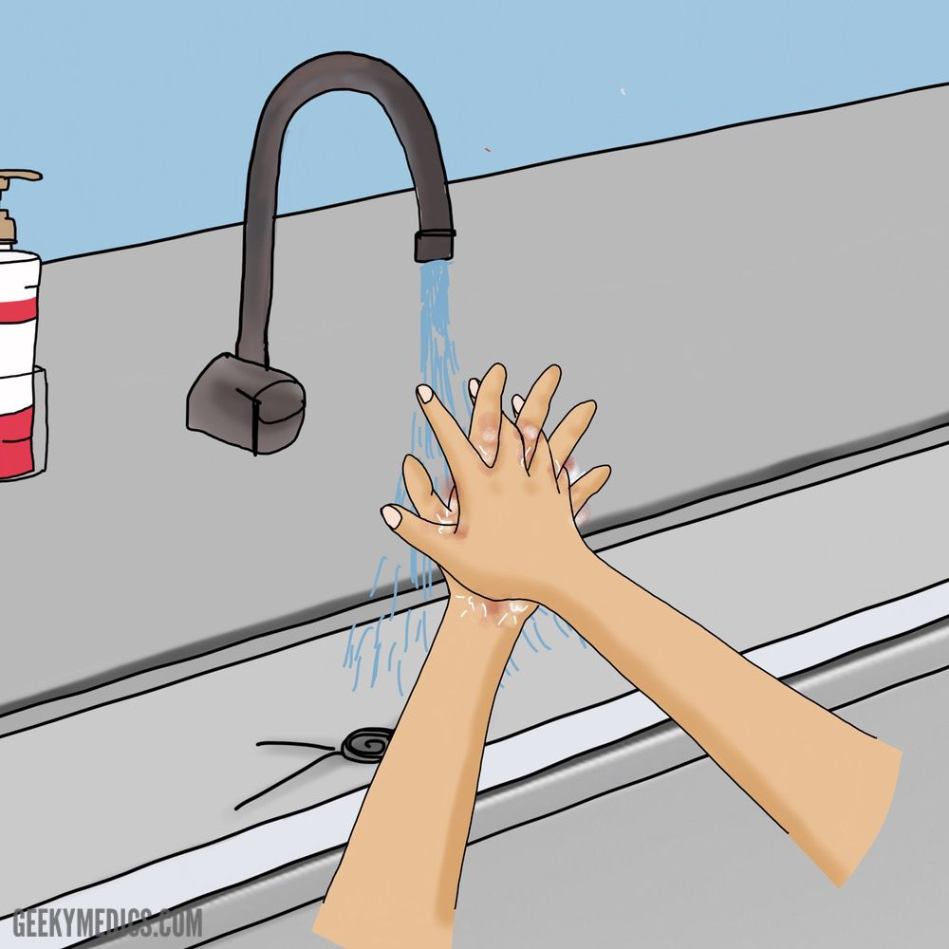
Step 3
Rub palm to palm, with fingers interlaced.

Slide 10
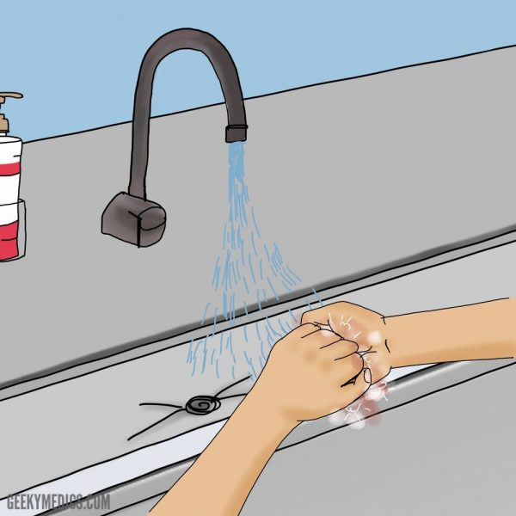
Step 4
Rub with back of fingers to opposing palms with fingers interlocked

Slide 11
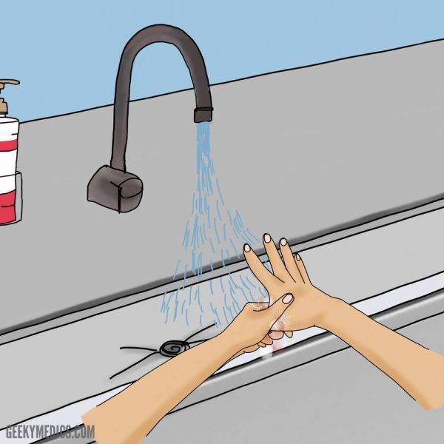
Step 5
Perform rotational rubbing the thumb clasped in the hand.

Slide 12
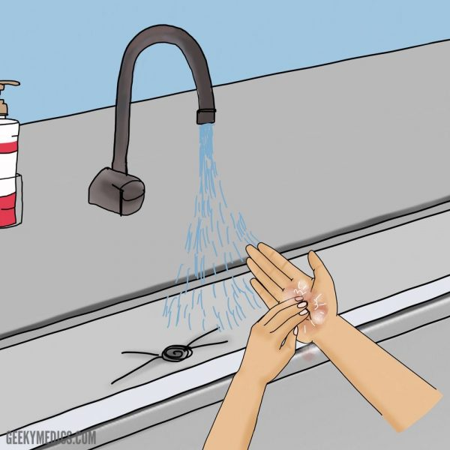
Step 6
Rub the fingertips in opposite palm in circular motion.

Slide 13
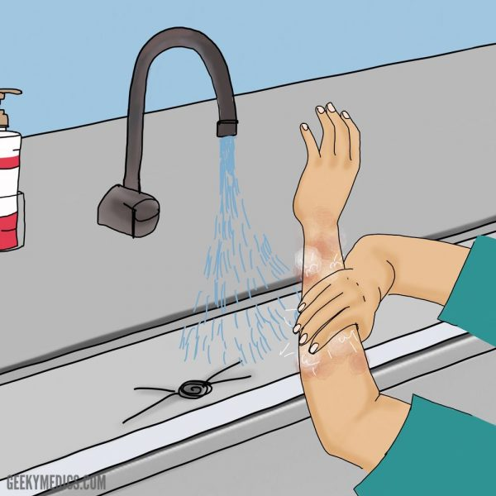
Step 7
Rub each wrist with opposing hand, working to just below the elbows.

Slide 14
Step 8
Rinse the hands under running water, allowing the water to run from fingertips to elbows.

Slide 15
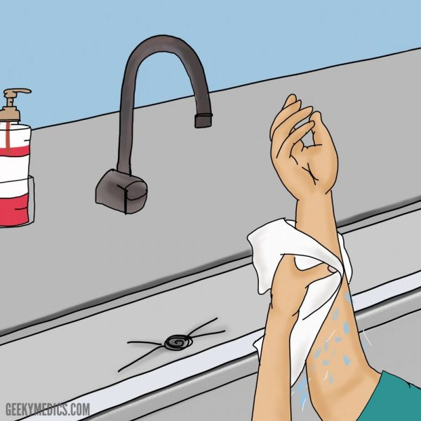
Step 9
Secure sterile towel to dry each hand and arm separately.

Slide 16
`
Thank you

