Slide 1

Al-Mustaqbal University College
Pharmacology II 4th stage
Antiepileptic Drugs Part 2
Dr. Hasanain Owadh

Slide 2
Antiepileptic Drugs
The new drugs (second generation), which include gabapentin, lamotrigine, topiramate, levetiracetam, oxcarbazepine, zonisamide have not shown better efficacy and adverse effects than the older agents (first generation) such as phenobarbital, phenytoin, carbamazepine, ethosuximide, divalproex and valproic acid.
Adverse effects: nausea and vomiting , drowsiness, sedation, ataxia, rash, hyponatremia, weight gain or weight loss, teratogenicity and osteoporosis.

Slide 3
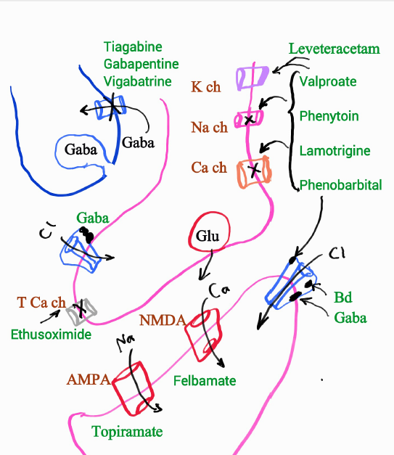

Slide 4
A. Benzodiazepines
Benzodiazepines bind to GABA inhibitory receptors to reduce firing rate.
Diazepam, and lorazepam are most often used as an adjunctive therapy for myoclonic as well as for partial and generalized tonic-clonic seizures.
Lorazepam has a shorter pharmacokinetic half-life but stays in the brain longer than diazepam. Diazepam is available for rectal administration.

Slide 5
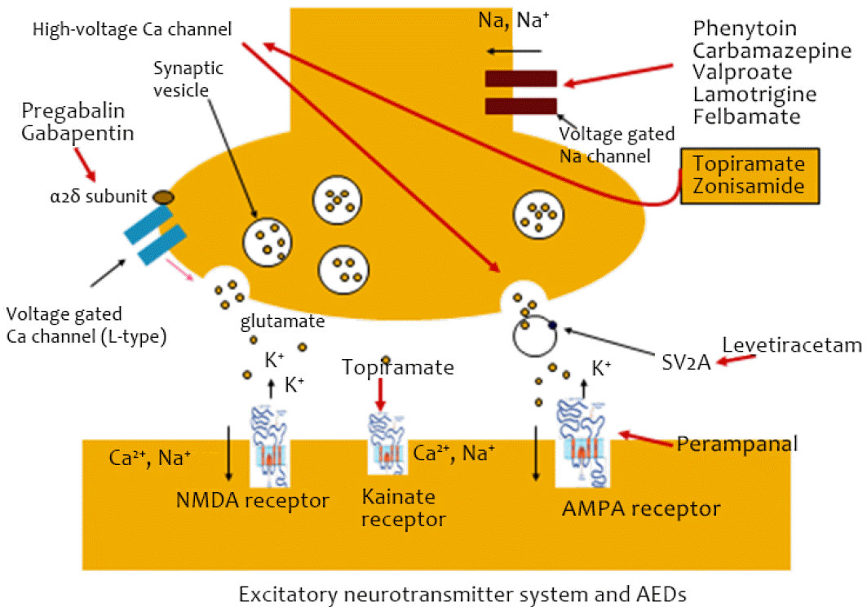
B. Carbamazepine
Carbamazepine reduces the propagation of abnormal impulses in the brain by blocking sodium channels, thereby inhibiting the generation of repetitive action potentials in the epileptic focus and preventing their spread.
Carbamazepine is effective for treatment of partial seizures and secondarily generalized tonic-clonic seizures.

Slide 6
Carbamazepine is absorbed slowly and erratically following oral administration. Carbamazepine is an enzyme inducer, it may increase the clearance and reduce the efficacy of drugs that are metabolized by these enzymes. Carbamazepine should not be prescribed for patients with absence seizures because it may cause an increase in seizures.

Slide 7
C. Divalproex
Divalproex sodium is a combination of sodium valproate and valproic acid and is reduced to valproate when it reaches the gastrointestinal tract. Proposed mechanisms of action include
sodium channel blockade, blockade of GABA transaminase, and action at calcium channels.

Slide 8
These many mechanisms provide a broad spectrum of activity against seizures. It is effective for the treatment of partial and primary generalized epilepsies.
Valproate is an enzyme inhibitor, it is bound to albumin (greater than 90 percent), which can cause significant interactions with other highly protein bound drugs. Teratogenicity is of great concern including neural tube defects.

Slide 9
D. Ethosuximide
Ethosuximide reduces propagation of abnormal electrical activity in the brain, most likely by inhibiting calcium channels. It is effective in treating only primary generalized absence seizures.

Slide 10
E. Felbamate
The drug has multiple proposed mechanisms including
1) blocking voltage-dependent sodium channels,
2) competing with the glycine-coagonist binding site on the N-methyl-D-aspartate (NMDA) glutamate receptor,
3) blocking calcium channels, and
4) potentiation of GABA actions. It is an inhibitor of drugs metabolized by CYP2C19. It is reserved for use in refractory epilepsies

Slide 11
F. Gabapentin
Gabapentin is an analog of GABA. However, it does not act at GABA receptors nor enhance GABA actions, nor is it converted to GABA.
It is approved as adjunct therapy for partial seizures. Gabapentin does not bind to plasma proteins and is excreted unchanged through the kidneys. Reduced dosing is required in renal disease. It has mild adverse effects.

Slide 12
G. Lamotrigine
Lamotrigine blocks sodium channels as well as high voltage dependent calcium channels.
Lamotrigine is effective partial seizures, generalized seizures, typical absence seizures. It is approved for use in bipolar disorder as well.

Slide 13
The half-life of lamotrigine (24-35 hours) is decreased by enzyme-inducing drugs (for example, carbamazepine and phenytoin) and increased by greater than 50 percent with addition of valproate. Rapid titration to high serum concentrations of lamotrigine have been reported to cause a rash, which in some patients may progress to a serious, life-threatening reaction.

Slide 14
H. Levetiracetam
Levetiracetam is approved for adjunct therapy of partial onset seizures, myoclonic seizures, and primary generalized tonic-clonic seizures in adults and children. The drug is well absorbed orally, and excretion is urinary.

Slide 15
I. Oxcarbazepine
Oxcarbazepine is a prodrug that is rapidly reduced to the 10-monohydroxy (MHD) metabolite which is responsible for its anticonvulsant activity. MHD blocks sodium channels preventing the spread of the abnormal discharge. Modulation of calcium channels is also a hypothesis. It is approved for use in adults and children with partial onset seizures. Oxcarbazepine is a less potent enz. Inducer than carbamazepine.

Slide 16
J. Phenobarbital
The primary mechanism of action is the enhancement of inhibitory effects of GABA-mediated neurons. The primary use for phenobarbital in epilepsy is in treatment of status epilepticus.

Slide 17
Due to interaction with the cytochrome P450 enzymes as an inducer, and adverse effects of sedation, cognitive impairment, and potential for osteoporosis, this drug should only be considered for chronic therapy once a patient is found to be refractory to many other drugs, and the benefits of therapy outweigh the multiple risks.

Slide 18
K. Phenytoin and fosphenytoin
Phenytoin blocks voltage-gated sodium channels by selectively binding to the channel in the inactive state and slowing its rate of recovery. At very high concentrations, phenytoin can block voltage-dependent calcium channels and interfere with the release of monoaminergic neurotransmitters.

Slide 19
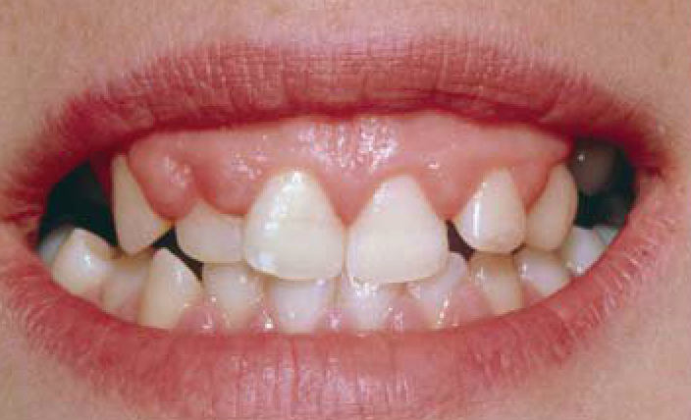
Phenytoin is effective for treatment of partial seizures and generalized tonic-clonic seizures and in the treatment of status epilepticus. Phenytoin is an enzyme inducer. Depression of the CNS occurs causing nystagmus and ataxia, in addition gingival hyperplasia may cause the gums to grow over the teeth.

Slide 20
Fosphenytoin is a prodrug and is rapidly converted to phenytoin in the blood, providing high levels of phenytoin within minutes. Fosphenytoin may also be administered intramuscularly (IM). Phenytoin sodium should never be given IM because it can cause tissue damage and necrosis.
L. Pregabalin
Pregabalin binds to the voltage-gated calcium channels in the CNS, inhibiting excitatory neurotransmitter release. The drug has proven effects on partial onset seizures, neuropathic pain associated with diabetic peripheral neuropathy.
Drowsiness, blurred vision, weight gain, and peripheral edema have been reported.

Slide 21
M. Primidone
Primidone has two active metabolites, phenobarbital and phenylethylmalonamide, which have longer half-lives than the parent drug.
Due to the nature of the long-term adverse effects associated with phenobarbital, this drug should be considered for use only in those patients with refractory epilepsy.

Slide 22
N. Tiagabine
Tiagabine blocks GABA uptake into presynaptic neurons, permitting more GABA to be available for receptor binding, thus, there is thought to be enhanced inhibitory activity.
Tiagabine is effective in decreasing the number of seizures in patients with partial onset epilepsy

Slide 23
O. Topiramate
Topiramate blocks voltage-dependent sodium channels;
it has been shown to increase the frequency of chloride channel opening by binding to the GABAA receptor.
High-voltage calcium currents are reduced by topiramate. It is a carbonic anhydrase inhibitor and may act at glutamate (NMDA) sites.
Topiramate is effective and approved for use in partial and primary generalized epilepsies. It is also approved for treatment of migraine.
Topiramate is renally eliminated to a high degree. Adverse effects include somnolence, weight loss, and paresthesias; renal stones are reported to occur at a higher incidence.

Slide 24
P. Zonisamide
Its effect include blockade of both voltage-gated sodium channels and calcium currents.
It has a limited amount of carbonic anhydrase activity.
Zonisamide is approved for use in patients with partial epilepsy. In addition to the typical CNS adverse effects, zonisamide may cause kidney stones. Oligohidrosis (decreased sweating) has been reported, and patients should be monitored for increased body temperature and decreased sweating.

Slide 25
Vagal Nerve Stimulation
Vagal nerve stimulation requires surgical implant of a small pulse generator with a battery and a lead wire for stimulus. The device is implanted and lead wires wrapped around the patient's vagal nerve.

Slide 26
The VNS is designed to prevent seizures by sending regular, mild pulses of electrical energy to the brain via the vagus nerve, this device is sometimes referred to as a "pacemaker for the brain." It is placed under the skin on the chest wall and a wire runs from it to the vagus nerve in the neck.

Slide 27
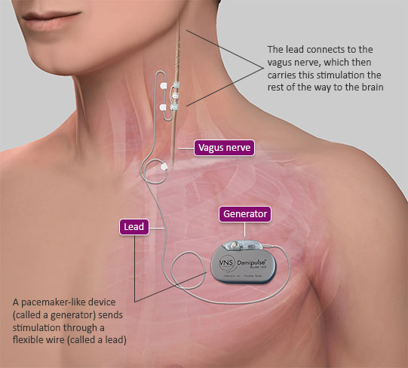

Slide 28
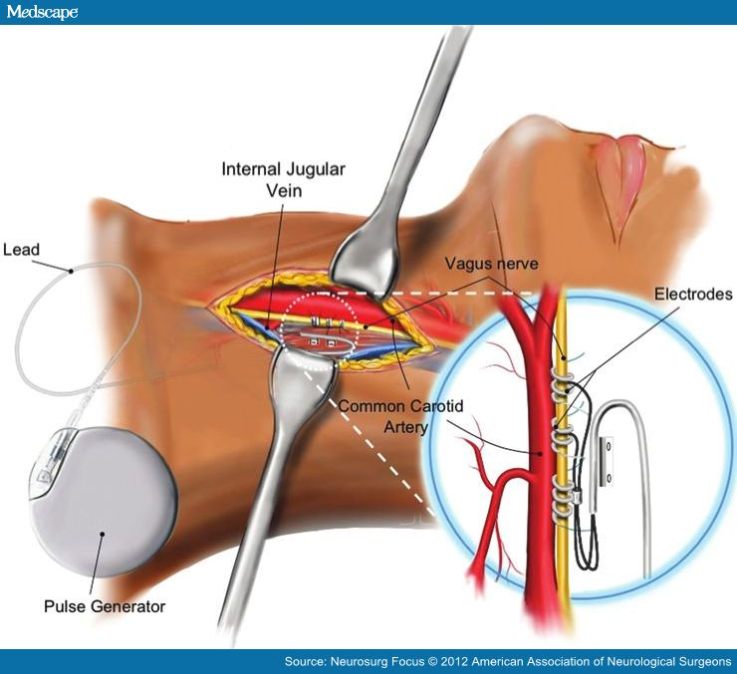

Slide 29
The vagus nerve is part of the autonomic nervous system, which controls functions of the body that are not under voluntary control, such as the heart rate. The vagus nerve passes through the neck as it travels between the chest and abdomen and the lower part of the brain.

Slide 30
Vagal nerve stimulation has been effective in treatment of partial onset seizures and has enabled reduction of drug therapy in some cases. It is an alternative for patients who have been refractory to multiple drugs, who are sensitive to the many adverse effects of antiseizure drugs, and who have difficulty adhering to medication schedules. Vagal nerve stimulation requires invasive procedure and is expensive.

Slide 31
Epilepsy in Pregnancy
Women with epilepsy who are considering pregnancy should be treated with the least teratogenic but most efficacious antiepileptic drug for their particular type of epilepsy at the lowest effective dose and should be on high doses of folic acid prior to conception.
parents should understand that there are no 'safe' antiepileptic drugs in pregnancy and all risk of harm cannot be eliminated. Divalproex and barbiturates should be avoided.

Slide 32
When seizures are controlled, maintenance medication should be reduced, if possible, to the lowest dose that provides control. If seizures are not controlled, medications and dosages should be adjusted.

Slide 33


