Slide 1
Carcinogenesis
Lec:

Slide 2
HALLMARKS OF CANCER
• Self-sufficiency in growth signals
• Insensitivity to growth inhibitory signals
• Evasion of cell death
• Limitless replicative potential
• Development of sustained angiogenesis
• Ability to invade and metastasize

Slide 3
some fundamental principles :
1-non-lethal genetic damage (mutation)
2-The tumor is the result of clonal expansion of a single precursor cell
3-Carcinogenesis is a multi-step process: Phenotypic (tumor progression) genetic ( accumulation of mutations)
4- Involvement of normal regulatory genes

Slide 4
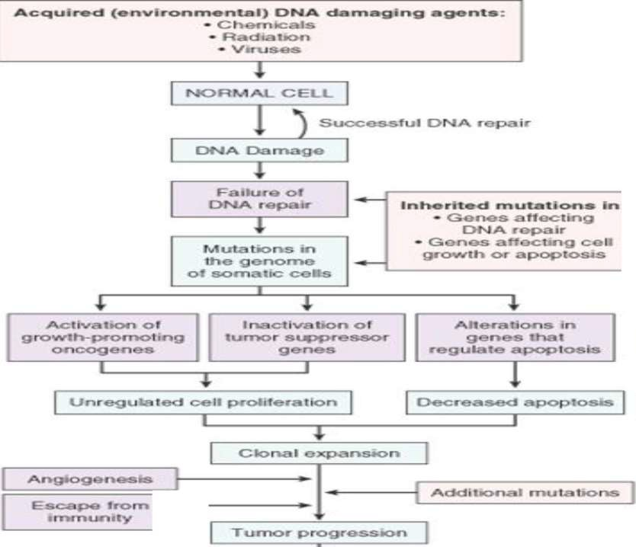
:
I

Slide 5
1 Non-lethal genetic damage (mutation)
A.Acquired through the action of environmental factors: radiation, chemicals or viruses.
e.x HPV associated with cancer of the cervix
B. Inherited in germ line cells.
e.x Familial adenomatous polyps (APC gene, autosomal dominent disorder)

Slide 6
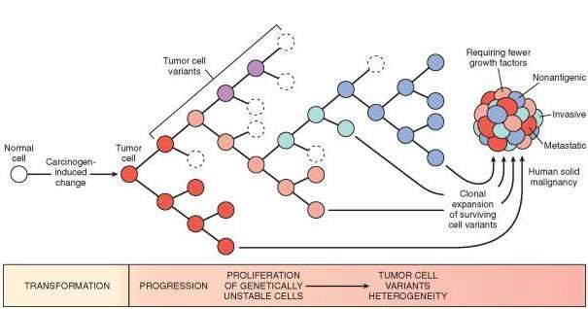
2The tumor is the result of clonal expansion of a
single precursor cell.
3Multistep carcinogenesis: Phenotypic (tumor progression), genetic (accumulation of mutations)

Slide 7
4-Involvement of normal regulatory
genes:
A: The growth promoting genes (proto-
onco-genes.)
B: The growth inhibiting genes (cancer suppressor genes.)
C: Genes that control programmed cell
death (apoptosis.)
D: DNA repair genes.

Slide 8
Transformation of proto-oncogenes to oncogenes:
-point mutation
-Chromosomal translocation (philadelphia
chromosome in chronic myeloid leukaemia)
-Amplification (myc gene, HER2 gene)

Slide 9
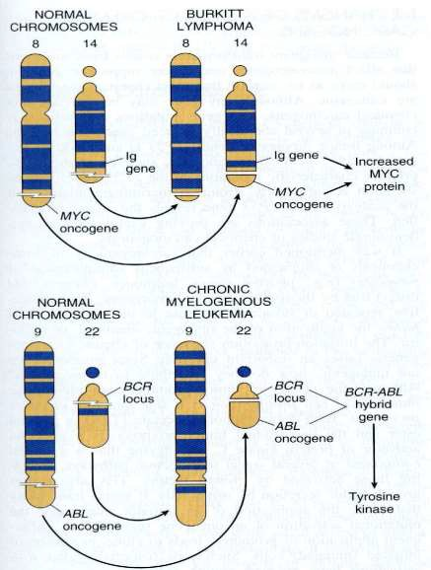
Chromosomal translocations
The chromosomal translocations and associated oncogenes in Burkitt’s lymphoma
and chronic myelogenous leukemia
Pheladelphia chromosome

Slide 10
 Rb gene
 P53 gene
 TGF-beta
 NF-1

Slide 11
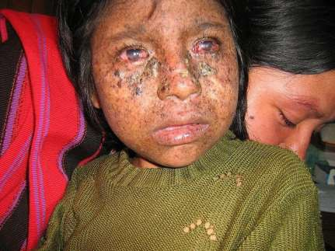
-4DNA repair genes
Xeroderma pigmentosum, or XP, is genetic disorder of nucleotide excision repair mechanism ability to repair damage caused by ultraviolet (UV) light is deficient
Children of the Night Photosensitivity
Skin lesions & changes
skin cancer at early age

Slide 12
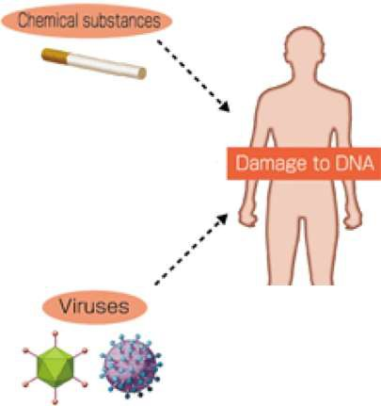
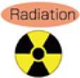
······- -
0 Z O O M

Slide 13
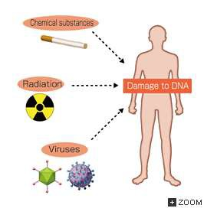
TYPES OF CARCINOGENS Three main types:
nitrosoureas yl chloride
Chemical • Direct acting • Indirect acting
Physical (radiation)
Biological (especially virus)
CHEMICAL CARCINOGENS Direct-acting
Weak carcinogens
Require no chemical transformation
Alkylating agents – Cyclophosphamide, chlorambucil,
Acylating agents - Acetyl-imidazole, Dimethylcarba m
CHEMICAL CARCINOGENS Indirect-acting
Require metabolic conversion before they become active.
Aromatic amines and azo dyes
Beta-naphthylamine: Bladder CA in rubber factories
Azo dyes used in food color
Aflatoxin B( Aspergillus in grains: Hepatocellular cancer)
Polycyclic hydrocarbons: fossil fuels, cigarette smoke

Slide 14
Physical carcinogenesis
Physical
carcinogenesis
I
I
I
 | radiation Physical Carcinogenes is
 | Radiation
Non-radiation l
Physical
Carcinogene sis j
I
I
I
Ultraviolet l ight
Ionising radiation

Slide 15
DNA viruses:
HPV= Human papilloma virus (cancer of cervix)
HBV = hepatitis B virus
Herpes viruses (EBV, HSV1 & 2, KSV)
EBV= Epstein Barr Virus (Burkitt lymphoma, Nasopharyngeal carcinoma)
HSV (type 1 &2): Cancer of cervix KSV (kapossi sarcoma)
RNA viruses:
HTLV -1=Human T-cell lymphotropic virus type1
(adult T-cell leukemia/lymphoma( HCV

Slide 16
Summary
•Cancer results from clonal expansion
•Carcinogenesis is a multistep process
•Four groups of normal regulatory genes are
involved in carcinogenesis
•Tumour suppressor gene (P53 & Rb) play important role in the control of cell growth Three main types of carcinogens
Chemical • Direct acting • Indirect acting
Physical (radiation)
Biological (especially virus)

