Slide 1
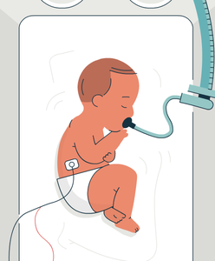
Infant Incubators
Experiment no. 3
Asst. Lect. Mays Khalid

Slide 2
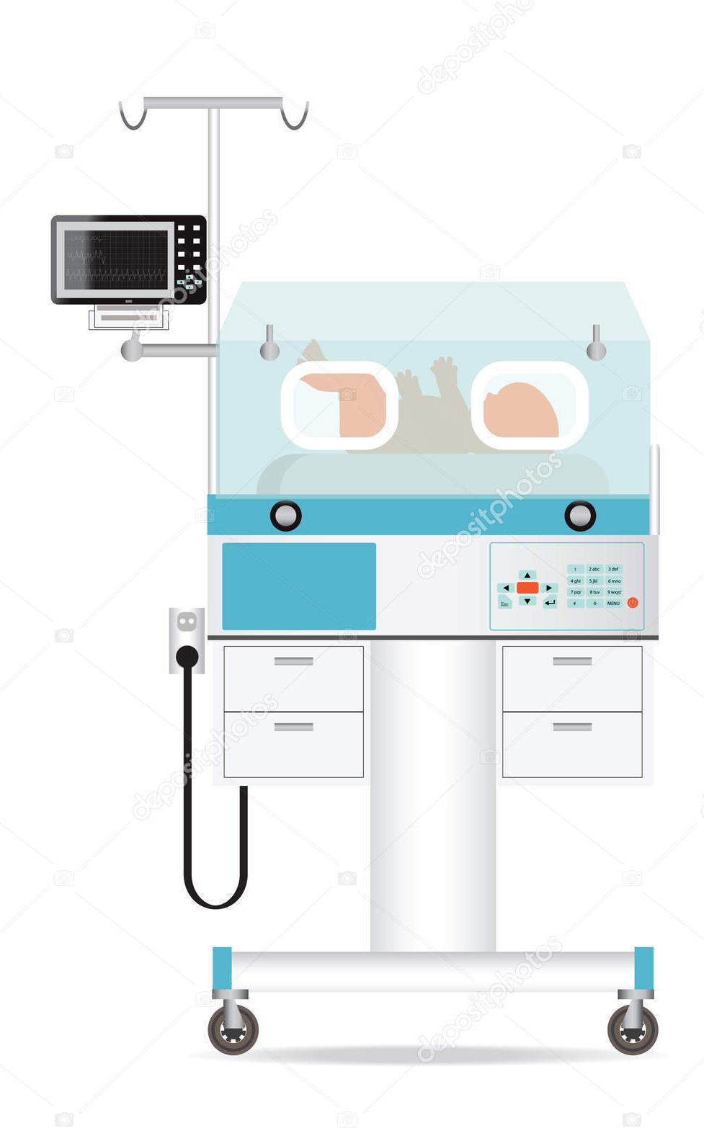
Infant incubators maintain a healthy environment for newborn babies.
They are used for premature babies which are still small and weak as well as for some sick full-term babies.
Incubators are used in the primary care department of a hospital or in the neonatal intensive care unit, NICU
Infant incubators should not be confused with laboratory incubators, which are used to keep reagents or samples warm.

Slide 3
Purpose
The incubator consists of a transparent cabinet in which the baby is kept in a neutral environment for medical care. Neutral means, that the surrounding air has the optimal temperature and moisture and the baby only needs minimum of energy to maintain normal body temperature.

Slide 4
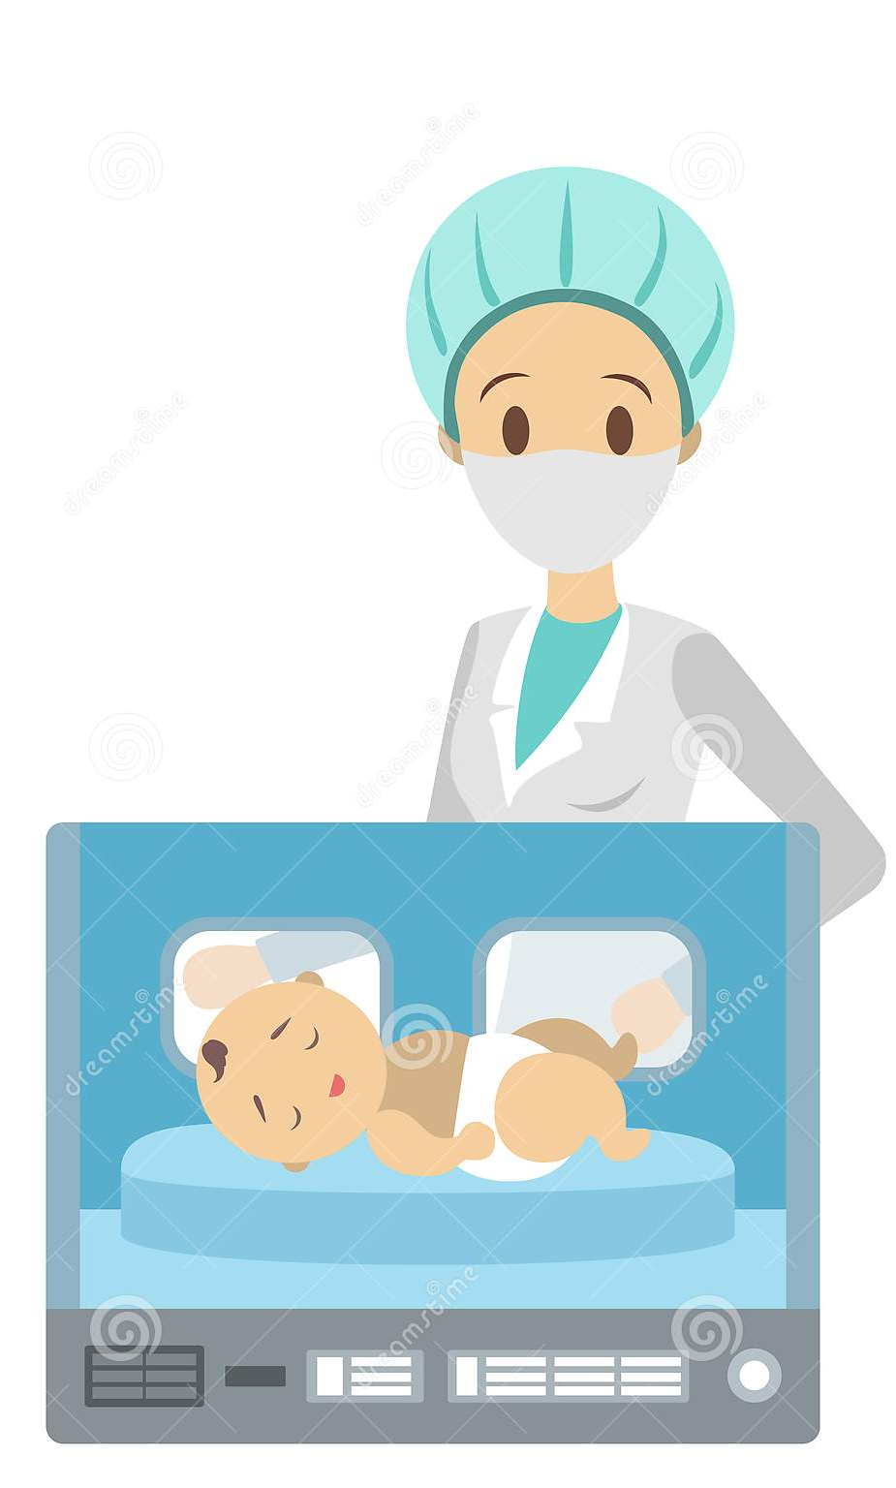
The infant incubator
controls the temperature
controls the humidity
can deliver additional oxygen
protects against infections and
diseases
protects against noise

Slide 5
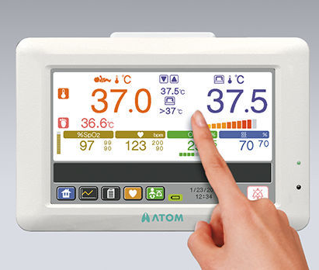
In order maintain the body temperature of the baby (36 - 37.2°C) the incubator must be able to create an ambient air of 34 - 38°C with a humidity of 40 - 80%.

Slide 6
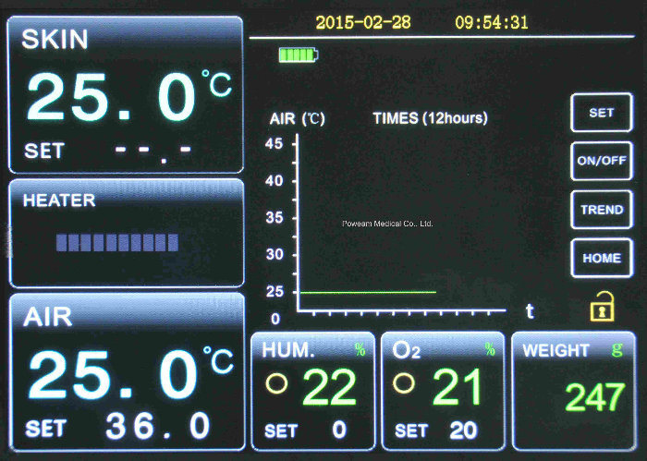
Example

Slide 7
Design
A fan blows filtered ambient air over a heating element and a water container
Through a control valve additional oxygen can be supplied to the air
The moistened, heated and enriched air now flows into the above cabinet with the baby. One part of the air escapes from the cabinet through vent holes, another part gets back into the air processing.
Humidity and oxygen concentration are usually controlled manually by the nurse.
an alarm is given when the fan does not turn in case the power fails

Slide 8
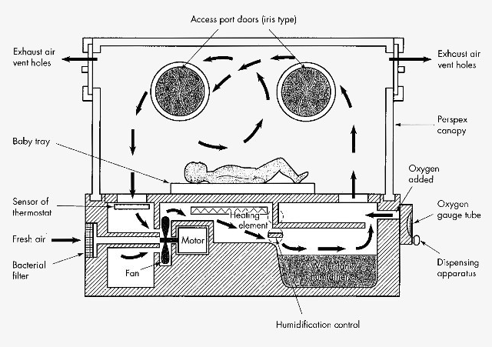

Slide 9
Usage
The usage of an infant incubator is not difficult and the functions should be self-explanatory. Nevertheless the technician and the user have to read the user manual carefully before usage. A missing user manual should be available from the manufacturer or from the Internet. In addition to the instruction of the manufacturer here some general hints:
Check and record the temperature every 5 hours and hourly in a critical care stage.
Default air temperature in the incubator is 35°C.
The setting for the humidity for small babies is 70 - 80% in the beginning, later 40%.
Use distilled water only. It has to be drained and renewed every day.

