Slide 1
Ministry of Higher Education and Scientific Research Al-Mustaqbal University College Radiology Techniques Department
Radiography Abdomen
Radiography Techniques Laboratory
By
Karar Haider

Slide 5
Radiography Abdomen
1- AP supine (KUB)
2- AP erect
3- Left lateral decubitus

Slide 6
AP Supine (KUB): Abdomen
Position
Supine, legs extended, arms at sides
* Ensure no rotation
* Center of IR to level of iliac crests, ensuring that upper margin of symphysis pubis is included on lower IR margin (A large hypersthenic patient may require that the IR be placed landscape with a second IR centered higher)

Slide 7
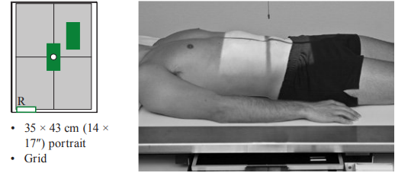
Central Ray: CR to center of IR (level of iliac crests)
SID: 40″ (102 cm)
Collimation: Collimate to upper and lower abdomen so tissue borders
Respiration: Expose at end of expiration
IR size 35 × 43 cm (14 × 17″) lengthwise
Grid

Slide 9
AP Erect : Abdomen
Position
Erect, back against table, arms at sides
Ensure no rotation
Center of IR ≈2″ (5 cm) above iliac crest to include diaphragm (For sthenic patient, top of IR is at level of axilla)
Central Ray: CR horizontal, to center of IR (2″ [5 cm] above iliac crest)
SID: 40″ (102 cm)
Collimation: to so tissue margins of abdomen and diaphragm

Slide 10
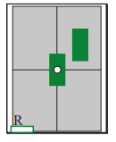
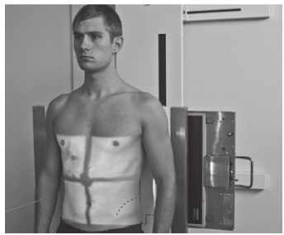
35 × 43 cm (14 × 17″) lengthwise
Grid
Erect marker
Patient should be on side a minimum of 5 minutes before

Slide 12
Lateral Decubitus (AP): Abdomen
Position
Lock wheels of stretcher
Adjust patient and stretcher so that center of IR and table (and CR) is approximately 2″ (5 cm) above level of iliac crest (to include diaphragm)
Adjust height of IR to ensure that upside of abdomen is included for possible free air
Central Ray: CR horizontal, to center of IR
SID: 40″ (102 cm)
Collimation: to so tissue margins of abdomen and diaphragm

Slide 13
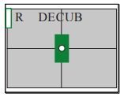
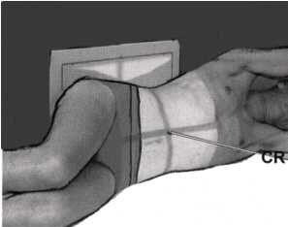
35 × 43 cm (14 × 17″)
Grid
Decubitus marker
Patient should be on side a minimum of 5 minutes before exposure; a period of 10–20 minutes is preferred

Slide 15
Dorsal Decubitus (Lateral): Abdomen
Position
Patient supine (on decubitus board or support to elevate posterior abdomen), side against table, arms above head Secure stretcher (lock wheels)
Center of IR and table (and CR) at level of iliac crest (2″ [5 cm] above iliac crest to include diaphragm)
Central Ray: CR horizontal, to center of IR
SID: 40″ (102 cm)
Collimation: Collimate to upper and lower abdomen so tissue borders

Slide 16
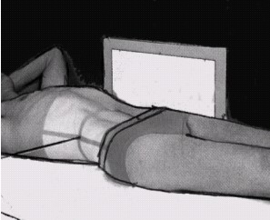
35 × 43 cm (14 × 17″)
landscape
Grid
Include decubitus marker

