Slide 1
lec 2
Pharmaceutical Technology
syrup
Stage: 3/ 1st course
Dr. Ameer S. Sahib

Slide 2
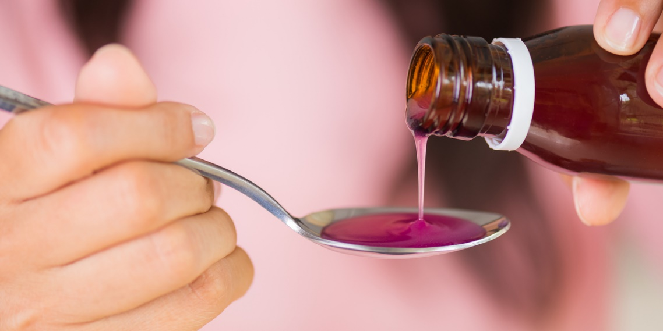
Syrups
Syrups are concentrated solutions of sugar (such as sucrose) in water or other aqueous liquids with or without added flavoring agents and medicinal substances. This mean that there is three types of syrups
1. Simple syrup–concentrated solution of sucrose in purified water alone.
2. Medicated syrup–aqueous solution of sucrose containing other substances as polyols (glycerin and sorbitol)
3. Non‐medicated/Flavored syrup–contained various aromatic and pleasantly flavored substances and is intended as a vehicle or flavor for preparations.

Slide 3
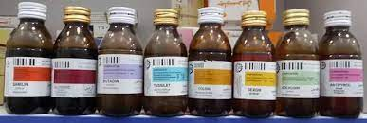
Perhaps the most frequently found types of medications administered as medicated syrups are antitussive agent, antipyretics, analgesics, antihistamines, and others.

Slide 4
Advantage of syrups
Retard oxidation because it partly hydrolyzed into dextrose & levulose (reducing sugary) so prevent decomposition of many substances
Exert high osmotic pressure – prevents the growth of MOs (bacteria, fungi, molds, etc)
Palatable sweet – it is suitable as a vehicle for bitter/nauseous substances
Appropriate for any patient, whatever the age is
Economical and safe to the patient

Slide 5
Disadvantages
Delayed onset of action because absorption takes time
Not suitable in emergency and for unconscious patients
Not convenient for a patient with a gastrointestinal disorder such as diarrhea, constipation, ulceration, and hyperacidity in stomach
Can’t avoid first pass metabolism

Slide 6
Main features of syrups
Sweet
Viscous
Flavored
Sweet so it mask the unpleasant taste of drugs
Flavored will also aid in taste masking
Viscous will ensure physical concealment of the taste due to covering of the taste buds ,also the thick viscous nature of the medicine will sooth the irritated tissue of the throat as it passes over it (especially in case of antitussive syrups)

Slide 7
Classification
medicated
Antihistamine
Vitamins
Flavored (non medicated)
Pleasant tasting vehicle for drugs not available as solution
Used in extemporaneous compounding
Antitussives
Sedatives
For children and elderly who have difficulty swallowing tablet or capsule

Slide 8
Examples of Non medicated syrups
Syrup | Comments
Cherry syrup | Sucrose-based syrup with cherry juice about 47% by volume. Tart fruit flavor is attractive to most patients and acidic pH makes it useful as a vehicle for drugs requiring an acid medium
Cocoa syrup | Suspension of cocoa powder in aqueous vehicle sweetened and thickened with sucrose, liquid glucose, glycerin; flavored with vanilla, sodium chloride. Particularly effective in administering bitter-tasting drugs to children
Orange syrup | Sucrose-based syrup uses sweet orange peel tincture, citric acid as the source of flavor and tartness. Resembles orange juice in taste; good vehicle for drugs stable in acidic medium
Ora-Sweet, Ora-Sweet SF | Commercial vehicles for extemporaneous compounding of (Paddock Laboratories) syrups. Both have a pH of 4-4.5 and are alcohol free. Ora-Sweet SF is sugar free
Syrup | 85% sucrose in purified water. Simple syrup may be used as the basis for flavored or medicated syrups

Slide 9
example Captopril oral liquid
Preferred formula
Using a typical strength of 1 mg/mL as an example:
* captopril tablets 25 mg4
* Ora-Plus to 50mL
* Ora-Sweet to 100 mL.
Method guidance
Tablets can be ground to a fine uniform powder in a pestle and mortar. A small amount of Ora-Plus may be added to form a paste, before adding further portions of Ora-Plus up to 50% of the final volume. Transfer to a measuring cylinder. The Ora-Sweet can be used to washout the pestle and mortar before making the suspension up to 100% volume. Transfer to an amber medicine bottle.
Shelf-life
7 days refrigerated in amber glass. Shake the bottle
Notes:
Handbook of Extemporaneous Preparation A guide to pharmaceutical Compounding
Edited by
Mark Jackson BSc, MPhil, MRPharmS Deputy Director, QCNW/Head of QA/QC, Liverpool Pharmacy Practice Unit, Liverpool, UK Andrew Lowey DPharm, MRPharmS Clinical Pharmacy Manager, Leeds Teaching Hospitals, Leeds, UK On behalf ofThe NHS Pharmaceutical Quality Assurance Committee

Slide 10
Syrup components
Sugar usually sucrose or sugar substitutes.
Antimicrobial preservative
Flavoring agent
Purified water, Solvents, solubility agent, thicker, stabilizer
Drug
Also, it may contain a special solvents (including alcohol), solubilizing agents, thickeners, or stabilizers
antimicrobial
Flavour
Solvent
Drug
Sugar
colour

Slide 11
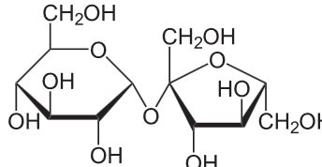
Sucrose
Purest compound commercially available
sweet
Lack of color
Easy to handle

Slide 12
Simple syrup NF
Ŗχ
Sucrose | 85 g
Purified water q.s. | 100 ml
Sucrose 85% w/v
This concentration requires no additional preservatives if the syrup is used soon and not stored or stored properly.

Slide 13
Characteristics of simple sucrose syrup:
The specific gravity of syrup is an important property to identify its concentration. Syrup has a specific gravity of about 1.313, which means that each 100 ml of syrup weighs 131.3 g.
So,
131.3 – 85 = 46.3g or mL of water in the syrup. Thus, 46.3 g of water are mixed with 85 g of sucrose to give syrup 85%w/v.
Solubility of sucrose is expressed as 1g in 0.5ml water
1g 0.5ml
85 X X=42.5
To dissolve 85g of sucrose 42.5ml of water is needed
46.3-42.5=3.8ml /100ml syrup excess water (these 3.8 mL of water are free of sucrose).
Thus, only a very slight excess of water (about 3.8 mL per 100 mL of syrup) is employed in the preparation of syrup. Although not enough to be particularly amenable to the growth of microorganisms, the slight excess of water permits the syrup to remain physically stable in varying temperatures.

Slide 14
Saturated sucrose solution
If the syrup were completely saturated with sucrose, it might crystallize from solution upon cooling
Thereby acting as nuclei that initiate chain reaction which result in separation of an amount of sucrose disproportionate to it’s solubility at the storage temperature.
If it is unsaturated (less concentrated), it will be suitable for microbial growth.
Note: Simple syrup is a saturated solution at 4°C, so no crystallization should be observed unless the temperature drops below 4°C or super saturated

Slide 15
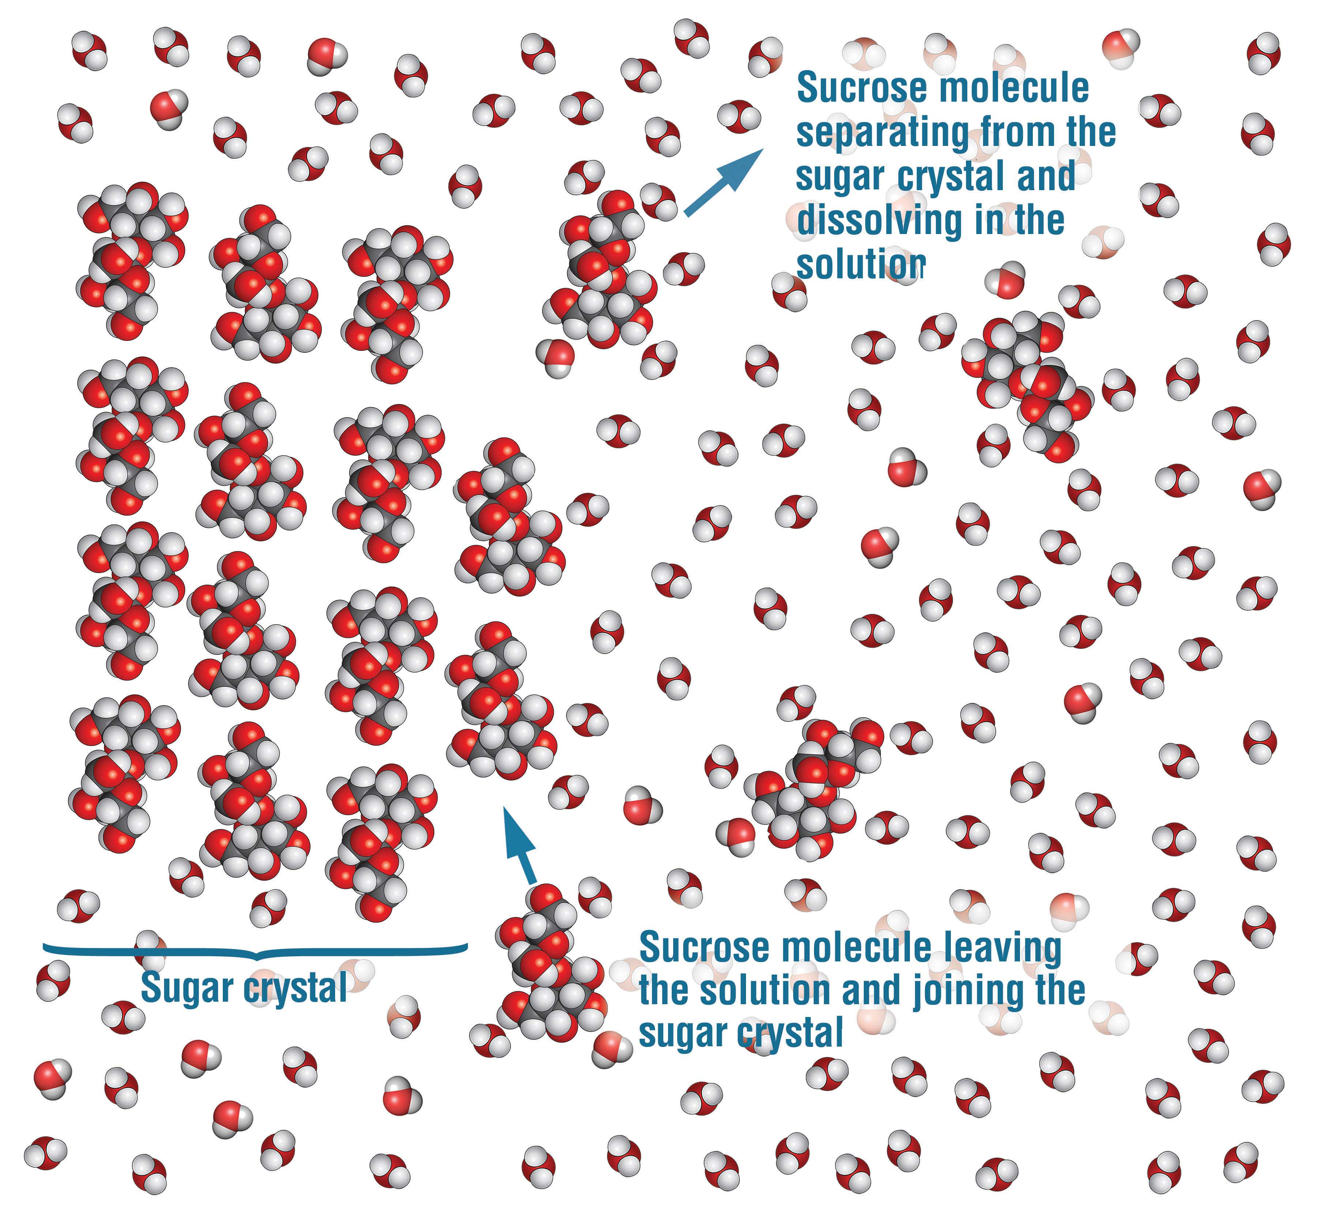

Slide 16
Syrups containing sucrose
Most syrups contain about 60-80% sucrose. This percent is desirable for sweetness and viscosity.
Dilute sucrose solution are prone to microbial growth which result in turbidity, fermentation ,change in color.
Concentrated sugar solution (85%w/v) are resistant to microbial growth.
Syrups containing less than (85%w/v) sucrose, preservatives must be added.

Slide 17
Preservatives
High sucrose concentrations will usually protect an oral liquid dosage form from growth of most microorganisms.
A problem arises, however, when pharmacists must add other ingredients to syrups that can result in a decrease in the sucrose concentration. This may cause a loss of the preservative effectiveness of the sucrose. This can be overcome, however, by calculating the quantity of a preservative (such as alcohol) to add to the formula to maintain the preservative effectiveness of the final product.

Slide 18
Anti- microbial preservative
preservative | Concentration used as %
Benzoic acid | 0.1-0.2
Sod benzoate | 0.1-0.2
Butyl paraben (butyl p-hydroxybenzoate) | 0.02
Propyl paraben 4-hydroxybenzoic acid propyl ester | 0.05
Methyl paraben 4-hydroxybenzoic acid methyl ester | 0.1
Sorbic acid | 0.1
Alcohol 99% | 15-20 (18)
Glycerin | 45

Slide 19
Preservatives
The benzoates and the parabens (hydroxyl-benzoic acids) and sorbic acid are most effective in acid solution
Mixture of parabens are frequently employed to take advantage of their potentiating effect
The amount of added preservative needed in syrups containing sucrose less than 85% w/v is estimated according to the calculated free water.
If the syrups are diluted with water preservatives must be added

Slide 20
Calculate the amount of preservative
Calculate the preservative amount required for 65% sucrose syrup knowing that 85%w/v sucrose will preserve 100ml solution (syrup)
Answer
85 100
65 X X=76.5ml volume of solution preserved by 65%w/v sucrose.
100 - 76.5 = 23.5ml free water (not preserved)
If 0.1% of benzoic acid used, so
0.1g 100
X 23.5 X= 0.0235g of benzoic acid used
The amount of preservative added is calculated according to the volume of the free water

Slide 21
Q calculate the volume of ethanol
Material | Quantity
Drug | 5ml volume occupied
Solids (Other drug solids) | 3ml volume occupied
Glycerin | 15ml
Sucrose | 25g
Ethanol 95% | q.s.
Purified water q.s. | 100ml
Water and ethanol
Sucrose
Glycerin
Others
Drug

Slide 22
Answer
85 / 100 = 25/v v=29.4ml volume of solution preserved
100 - 29.4 = 70.6ml volume of solution not preserved by sucrose
Glycerin can preserve a double amount of water 15×2 =30ml
70.6 – 30 = 40.6ml (not preserved by sucrose and glycerin)
Volume occupied by other components 5+3=8
40.6 – 8 = 32.6ml (not preserved)
0.18 × 32.6 = 5.868 ≈5.9ml of alcohol(99%) required
18 100
X 32.6 X=5.9 ml of alcohol
5.9/0.95=6.21ml of alcohol 95% will be required

Slide 23
Another method for calculations
Simple syrup 85g /100ml solution weighs 131.3g
131.3 - 85=46.3 wt. (g) or volume (ml) of water
100 - 46.3=53.7 ml volume occupied by sucrose
85g sucrose preserves 46.3 ml of water so that:
1g of sucrose preserves 0.54ml of water
Also 85g of sucrose will occupy a volume of 53.7ml so that :
1g of sucrose will occupy 0.63ml
From these two facts we can complete the answer (how?).

Slide 24
Alcohol
In some syrups alcohol is present in small amount as a solvent for alcohol soluble ingredients
Although the concentration of alcohol is not sufficient for preservative effect but the alcohol concentrates in vapor above the syrup, thus preventing the growth of surface molds
In sealed containers vaporization of water from the syrup and condensation will create a dilute solution of sucrose on the surface ,which supports mold growth
Syrups can withstand 10% of alcohol not more.

Slide 25
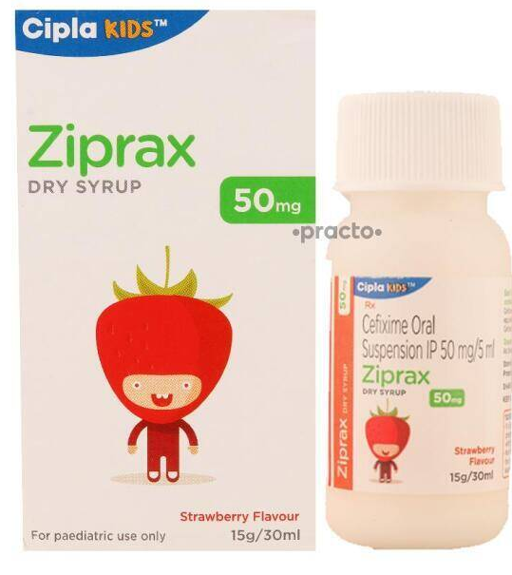
Flavorant
Synthetic flavorants
Naturally occurring materials
Volatile oils
Vanillin
Because syrups are aqueous preparations, these flavorants must be water soluble.

Slide 26
Colorant
The colorant is generally
water soluble.
Non-reactive with the other syrup components.
Color stable at the pH range and under the intensity of light that the syrup is likely to encounter during its shelf life.
Green with mint
Brown with chocolate

Slide 27
Syrups can be preserved by
Storage at low temperature
Adding preservatives in the formulation
By the maintenance of a high concentration of sucrose as a part of the formulation

Slide 28
Antihistamine Syrup
Chlorpheniramine maleate 0.4 g
Glycerin 25.0 mL
Syrup 83.0 mL
Sorbitol solution 282.0 mL
Sodium benzoate 1.0 g
Alcohol 60.0 mL
Color and flavor qs
Purified water qs 1,000 mL
Acetaminophen Syrup Acetaminophen 24.0 g
Benzoic acid 1.0 g
Disodium calcium EDTA 1.0 g Propylene glycol 150.0 mL
Alcohol 150.0 mL
Saccharin sodium 1.8 g
Purified water 200.0 mL
Flavor qs
Sorbitol solution qs 1,000 mL

Slide 29
Home work
Calculate the required amount of sodium benzoate, if you know 0.1% w/v is required to achieve preservation.
State the function of each ingredient in the table.
What do you predict pH of the formula, why?
Predict the color of the formula.
What is the meaning of NF, US, and BP?
If the patient is diabetic, re-write the formula accordingly without the weight of ingredient.
Rx | Amount
Drug | 24ml volume occupied
Sod benzoate | q.s.
Glycerin | 150ml
Alcohol | 15ml
Sucrose | 200g
Orange oil | 2ml
Color | 2ml
Purified water qs | 1000ml

Slide 30
Preparation of syrups
Syrups are prepared by 4 different methods depending on the physical and chemical characteristics of the ingredients
Solution of ingredients with the aid of heat, or called the hot process (Simple Syrup USP).
Solution of ingredients by agitation without heat, or called (simple admixture of liquid component), e.g. Ephedrine Sulphate Syrup USP.
Addition of sucrose to a prepared medicated liquid or to a flavored liquid (Orange Syrup USP).
Percolation of either the source of the medicating substance or of the sucrose. Wild Cherry Syrup USP, Licorice syrup USP, Ipecac Syrup USP

Slide 31
Solution with the aid of heat
Syrups are prepared by this method for the following reasons:
A. When desired to prepare the syrup as quickly as possible, and
B. When the syrups components are not damaged or volatilized by heat
Procedure:
1. Add the sugar to the purified water and heat until solution is affected.
2. Heat stable components are added to the hot syrup
3. Cool and made up to volume.
4. If other components are heat labile, they are added after cooling, like alcohol and oil.
Caution: Do not apply excessive heat -inversion of sucrose causing discoloration due to caramelization (what is the cause of caramelization?).
Examples : Acacia syrup, NF; Cocoa Syrup, NF; Syrup USP (85% sugar, made by cold and hot process, percolation).

Slide 32

Precautions
Because of the prospect of decomposition by heat, syrups cannot be sterilized by autoclaving
The use of excessive heat cause hydrolytic decomposition of sucrose to glucose and fructose (invert sugar)
Inversion is increased by the presence of acids, the hydrogen ion acting as a catalyst to the reaction.
Invert sugar is sweeter darker in color (carmalization) and more susceptible to fermentation

Slide 33
hydrolysis of sucrose (specific acid catalyzed) called inversion
Sucrose | Glucose (dextrose) | Fructose (laevulose)
Dextro -rotation | Dextro- rotation | Levo rotation of the light more pronounced than dextrose
Degrees of sweetness 100 (1) | 74 (0.5-0.9) | 173 ( 1.2)
Colorless liquid | Solution of invert sugar are more prone to microbial growth | Degradation leads to brown discoloration (caramelization)

Slide 34
2. Solution of ingredients by agitation without the aid of heat
To avoid heat-induced inversion of sucrose, a syrup may be prepared without heat by agitation
Procedure:
1. Sucrose and other formulative agents maybe dissolved in purified water.
2. Place the ingredients in a bottle of greater capacity than the volume of syrup.
3. Agitate the mixture
Examples: Ferrous Sulfate Syrup, Ephedrine Sulfate, Citric acid Syrup, and Glycyrrhiza Syrup
More time consuming than the use of heat but the product has maximum stability
Miscible Liquid ingredients are incorporated during mixing
When solid agents are to be added to a syrup, it is best to dissolve them in a minimal amount of purified water and incorporate the resulting solution into the syrup, this because (viscous nature of the syrup retards the dissolution of solids , also amount of free water is limited )

Slide 35
3-Addition of Sucrose to a Medicated Liquid or to a Flavored Liquid
This method is resorted to those cases in which fluid extracts, tinctures, or other liquids are added to syrup to medicate it.
Syrups made in this way usually develop precipitates since alcohol is often an ingredient of the liquids and the resinous and oily substances dissolved by alcohol precipitate when mixed with syrup.
A modification of this process consists of mixing the fluid extract or tincture with the water, allowing the mixture to stand to permit the separation of insoluble constituents, filtering & and then dissolving the sucrose in the filtrate.
➔This procedure is not permissible when the precipitated
ingredients are the valuable medicinal agents.

Slide 36
4. Percolation
It is an extraction method used glass percolator.
In this method, either sucrose maybe percolated to prepare the syrup or the sucrose of the medicinal component may be percolated to form an extractive to which sucrose or syrup may be added
Procedure:
1. Purified water or aqueous solution of a medicating or flavoring liquid is allowed to pass slowly through a column of crystalline sucrose to dissolve it.
2. The percolate is collected and returned to the percolator as required until all of the sucrose has been dissolved.
3. Percolator with a pledge of cotton at the bottom is used
Example: Tolu Balsam syrup -flavor for cough syrup

Slide 37
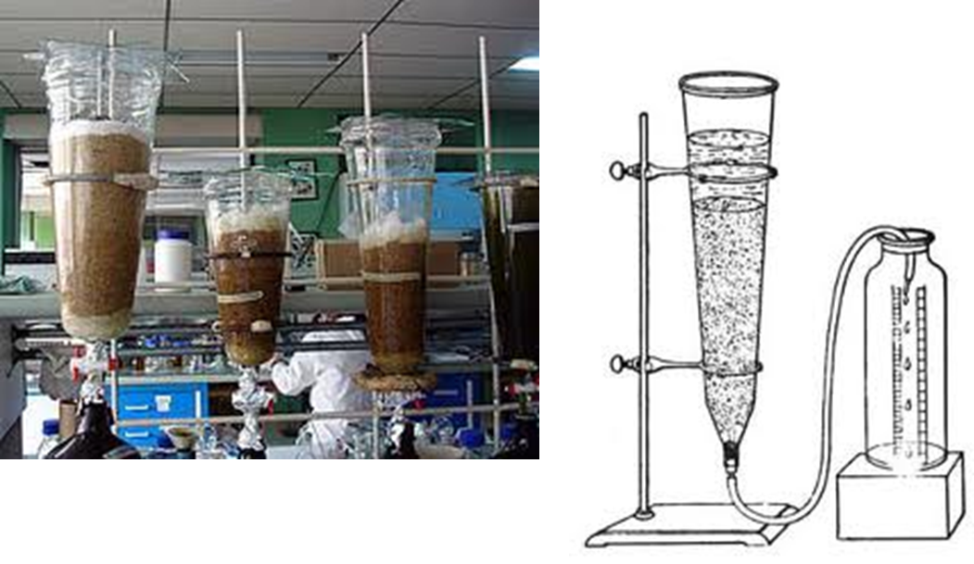
Percolator

Slide 38
percolation method
In percolation method either we prepare by
1- purified water or an aqueous solution is permitted to pass slowly through a bed of crystalline sucrose, thus dissolving it and forming a syrup a pledged of cotton is placed in the neck of the percolator
If necessary, a portion of the liquid is re passed through the percolator to dissolve all of the sucrose.
This method is used for the preparation of Syrup USP.
2- or the source of the medicinal component may be percolated to form an extractive to which sucrose or syrup may be added.
This latter method really is two separate procedures: first the preparation of the extractive of the drug and then the preparation of the syrup.

Slide 39
Ipecac syrup USP
Ipecac syrup, which is prepared by adding glycerin and syrup to an extractive of powdered ipecac obtained by percolation (2nd method).
The drug ipecac, which consists of the dried rhizome and roots of Cephaëlis ipecacuanha, contains the medicinally active alkaloids emetine, cephaeline, and psychotrine.
These alkaloids are extracted from the powdered ipecac by percolation with a hydroalcoholic solvent.
The syrup is categorized as an emetic with a usual dose of 15 mL.
This amount of syrup is commonly used in the management of poisoning in children when evacuation of the stomach contents is desirable. About 80% of children given this dose will vomit within half an hour.

Slide 40
Dextrose-Based Syrups
Dextrose may be used as a substitute for sucrose (WHEN?) in syrups containing strong acids in order to eliminate the discoloration associated with inversion.
Dextrose forms a saturated solution in water at 70% w/v, which is less viscous than simple syrup.
It dissolves more slowly than sucrose and is less sweet (0.7-.8). Preservatives are required to improve the keeping qualities of such syrups. Glycerin is added in 30% to 45% v/v as preservative.

Slide 41
Non- sucrose based syrups
Diabetic simple syrup
Artificial syrups (Non nutritive syrups )
Intended as substitutes for syrups and to be administered to persons who must regulate their sugar and/or calorie intake accurately. e.g. persons suffering from diabetes mellitus. Some early formulae included glycerin, however, glycerin and propylene glycol are glycogenetic substances, i.e. they are materials which are converted into glucose in the body. An example of non–nutritive syrup is “Diabetic Simple Syrup”. It contains compound sodium cyclamate (6% cyclamate sodium and 0.6% saccharin sodium) or saccharin . However, the cyclamate studies showed that the sweetener could produce cancer in animals and, as a result, this substance was removed from a wide variety of products. Similar studies have been carried out on saccharin. Much research has been done to find a safe synthetic substitute for sucrose. As a result, aspartame which is about 200 times sweeter than sucrose, is being used now in many commercial preparations as the sweetening agent.

Slide 42
Non- sucrose based syrups
Viscosity builders
Non-glycogenic
Natural
Semi synthetic
Glycogenic
Polyols

Slide 43
viscosity builders
1-Glycogenic (Polyols) sorbitol (64%), glycerin, propylene glycol
2- Non- glycogenic , Polymers (Gums)
  Natural Tragacanth, Acacia
  Semi synthetic
  Methylcellulose MC (nonionic , exothermic )
  Hydroxypropylmethylcellulose HPMC (nonionic)
  Sodium Carboxymethylcellulose Sod CMC(anionic),
  Sod Alginate (anionic) ,

Slide 44
Tragacanth and Acacia
Tragacanth
Naturally occurring dried gum consists of a mixture of water-insoluble and water soluble polysaccharides.
Bassorin, which is the main water-insoluble portion, while the remainder of the gum consists of the water-soluble material tragacanthin.
On hydrolysis, tragacanthin yields L-arabinose, L-fucose, D-xylose, D-galactose, and D-galacturonic acid.
Acacia
Complex, loose aggregate of sugars and hemicelluloses
The aggregate consists essentially of an arabic acid nucleus to which are connected calcium, magnesium, and potassium along with the sugars arabinose, galactose, and rhamnose.

Slide 45
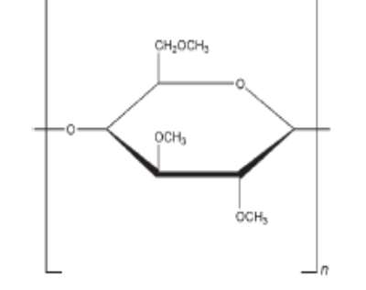
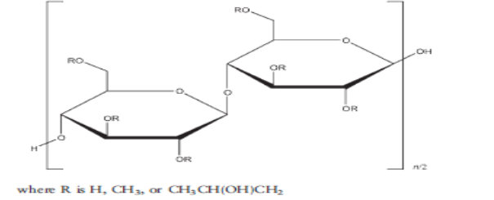
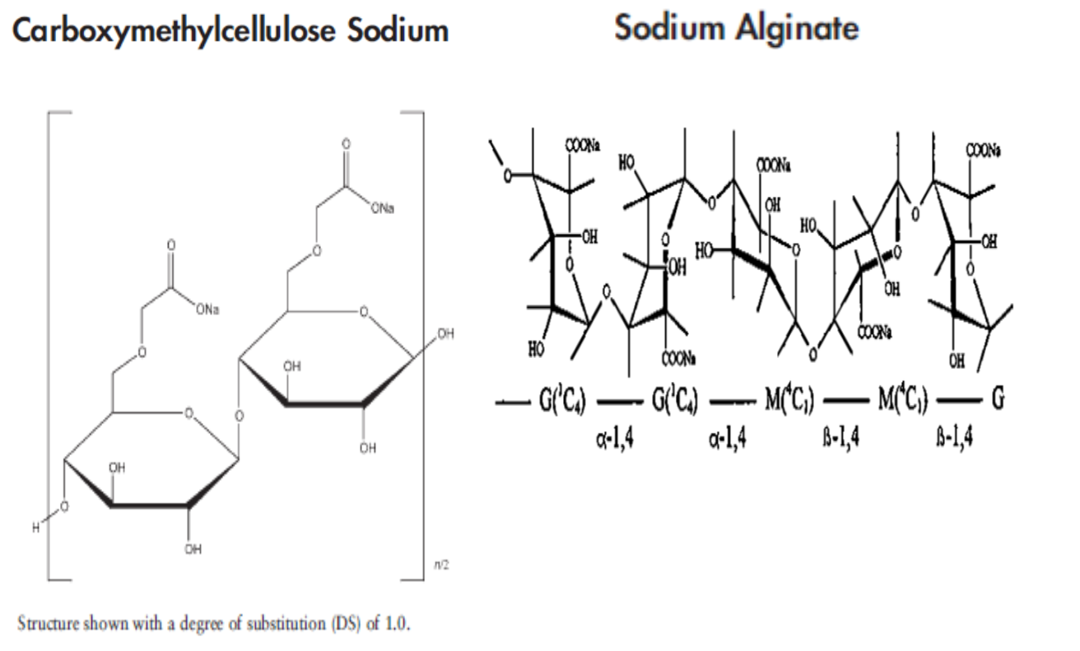
Structures of semisynthetic gums
Methylcellulose MC
Hydroxpropylmethyl cellulose HPMC

Slide 46
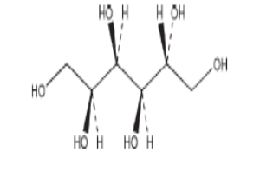
Sorbitol based syrup
Hexa-hydric alcohol
C6H14O6
Glucose hydrogenation
Crystalline sorbitol
White ,odorless
Non volatile
70%w/w
Substitute for sucrose
Diabetic patients

Slide 47
Sorbitol-Based Syrups
Sorbitol which is hexahydric alcohol made by hydrogenation of glucose has been used in the preparation of syrup.
It is used mostly in the form of a 70% w/w aqueous solution.
Sorbitol solution is not irritating to the membrane of the mouth and throat and does not contribute to the formation of dental carries.
Sorbitol is metabolized and converted to glucose; however, it is not rapidly absorbed from the GlT as sugars. No significant hyperglycemia has been found (WHY?); it may be used as component of non-nutritive vehicles.
Sorbitol solution does not support mold growth. Preservative should be used in solution containing less than 60% w/w sorbitol.
It is chemically stable and inert with respect to drugs and other ingredients used in pharmaceutical perpetration.

Slide 48
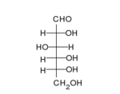

Sorbitol
Glucose

Slide 49
Advantage of sorbitol solution addition to simple syrup
Compatible with other polyols
Can be added (30%) to simple syrup to reduce crystallization
Sorbitol inhibits the sticking or locking of bottle caps which occur with high concentrations of sucrose

Slide 50
Linctuses
A syrupy or sticky preparation containing medicaments exerting a local action on the mucous membrane of the throat
Linctuses are viscous preparations that contain the therapeutic agent dissolved in a vehicle composed of a high percentage of sucrose and, if required, other sweetening agents. (honey or glucose syrup)
Linctuses are often used when the drug has a bitter taste
These formulations are administered orally and are primarily employed for the treatment of cough, due to their soothing actions on the inflamed mucous membranes.
Linctuses may also be formulated as sugar-free alternatives in which sucrose is replaced by sorbitol and the required concentration of sweetening agent

Slide 51
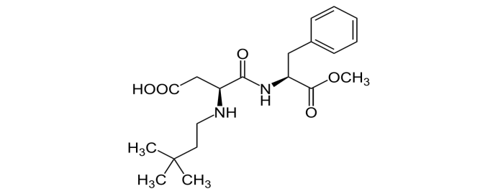
Sweetener | Degree of sweetness (sucrose reference) | Chemical structure | Comment
Saccharin Sweet “N” Low® | 500 |  | Bitter after taste
Sod cyclamate | 30 |  | Banned in USA
Aspartame Aspartyl phenylalanine methyl ester Canderel® Neotame (N-[N-(3,3- dimethylbutyl)-L--aspartyl]-L-phenylalanine 1-methyl ester) Nutrasweet® | 200 8000 |  | Unstable in hot solution,(PKU)
Sucralose Splenda® | 600 |  | Stable over a broad pH range
Acesulfame –K Nutrinova® | 200 |  | Heat stable

Slide 52
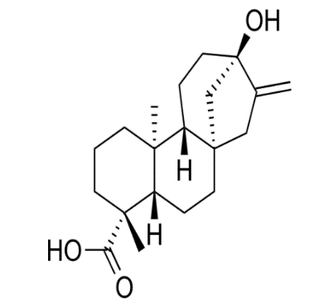
Natural Sweetener | Degree of sweetness | Chemical structure | Comments
Stevia | 250 |  | Extracts known as rebiana, Truvia, PureVia; mainly containing rebaudioside A, a steviol glycoside
Sorbitol | 0.6
Xylitol | 1.0
Mannitol | 0.5 |  | Derived from Mannose

Slide 53
