Slide 1
FAME
UNIT SEVEN

Slide 2
Contents
Past simple
Present perfect
Past simple vs. present perfect
Since and for
Adverbs
Word pairs

Slide 3
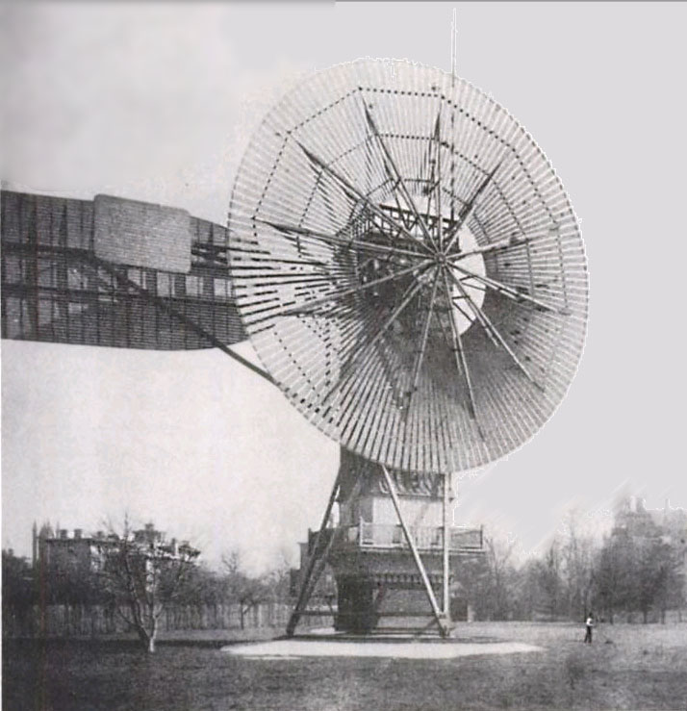
Past Tense
The past tense is formed by adding ‘ed’ to regular verbs:
Work – worked
Ask – asked
Irregular verbs are conjugated differently:
Go – went
Speak – spoke
Sleep – slept
Can – could
Dream – dreamt
Cut – cut

Slide 4
PAST SIMPLE
Affirmative: S + v-ed + c.
He helped his colleagues.
Negative: S + didn’t + base verb + c.
He didn’t help his colleagues.
Question: Did + s + base verb + c?
Did he help his colleagues?

Slide 5
SAMPLE QUESTIONS
She (copy) her classmate’s answer. (past)
She copied her classmate’s answer.
Nisa left school last year. (negative)
Nisa didn’t leave school last year.
He broke his leg in the match. (question)
Did he break his leg in the match?

Slide 6
PRESENT PERFECT
VERB FORM
To change the verb form into the past participle, you simply add ‘ed’ or ‘d’ to the end of the regular verb.
film –filmed
Answer –answered
If the verb is irregular, then it has a special form:
Go – gone
Write – written
Hide - hid
Notes:
Consider talking about:
Generator characteristics and stability
Offshore wind power
Collection and transmission network

Slide 7
PRESENT PERFECT
Affirmative: s + has/have + p.p. + c.
He has done his homework.
Negative: s + has/have + not + p.p. + c.
He has not done his homework.
Question: Has/Have + s + p.p. + c?
Has he done his homework?
Notes:
Consider talking about:
Generator characteristics and stability
Offshore wind power
Collection and transmission network

Slide 8
SAMPLE QUESTIONS
She (revise) for the test. (present perfect)
She has revised for the test.
They have met by chance. (negative)
They have not met by chance.
You have lived a broad. (question)
Have you lived abroad?
Notes:
Consider talking about:
Generator characteristics and stability
Offshore wind power
Collection and transmission network

Slide 9
PAST TENSE VS. PRESENT PERFECT
Past Simple
Present Perfect
Used to refer to an action at a definite time:
He died in 1882.
The action is finished.
I lived in Paris for ten years.
Adverbs: ago, last, in + year, yesterday,
Used to refer to an action at an indefinte time:
She has writtem many novels.
The action can continue to the present:
I have lived in Paris for ten years.
Adverbs: just, already, yet, never, ever

Slide 10
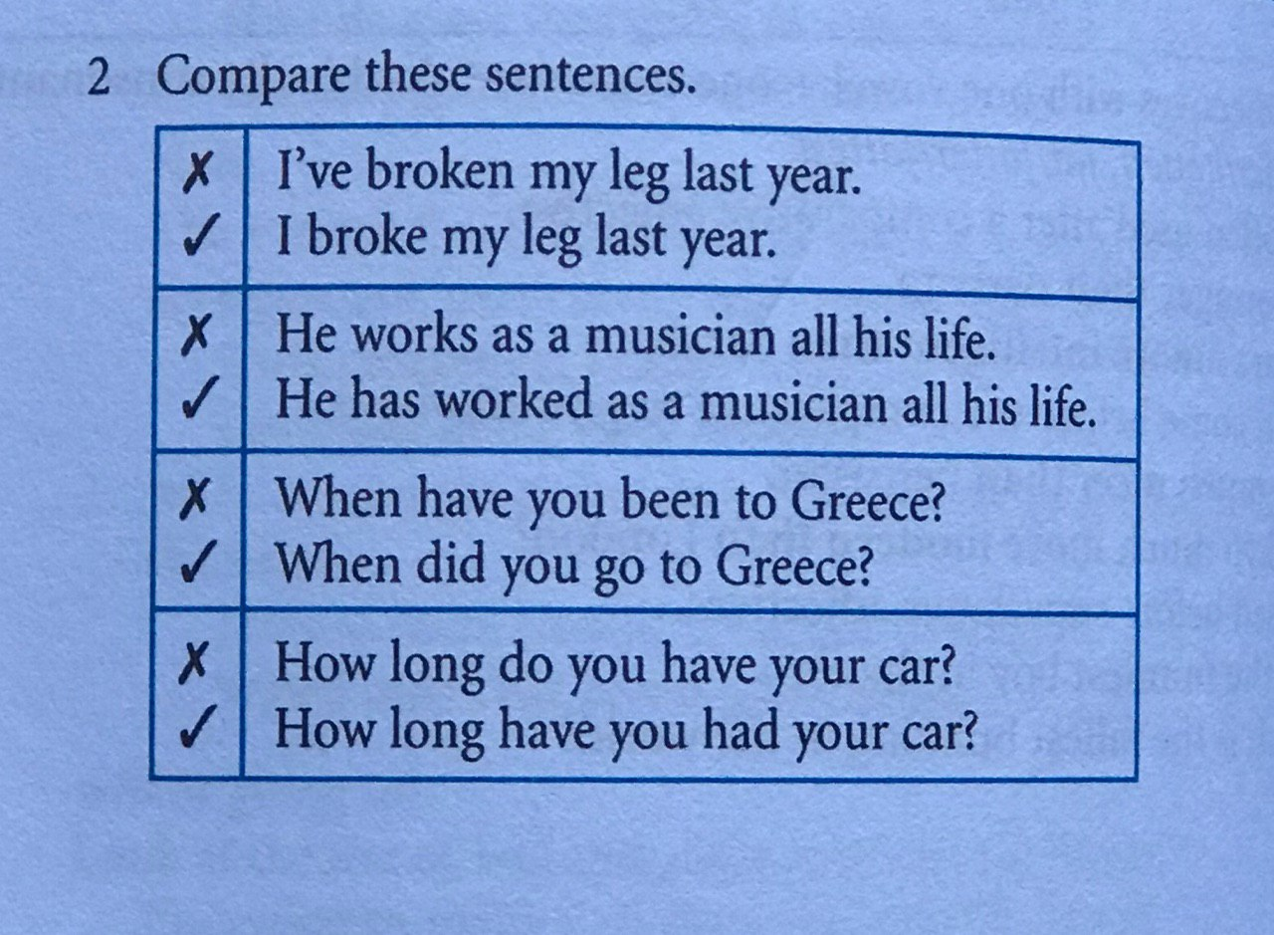
SAMPLE QUESTIONS
Used to refer to an action at an indefinte time:
She has writtem many novels.
The action can continue to the present:
I have lived in Paris for ten years.
Adverbs: just, already, yet, never, ever

Slide 11
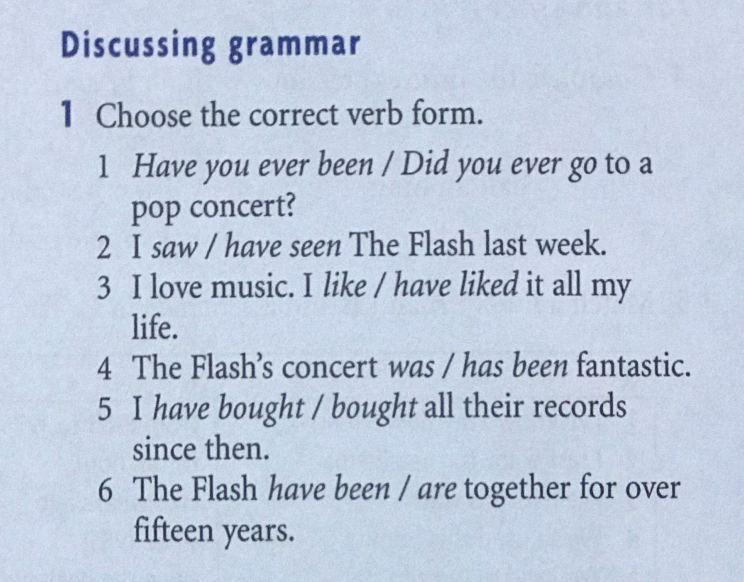
SAMPLE QUESTIONS

Slide 12
SINCE & FOR
We use for with a period of time.
For half an hour
For a couple of days
We use since with a point in time.
Since January
Since I was a student
Notes:
Consider talking about:
Growth trends
Capacity factor
Penetration
Variability
Predictability
Energy storage
Capacity credit, fuel savings and energy payback

Slide 13
SAMPLE QUESTIONS
Notes:
Consider talking about:
Growth trends
Capacity factor
Penetration
Variability
Predictability
Energy storage
Capacity credit, fuel savings and energy payback

Slide 14
WORD PAIRS
Notes:
Consider talking about:
Growth trends
Capacity factor
Penetration
Variability
Predictability
Energy storage
Capacity credit, fuel savings and energy payback

Slide 15
HOMEWORK
Notes:
Consider talking about:
Growth trends
Capacity factor
Penetration
Variability
Predictability
Energy storage
Capacity credit, fuel savings and energy payback

Slide 16
HOMEWORK
Notes:
Consider talking about:
Growth trends
Capacity factor
Penetration
Variability
Predictability
Energy storage
Capacity credit, fuel savings and energy payback

Slide 17
Thank you!
If you have any question, please do not hesitate to contact me.

