Slide 1
It all went wrong!
Unit three…

Slide 2
The past simple is used to talk about past events. Some adverbs such as yesterday, ago or last week are usually used with it.

Slide 3
The past form of the verb us either:
Regular
Irregualr
Ask – asked
Walk – walked
Wonder – wondered
Fail – failed
Stay – stayed
Study – studied
Go - went
Can – could
See – saw
Sleep – slept

Slide 4
Sample questions…
Write the infinitive of these verbs
Write the past form of these verbs
Wrote –
Hoped –
Moved –
Would
Can –
Hear –
Cover –
Carry –
Pray -

Slide 5
Making connections
I failed my test so I will re-take it.
I will re-take the test because I failed it.
It was my birthday yesterday and I got a special present.
It was my birthday yesterday, but I didn’t get any present.
So connects between cause and result
Because connects between result and cause
And connects between two senetnces without contrast
But connects two sentnces with contrast

Slide 6
Sample questions…
I felt ill ……….. (because, so, but) I went to bed.
We all laughed …………… (because, so, and) he told such a funny story.
I have lost my passport ………. (because, so, but) I haven’t found it yet.
I heard a strange noise ……….(because, and, but) I called the police.

Slide 7
Past simple and past continuous
We usually use the past simple and the past continuous in the same sentence when we have two actions. The verb that refers to the action that lasted longer is usually put in the past continuous and the shorter actions is put in the past simple.
I was grading the students’ test papers when the power went off.
Sara found her visa card while she was cleaning her bedroom.

Slide 8
Sample questions…
While I (shopped/was shopping) this morning, I (lost/was losing) my money.
Last week the police …………. (stop) Alan in his car because he ……… (drive) so fast.

Slide 9
Time expressions
American style
British style
Month/day/year
Day/month/year

Slide 10
Time prepositions at – on - in
I received my second citizenship ….. 10:30 ……. The morning …….. Wednesday ….. April ……. spring ……… 2016.
At with o’clock, the weekend
On with days, dates
In with the day parts, months, seasons, years, decades, centuries

Slide 11
Write your brithday date and time details in both American style and British Style
American
British
Ex.
I wsa born at four: twenty o’clock in the afternon on Saturday, June the fourth, 1988.
Ex.
I was born at twenty past four o’clock in the afternoon on Saturday, the fourth of June, 1988.

Slide 12
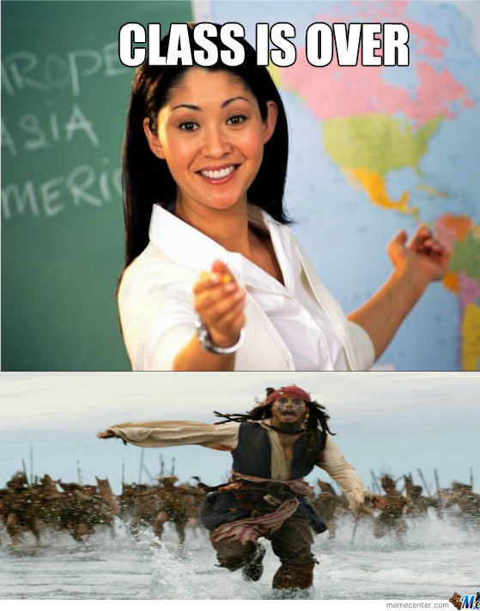
Bye

Slide 13
Dear students, If you have any questions or need help, please do not hesitate to contact the course instructor: Adyan Al-Rubyee e-mail: adyanalrubyee@gmail.com mobile: +9647817332801

