Slide 1
Pharmacology II
4th stage
Lec. 2
CNS Stimulants

Slide 2
CNS Stimulants
A type of drug that increases the levels of certain chemicals in the brain and increases alertness, attention, energy, and physical activity.
CNS stimulants also raise blood pressure and increase heart rate and breathing rate.

Slide 3
CNS Stimulants
two groups of drugs that act primarily to stimulate the central nervous system (CNS).
The first group, the psychomotor stimulants, cause excitement and euphoria, decrease feelings of fatigue, and increase motor activity.
The second group, the hallucinogens, produce profound changes in thought patterns and mood.

Slide 4
Psychomotor Stimulants include
A. Methylxanthines
B. Nicotine
C. Cocaine
E. Amphetamine
F. Dextroamphetamine
G. Methylphenidate

Slide 5
A. Methylxanthines
The methylxanthines include
Theophylline which is found in tea;
Theobromine, found in cocoa; and
Caffeine found in coffee, tea, cola drinks, chocolate, and cocoa.

Slide 6
Mechanism of action: includes,
inhibition of phosphodiesterase enzyme : lead to increase cyclic adenosine monophosphate cAMP and cyclic guanosine monophosphate cGMP .
blockade of adenosine receptors.

Slide 7
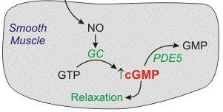
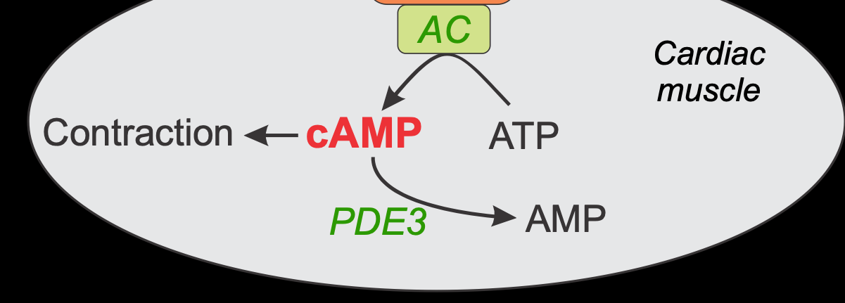
inhibition of phosphodiesterase enzyme
No: nitric oxide
GC: guanylyl cyclase
AC: Adenylyl cyclase
PDE: phosphodiesterase

Slide 8
Actions
CNS:
The caffeine contained in one to two cups of coffee (100-200 mg) causes a decrease in fatigue and increased mental alertness. Consumption of 1.5 g of caffeine (12 to 15 cups of coffee) produces anxiety and tremors.
Tolerance can rapidly develop to the stimulating properties of caffeine; withdrawal consists of feelings of fatigue and sedation.

Slide 9
Cardiovascular system: A high dose of caffeine has positive inotropic and chronotropic effects on the heart.
Diuretic action: Caffeine has a mild diuretic action that increases urinary output of sodium, chloride, and potassium.

Slide 10
Gastric mucosa: Because all methylxanthines stimulate secretion of hydrochloric acid from the gastric mucosa, individuals with peptic ulcers should avoid beverages containing methylxanthines.

Slide 11
Therapeutic uses: Caffeine and its derivatives relax the smooth muscles of the bronchioles so it can be used in asthma.
Pharmacokinetics: The methylxanthines are well absorbed orally. All the methylxanthines are metabolized in the liver and excreted in the urine.
Adverse effects: Moderate doses of caffeine cause insomnia, anxiety, and agitation.

Slide 12
B. Nicotine
Nicotine is the active ingredient in tobacco. In low doses, nicotine causes ganglionic stimulation by depolarization. At high doses, nicotine causes ganglionic blockade.

Slide 13
Actions:
CNS: Nicotine is highly lipid soluble and readily crosses the blood-brain barrier. Cigarette smoking or administration of low doses of nicotine produces some degree of euphoria and relaxation. It improves attention, learning, problem solving.

Slide 14
High doses of nicotine result in central respiratory paralysis and severe hypotension caused by medullary paralysis .
Nicotine is an appetite suppressant.

Slide 15
Peripheral effects: Stimulation of sympathetic ganglia as well as the adrenal medulla increases blood pressure and heart rate. Stimulation of parasympathetic ganglia also increases motor activity of the bowel.

Slide 16
At higher doses, the activity ceases in both the gastrointestinal tract and bladder musculature as a result of a nicotine-induced block of parasympathetic ganglia.

Slide 17
Pharmacokinetics: Because nicotine is highly lipid soluble, absorption readily occurs via the oral mucosa, lungs, gastrointestinal mucosa, and skin.
Nicotine crosses the placental membrane and is secreted in the milk of lactating women.
Clearance of nicotine involves metabolism in the lung and the liver and urinary excretion.

Slide 18
Adverse effects: irritability, tremors, intestinal cramps, diarrhea, and increased heart rate and blood pressure.
Withdrawal syndrome: nicotine is an addictive substance. Withdrawal is characterized by irritability, anxiety, restlessness, difficulty concentrating, headaches, and insomnia.

Slide 19
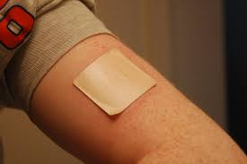
Nicotine patch

Slide 20
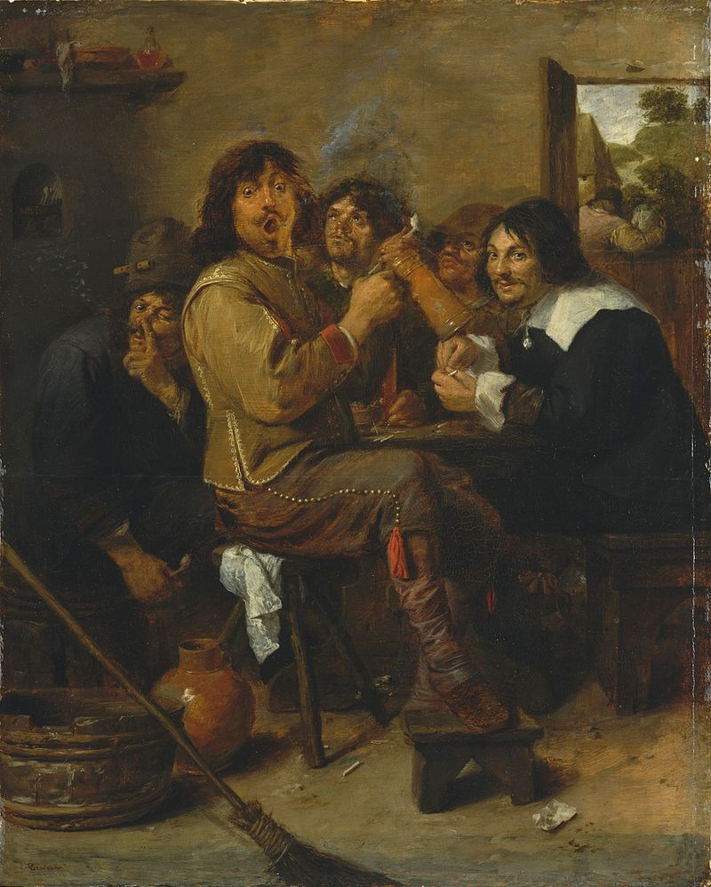
C. Cocaine
Cocaine is a widely available and highly addictive drug. The primary mechanism of action is blockade of reuptake of the monoamines (norepinephrine, serotonin, and dopamine) into the presynaptic terminals from which these neurotransmitters are released.

Slide 21
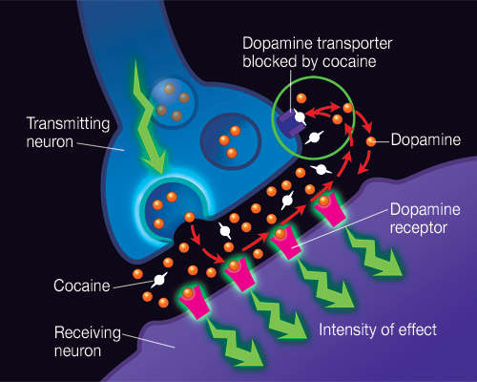

Slide 22
Actions:
CNS: Cocaine acutely increases mental awareness and produces a feeling of well-being and euphoria. at high doses, it causes tremors and convulsions, followed by respiratory depression.

Slide 23
Sympathetic nervous system: Peripherally, cocaine potentiates the action of norepinephrine ,this is associated with tachycardia, hypertension, pupillary dilation, and peripheral vasoconstriction.

Slide 24
D. Amphetamine
Amphetamine shows effects quite similar to those of cocaine.
Mechanism of action
As with cocaine, the effects of amphetamine on the CNS and peripheral nervous system are indirect; that is, both depend upon an elevation of the level of catecholamine neurotransmitters in synaptic spaces. Amphetamine, however, achieves this effect by releasing intracellular stores of catecholamines. Amphetamine also inhibits monoamine oxidase (MAO).

Slide 25
Actions:
CNS: increasing the release of dopamine and norepinephrine leads to increased alertness, decreased fatigue, depressed appetite, and insomnia.
These CNS stimulant effects of amphetamine and its derivatives have led to their use in therapy for hyperactivity in children, narcolepsy, and for appetite control.

Slide 26
Narcolepsy is a relatively rare sleep disorder that is characterized by uncontrollable bouts of sleepiness during the day. It is sometimes accompanied by catalepsy, a loss in muscle control, or even paralysis brought on by strong emotions, such as laughter. However, it is the sleepiness for which the patient is usually treated with drugs such as amphetamine , methylphenidate and modafinil.

Slide 27
Attention deficit hyperactivity disorder (ADHD)
Some young children are hyperkinetic and lack the ability to be involved in any one activity for longer than a few minutes.

Slide 28
F. Methylphenidate
Used for the treatment of ADHD. Children with ADHD may produce weak dopamine signals, methylphenidate is a more potent dopamine transport inhibitor than cocaine, thus making more dopamine available.
Adverse reactions: Gastrointestinal effects include anorexia, insomnia, nervousness, and fever.

Slide 29
Hallucinogens
The individual under the influence of these drugs is incapable of normal decision making, because the drug interferes with rational thought.
Lysergic acid diethylamide:
B. Tetrahydrocannabinol
C.Phencyclidine

Slide 30
Lysergic acid diethylamide:
The drug shows serotonin (5-HT) agonist activity, activation of the sympathetic nervous system occurs.
low doses of LSD can induce hallucinations, High doses may produce long-lasting psychotic changes in susceptible individuals.

Slide 31
B. Tetrahydrocannabinol: present in marijuana.
THC can produce euphoria, followed by drowsiness and relaxation. In addition to affecting short-term memory and mental activity, appetite stimulation and visual hallucinations.

Slide 32
It is indicated as an appetite stimulant, It is also sometimes given for the severe emesis caused by some cancer chemotherapeutic agents .

Slide 33
The CB1-receptor antagonist, rimonabant, is effective in the treatment of obesity and has been found to decrease appetite and body weight in humans.
Adverse effects include increased heart rate, and reddening of the conjunctiva.

