Slide 1
Packed Cell Volume (PCV) M.sc. Duaa Falah pharmacology and toxicology

Slide 3
packed cell volume
PCV is a measurement of the proportion of blood that is made up of cells. The value is expressed as a percentage or fraction of cells in blood. For example, a PCV of 40% means that there are 40 millilitres of cells in 100 millilitres of blood

Slide 4
There are other names for the hematocrit
packed cell volume (PCV)
volume of packed red cells (VPRC)
erythrocyte volume fraction (EVF).
Theterm hematocrit ( British English) comes from the Ancient Greek.
hematocrit means "to separate blood.

Slide 6
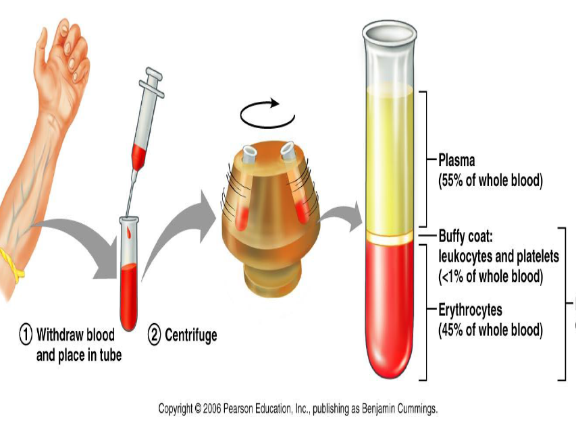

Slide 7
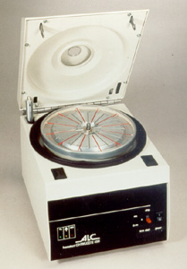
Specific Equipment
Capillary tubes
Oily-clay sealer
Hematocrit centrifuge
Hematicrit reader

Slide 8
Procedure: Fill blood into capillary tubes for up to 2/3 of its length.
Seal bottom of the tube with oily-clay sealer.
Clean outside the tube with tissue paper nicely.

Slide 9
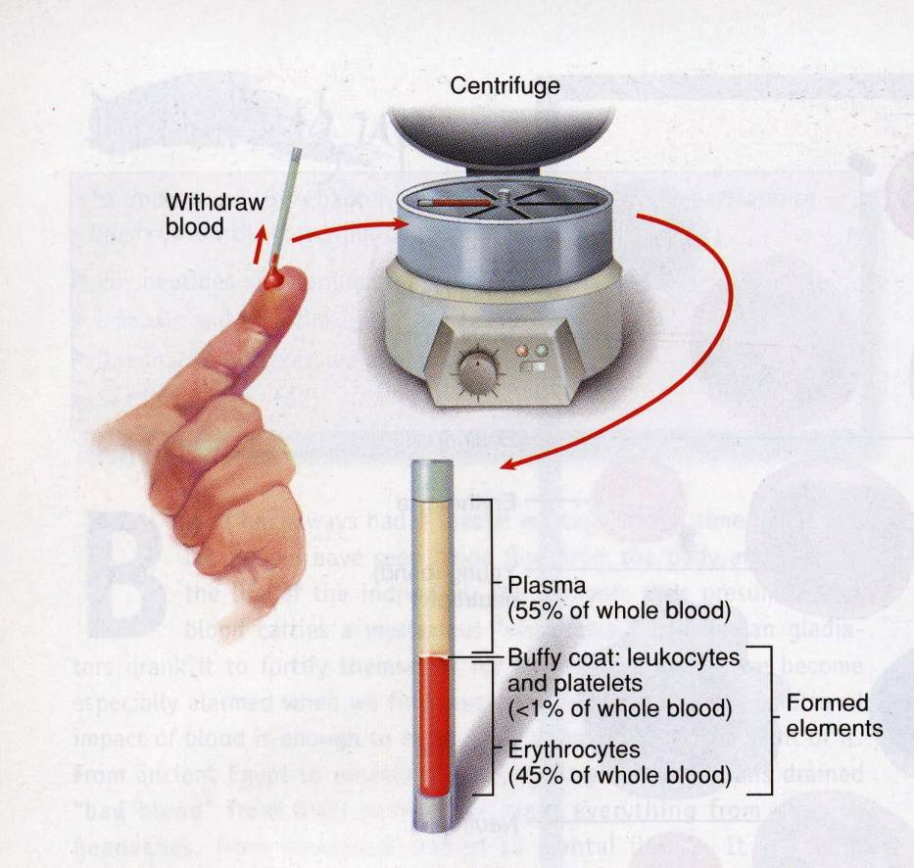
Place the tubes in to the
rotor (closed end at periphery).
Close inner lid tightly, then close the outer lid.
Centrifuge for (5 minutes)
Open the lid after the roter
was completely stopped.

Slide 10
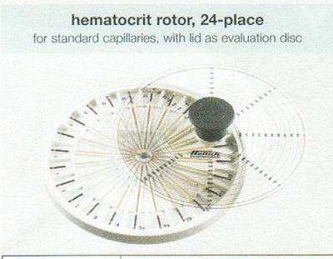
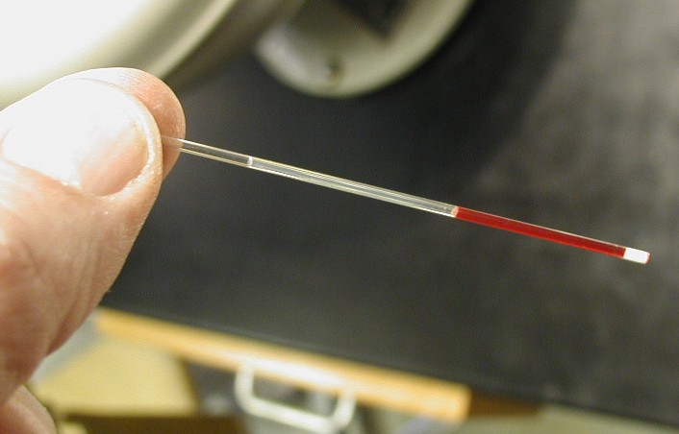

Slide 11
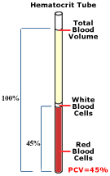
When a tube of blood is centrifuged, the red cell will be packed into the bottom of the tube.
The proportion of red cells to the total blood volume can be visually measured.

Slide 13
Read the value with Hct reader or ruler

Slide 14
How to read a hematocrit
Place the bottom of the tube along the red line below the scale.
Be sure that the place where the white hematocrit sealer meets the RBC’s is on the line at the bottom of the scale itself.
Move the tube along those lines until the top of the plasma intersects the top line of the scale.
The value of the hematocrit is read on the line where the RBC’s meet the plasma.

Slide 15
3
about 18%
4

Slide 16
Normal range
For male: 47 ± 7 % (40-54%)
For female: 42 ± 5 % (37-47%)
PCV of healthy children varied from 23 to 48%. The mean PCV for the whole group was 35.90%, but the children of the urban elite had a mean PCV of 36.4% while rural children had a mean PCV of 34.5%. There was a general rise of PCV with age.

Slide 17
Why is PCV lower in females?
The sex difference in mean venous hemoglobin levels and red cell mass is generally considered to be caused by a direct stimulatory effect of androgen in men in the bone marrow in association with erythropoietin, a stimulatory effect of androgen on erythropoietin production in the kidney.

Slide 18
Clinical Problems
Decreased levels PCV
acute blood loss
anemia
organ failure & malignancies
cirrhosis of the liver
protein malnutrition
deficiency of vitamins
pregnancy
the influence of some drugs.

Slide 19
Increased levels pcv
dehydration / hypovolemia
severe diarrhea
polycythemia vera
Fall in blood plasma.
Administering of testosterone supplement therapy.
In cases of dengue fever .
Chronic obstructive pulmonary disease.
Capillary leak syndrome.

Slide 20
Accuracy of test results
A number of factors can affect the outcome of a hematocrit test and yield inaccurate or misleading results, including:
Living at a high altitude
Pregnancy
Significant recent blood loss
Recent blood transfusion
Severe dehydration

Slide 21
What is PCV used for?
The test is done to diagnose polycythemia, dehydration or anemia in certain patients.
It is generally a part of the full blood count test.
That is used to estimate the need for certain blood transfusions and monitor the response to treatment.

Slide 22
What happen if PCV is low?
A decreased PCV generally means RBC loss from any variety of reasons like cell destruction, blood loss, and failure of bone marrow production.
An increased PCV generally means dehydration or an abnormal increase in red blood cell production.

Slide 23
Headaches may occur because low levels of hemoglobin in red blood cells mean that not enough oxygen reaches the brain.
As a result, blood vessels in the brain may swell, causing pressure and headaches.

